Slide 1
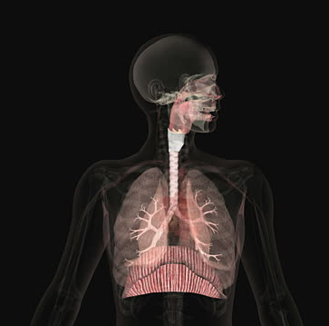
Respiratory system
Prepared by :- Jihad Bakhtyar

Slide 2
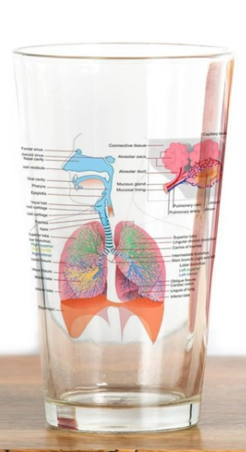
Respiratory system
The human respiratory system is a series of organs responsible for taking in oxygen and taking out carbon dioxide.

Slide 3
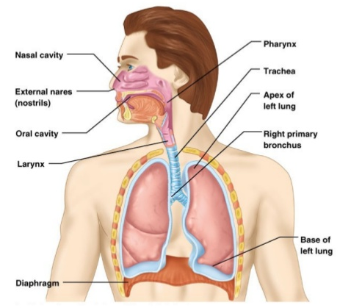
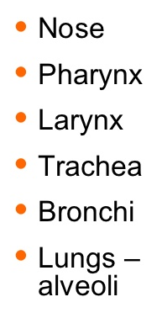
Organ’s of Respiratory System

Slide 4
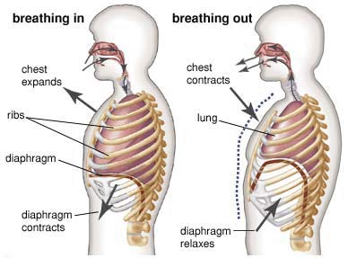
Types of Respiration
1- External Respiration

Slide 5
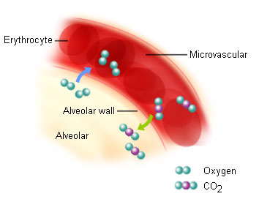
2- Internal Respiration

Slide 6


