Slide 1
Teaching method
Preapared by :halim hamza
Department :biology

Slide 2
What is the teaching method
A teaching method comprises the principles and methods used for instruction to be implemented by teachers to achieve the desired learning or memorization by students. These strategies are determined partly on subject matter to be taught and partly by the nature of the learner. For a particular teaching method to be appropriate and efficient it has to be in relation with the characteristic of the learner and the type of learning it is supposed to bring about.

Slide 3

Clear expectations
  During first meeting clarify what is expected of students
  Encourage students to verbalize their goals for the course
  Make assignments clear with criteria for grading
  Be clear about examinations – timing, number, % of final grade

Slide 4
Classroom Climate
Check out the physical environment
  Temperature
  Lighting
  Seating
  Equipment

Slide 5
Build in break time, be clear about timing
Start and end on time
Make the rules of the class clear
On the first day, greet learners with enthusiasm
Try to learn about each student
Learn their names and address them by name as soon as possible
The climate should be one of respect for each individual

Slide 6
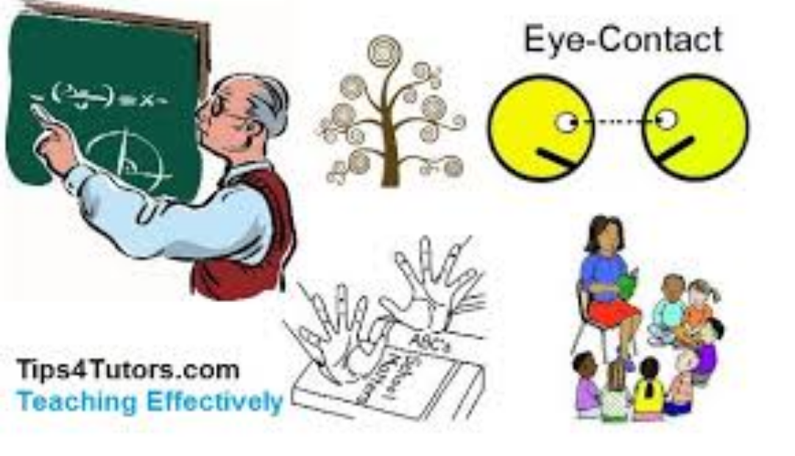
Lecture
Viewed by students as a complete learning experience; think lecturer presents all they need to know.

Slide 7
Enthusiasm is key element
Understand the content
Use notes but do not read your lecture
Speak clearly and loudly enough to be heard in the back of the room
Make eye contact
Use creative movement
Create a change of pace
Distribute a skeletal outline only if it helps the learner identify key points

Slide 8
Types of Lectures
Formal
Expository
Provocative

Slide 9
Types of Lectures
Formal lecture
  In a formal setting the lecturer delivers a well-organized, tightly constructed, highly polished presentation
  Preparation is time consuming
  Ignores the interactive dimension of teaching
  Sometimes fails to motivate students

Slide 10
Types of Lectures
Variation on Formal Lecture
  Lecture/Recitation
    During a formal lecture, the lecturer stops and asks students to respond to a particular point or idea by reading or presenting materials he/she had prepared for class.

Slide 11
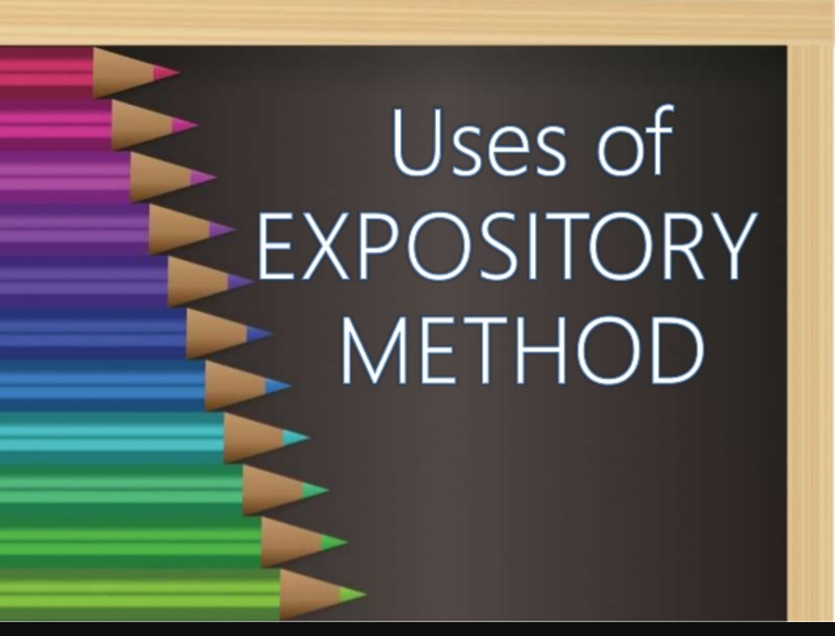
Types of Lectures
Expository lecture
  Less elaborate than the formal lecture
  Faculty does most of the talking, questions from students are periodically allowed

Slide 12
Types of Lectures
Provocative
  Instructor does most of the talking but challenges students knowledge and values with questions
    Lecture-practice
    Lecture-discussion
    Lecture-lab

Slide 13
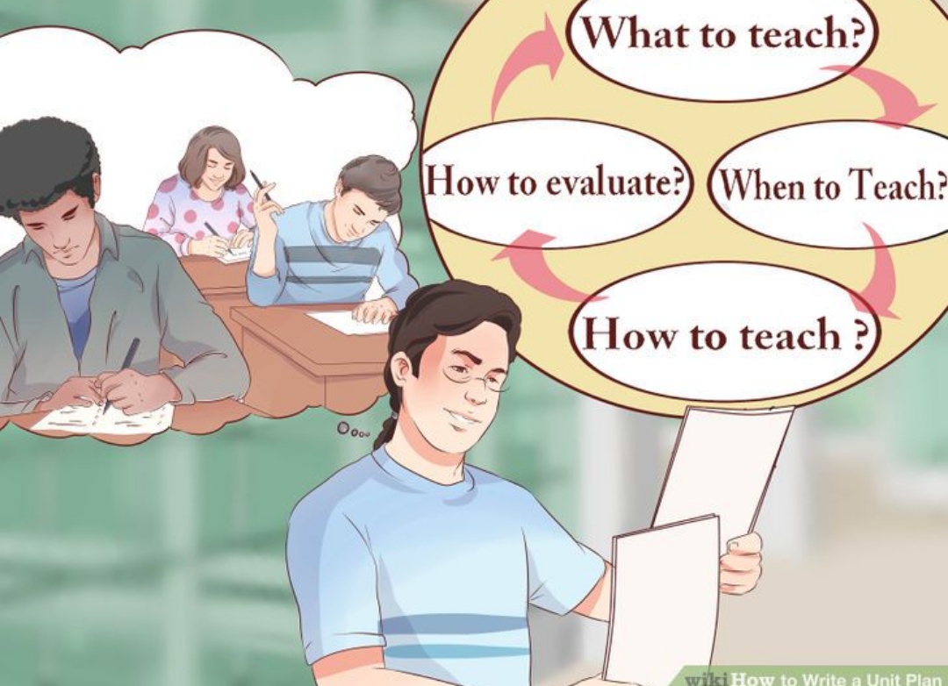
Planning a Lecture
Begin well in advance of the presentation date
Organize your thoughts and information
Write down what you want to say
Practice saying it
Time yourself – realize that it will take more time to present in front of a class then at home

Slide 14
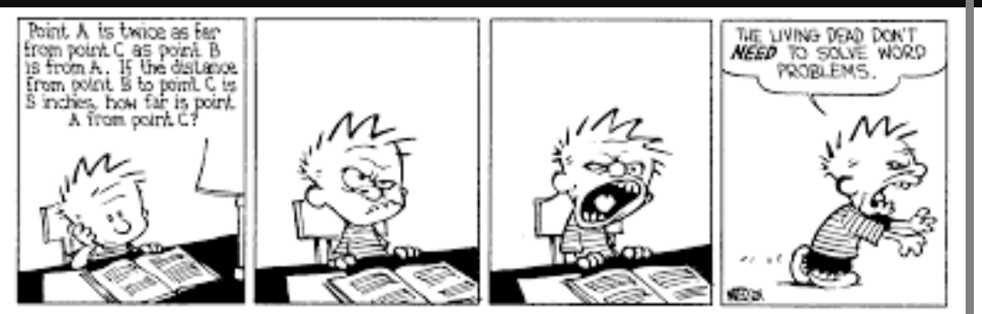
Lecture Problems
Student boredom
Institutional blocks
  Class timing
  Number of students
  Size of the room
  Seating
Knowledge retention

Slide 15

Evaluation
Ask a few specific questions
Anonymous comments

Slide 16
Thank you

