Slide 1
UNIT 2 – LESSON 1
WHY DO WE YAWN?

Slide 2
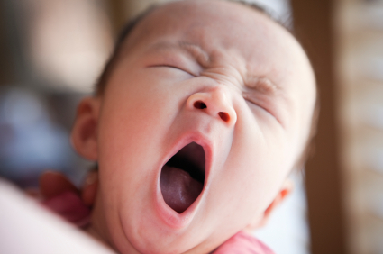
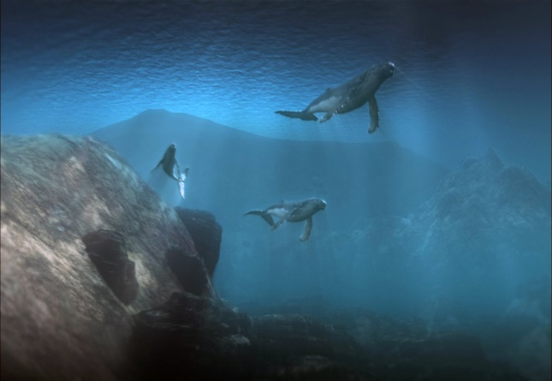
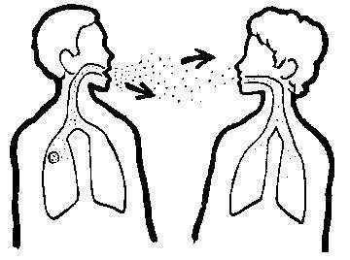
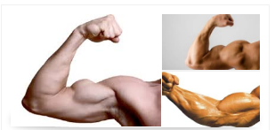
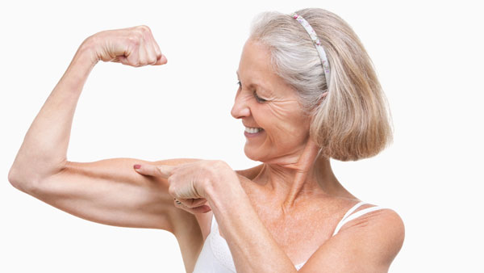
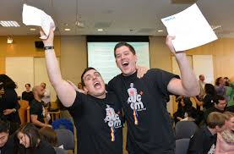
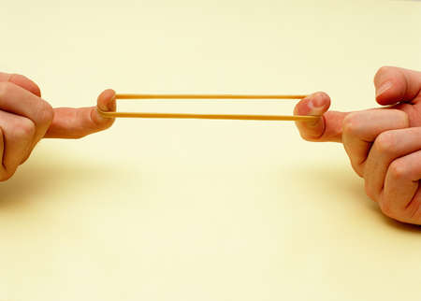
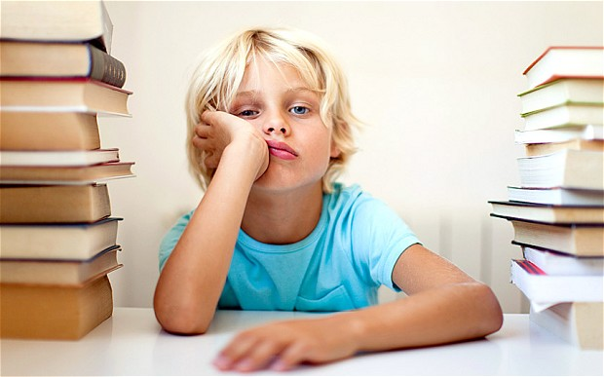
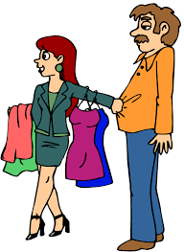
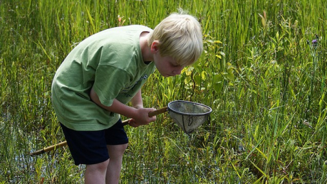
yawn
deep
contagious
Muscles /ˈmʌsəl/
excited
stretch
bored
İnterested

Slide 3
Y
d
C
M
E
S
b
i

Slide 4
Y
d
C
M
E
S
b
i

Slide 5
Y
d
C
M
E
S
b
i

Slide 6
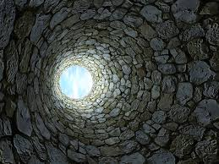
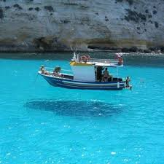
?

Slide 7
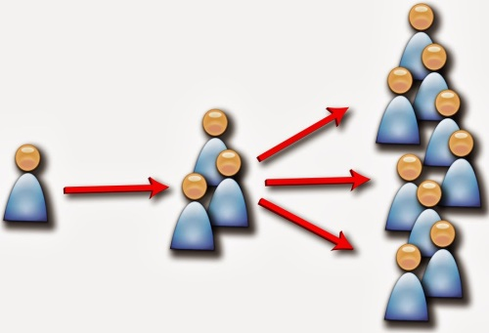
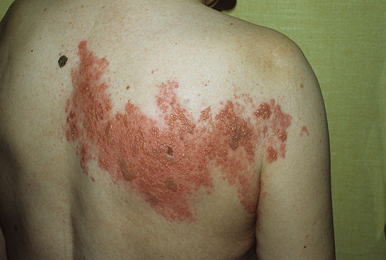
?

Slide 8
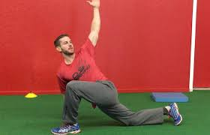
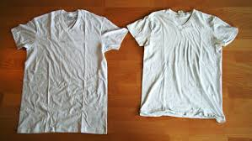
?

Slide 9
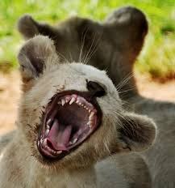
?

Slide 10
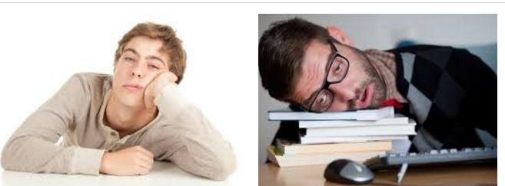
?

Slide 11
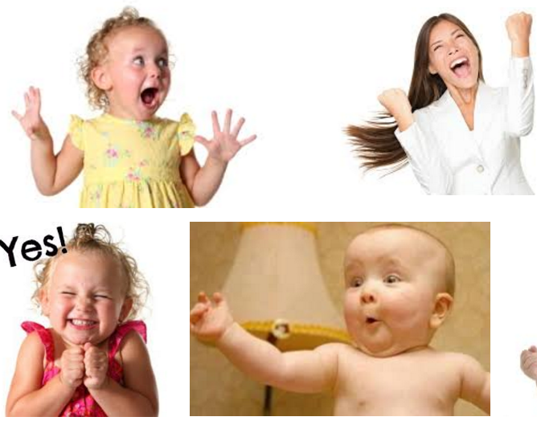
?

Slide 12
BORED ​ /bɔrd, boʊrd/ adjective:
DEFINITION: ​feeling tired and unhappy because something is not interesting or because you have nothing to do:
He was getting bored doing the same thing every day.
I am bored.
RELATED WORDS /EXPRESSIONS: …
get bored, …
look bored, …
become bored, …
easily bored,

Slide 13
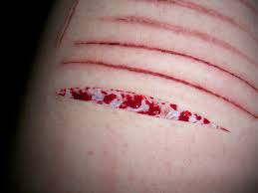
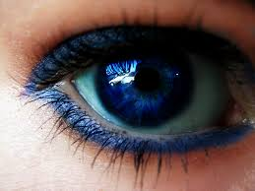
DEEP adjective: pronunciation: /diːp/
Definition: having a long distance from the top to the bottom
The lake is very deep.
RELATED WORDS /EXPRESSIONS: …
deep water ,
a deep hole,
a deep cut on her arm,
deep blue eyes

Slide 14
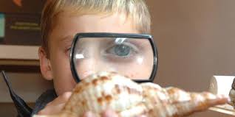
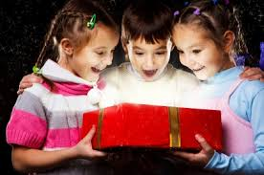
EXCITED /ɪkˈsaɪ.tɪd/ adjective : feeling very happy, especially about something good that has happened or is going to happen
An excited crowd waited for the singer to arrive.
He’s excited about his new job.
Doctors are very excited by the discovery.
I am excited
RELATED WORDS /EXPRESSIONS: …
children, project, having a new things, marriage, new job...
excited people, ...
excited children, ...
excited about, ...
get excited ...
really/very,

Slide 15
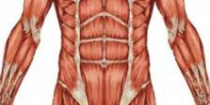
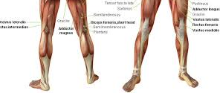
MUSCLE: /ˈmʌsəl/ noun: one of many pieces of tissue in the body that are connected to bones and which produce movement by becoming longer or shorter
Regular exercise helps to strengthen your muscles.
RELATED WORDS /EXPRESSIONS: …
sport, body, strong, weak,
stomach muscles
strengthen your muscles
big arm muscles
leg muscles

Slide 16
http://www.busyteacherscafe.com/printables/reading.html

Slide 17
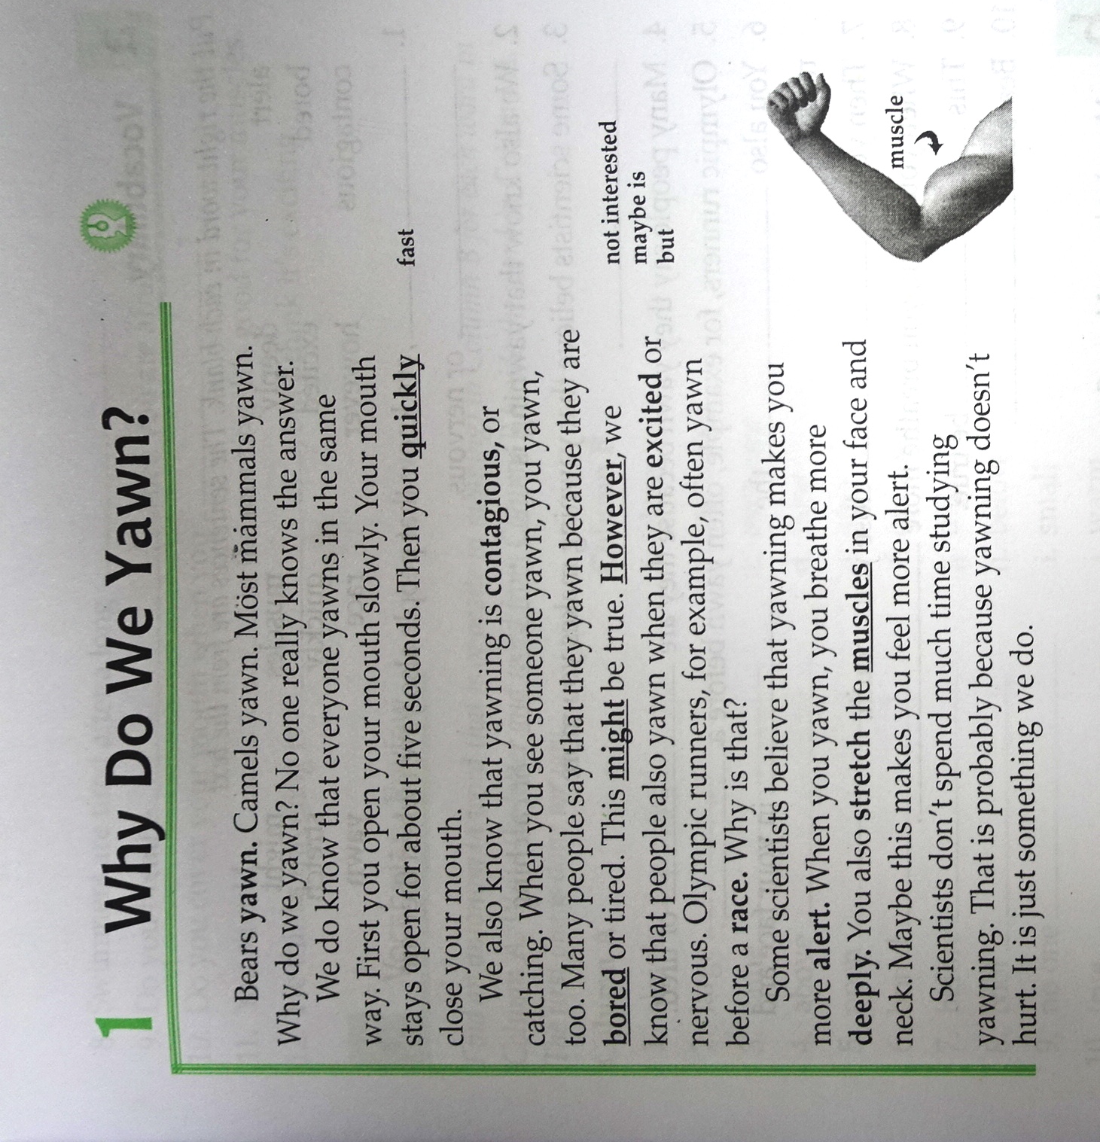
Many animals yawn, such as camels, bears, and most mammals.
Everybody yawns the same way. First , we open our mouth slowly and stays open for about five seconds.
Yawning is contagious. When people are bored, tired, excited or nervous, they yawn.
Yawning makes us alert. We breath more deeply.

Slide 18
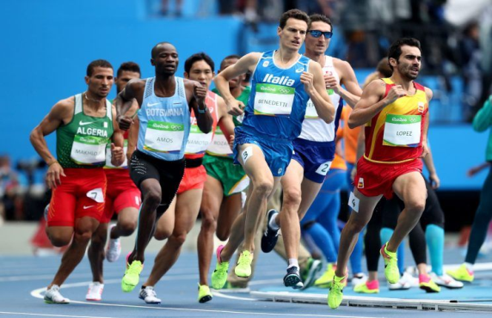
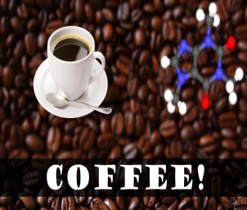
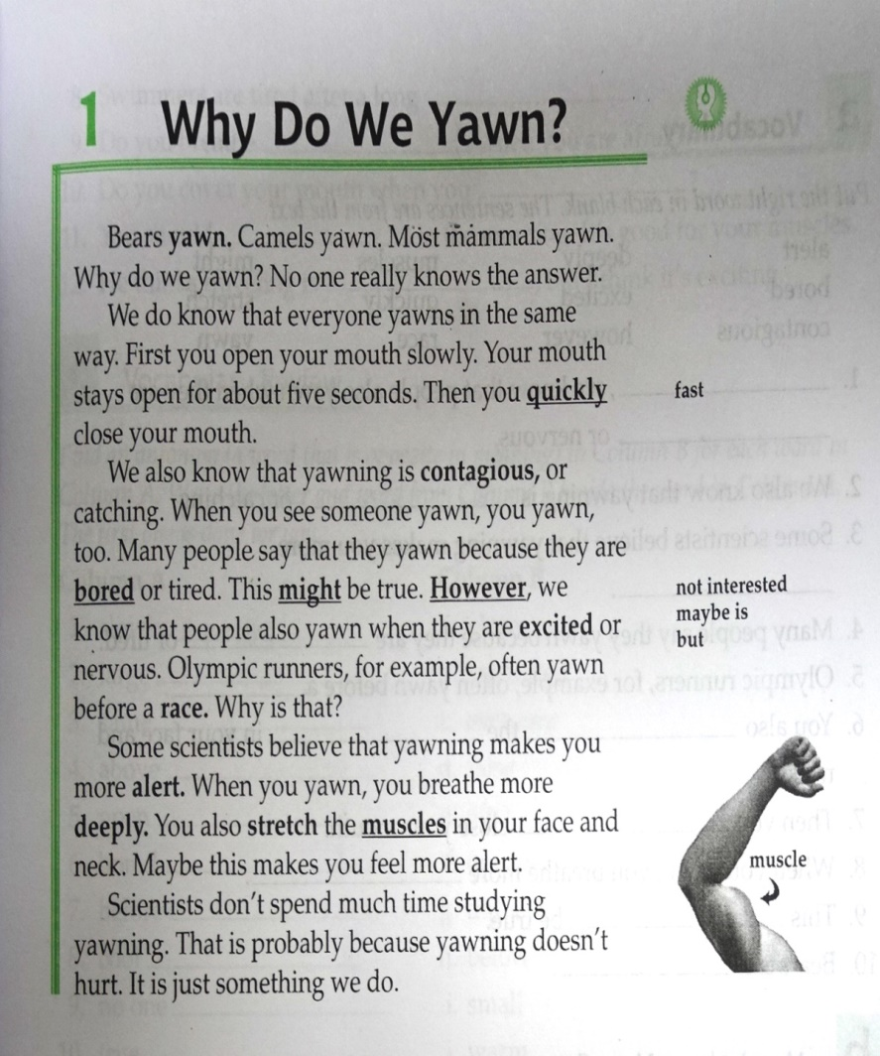
YAWNING STEPS
Graphic Organizer Paragraph 2
First, we open our mouth slowly.
Second, our mouth stays open for about five seconds.
Then, we quickly close our mouth.

Slide 19
Why do we yawn?
Who yawns?
Bears and camels yawn.
Most mammals yawn.
When we are tired and bored, we yawn.
When we are excited or nervous, we yawn.
What happens when we yawn?
Yawning makes us alert.
We stretch the muscles in our face and neck.
When we yawn, we breath more deeply.

Slide 20
HOMEWORK
1. Listen to Unit 2, Lesson 1 20 times, record your voice into your cell phone

Slide 21

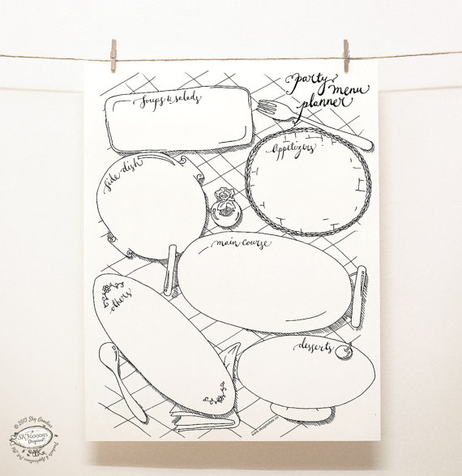
ORGANIZER

