Slide 1

FACTS and FIGURES
UNIT 5 – LESSON 1

Slide 2

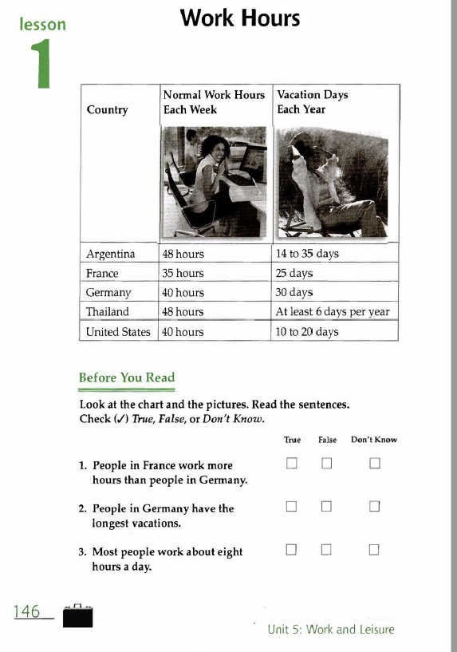
Slide Title
Make Effective Presentations
Using Awesome Backgrounds
Engage your Audience
Capture Audience Attention

Slide 3
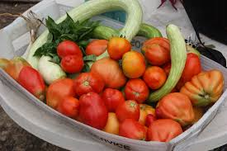
enough
as much as is necessary; in the amount or to the degree needed:
Do we have enough tomato for a salad?
He had enough time to make his project.

Slide 4
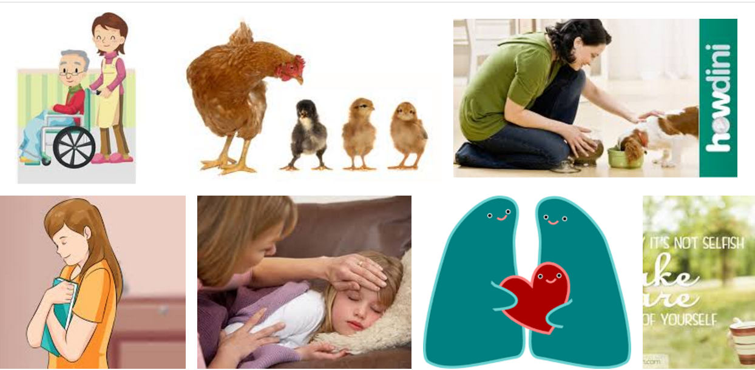
take care of someone/something
to be responsible for someone or something:
I have to take care of my little sister this afternoon.

Slide 5

Vary v ˈveər·i, ˈvær·i/
​BE DIFFERENT; to change in some way, or to cause similar things to differ:
Car prices vary greatly across Europe.
Roses vary widely in size and shape.

Slide 6

employee /ɪmˈplɔɪiː/
someone who is paid to work for a person or company
How many employees does the firm have?
employer /ɪmˈplɔɪ·ər/

Slide 7
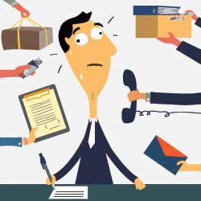
Duty /ˈdʒuː.ti/ US ​ /ˈduː.t̬i/
something that you have to do because it is part of your job,
It is my duty to prepare the lesson

Slide 8
Average /ˈæv·rɪdʒ, -ər·ɪdʒ/
Normal, regular,

Slide 9
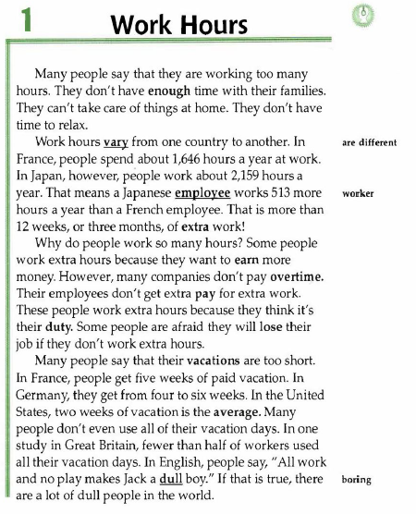
Slide Title
Enough:
Take care of:
Vary:
However:
Employee:
Extra: more
Overtime: extra hours
Duty:
Afraid:
Vacation
average
Dull:

Slide 10
KEY WORDS
KEY WORDS – Writing and Speaking Activity
Prg1: People – enough – working – families – take care of- things – relax
Prg 3: ? extra hours – earn more money – some companies– pay overtime – extra pay for extra work – duty- extra hours – lose job
Prg 3:

Slide 11
WHAT DO YOU REMEMBER

Slide 12
Assignment
Analyze the text

