Slide 1
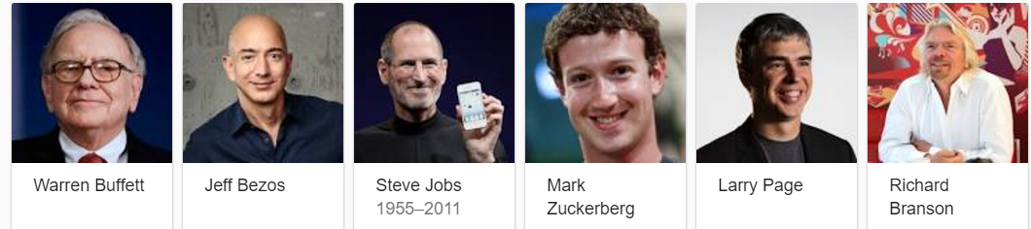
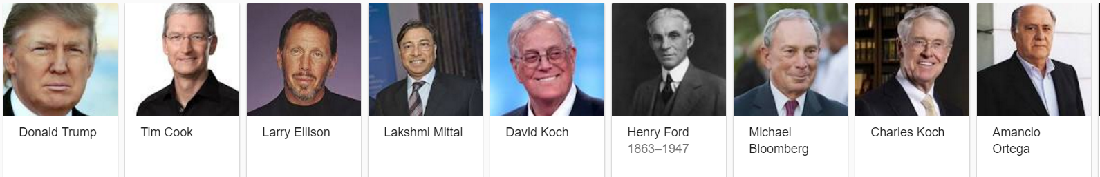
Select Reading – Pre-int
Chapter 6
GENERATION Z: HOW TO BE a SUCCESSFUL BUSINESSPERSON
Notes:
a person born or brought up during the age of digital technology and so familiar with computers and the Internet from an early age.

Slide 2
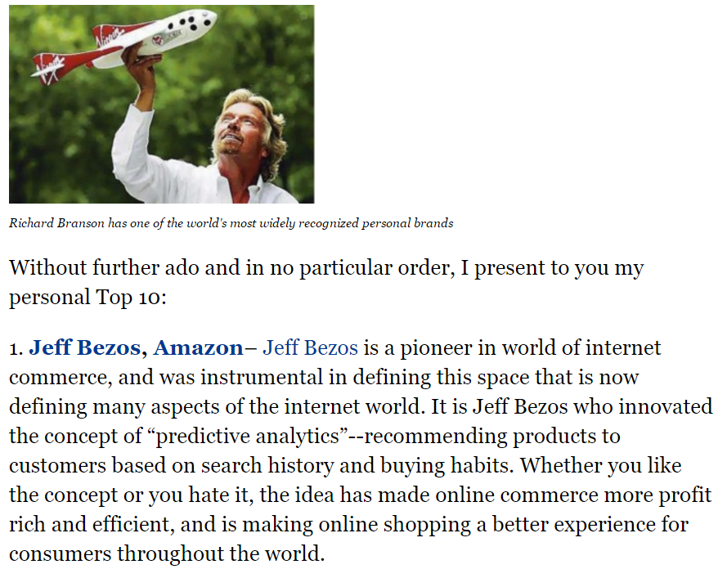
a SUCCESSFUL BUSINESSPERSON

Slide 3
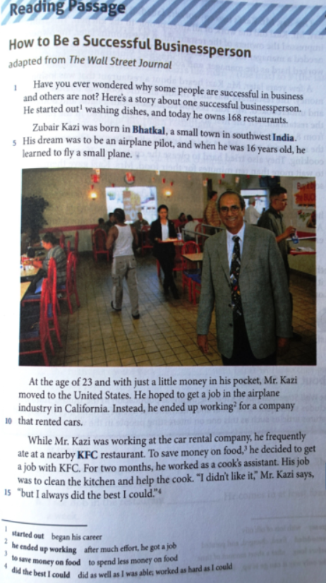
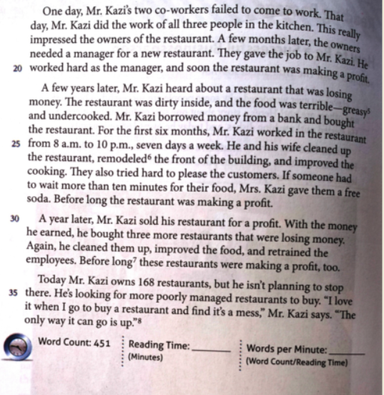

Slide 4
Vocabulary
fail: be wrong with; to not be able to do what you are trying to achieve or are expected to do:
She applied to Harvard University but failed to get accepted.
frequently adv.: often, regularly, commonly
I don’t see my brother frequently.
impressed adj.: affected, influenced
One of our friends impressed us with his wonderful projects.
improve v.: increase, develop
I wanted to improve my English, so I got a job in London.
Profit n. : income, benefit, advantage
The shop’s daily profit is usually around $500.
wonder: to think about something that you are not sure about and try to guess what is true, what will happen etc
Sometimes he wondered why his father hated him.

Slide 5
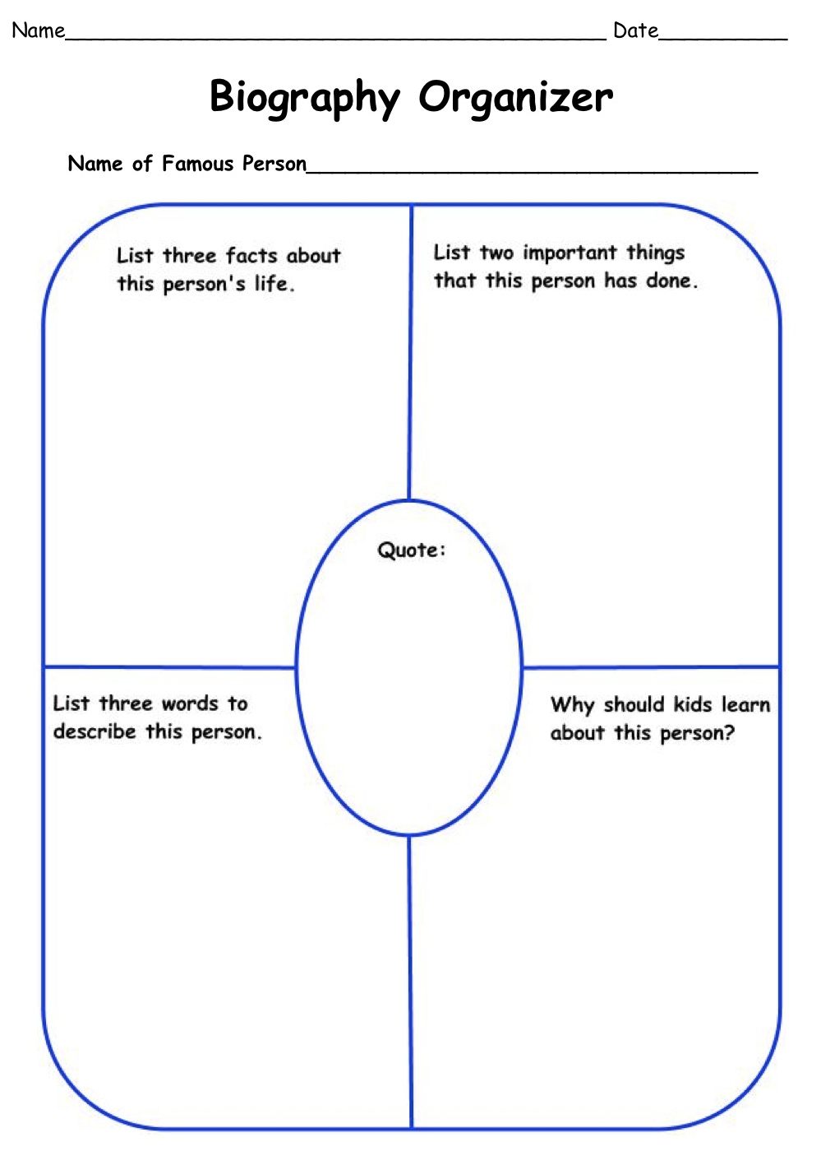
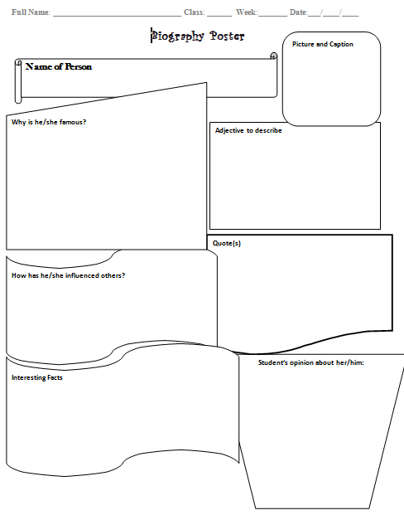
BIOGRAPHY

Slide 6
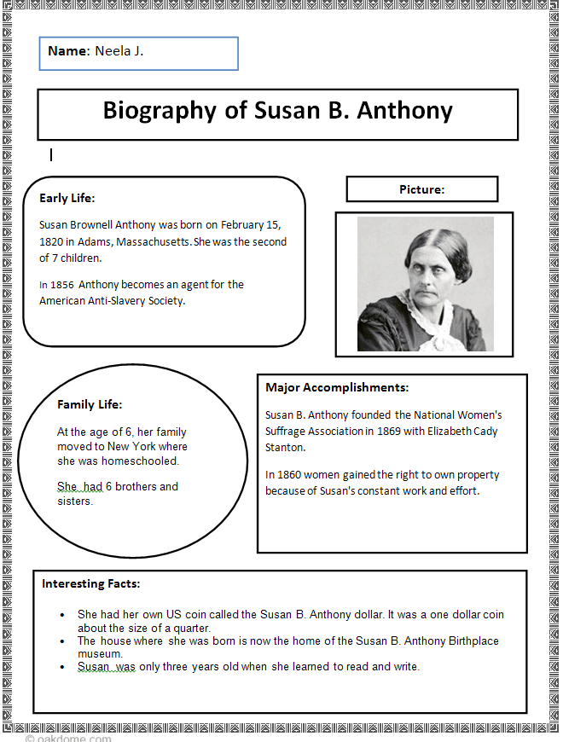

Slide 7
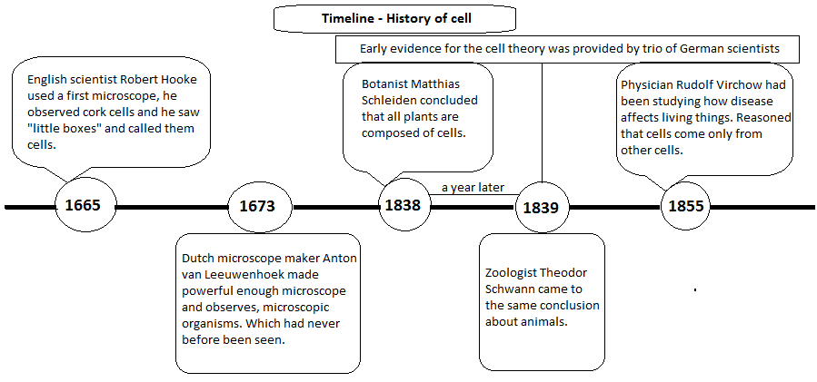
TIME LINE ORGANIZER

Slide 8
Time Line Organizer
_________________
_________________
_________________
_________________
_________________
_________________
_________________
_________________
_________________
_________________
_________________
_________________
_________________
_________________
_________________
_________________
_________________
_________________
_________________
_________________
_________________
_________________
_________________
_________________
_________________
_________________
_________________
_________________
_________________
_________________
_________________
_________________
_________________
_________________
_________________
_________________
_________________
_________________
_________________
_________________
Name:
Date:
Class:
My Opinion: _____________________________________________
_________________________________________________________________________________
__________________________________________________________________________ __________________________________________________________________________

Slide 9
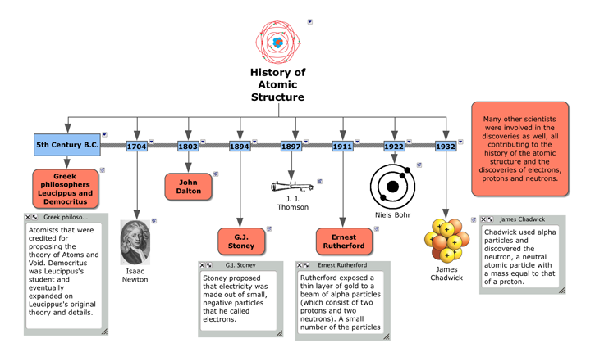
TIME LINE ORGANIZER

Slide 10
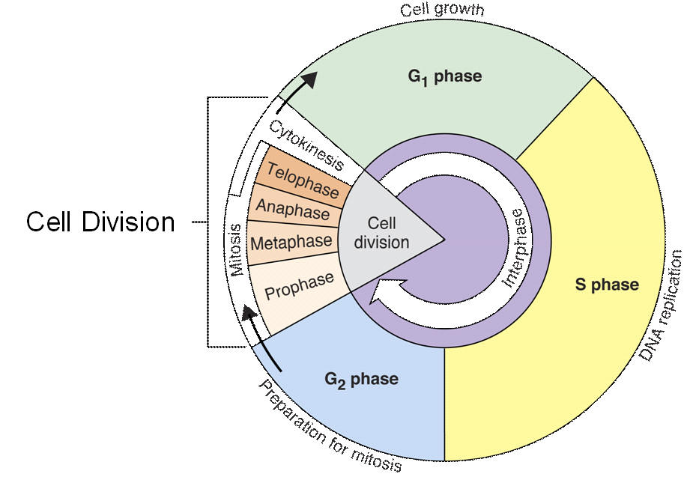
TIME LINE ORGANIZER - CELL

Slide 11
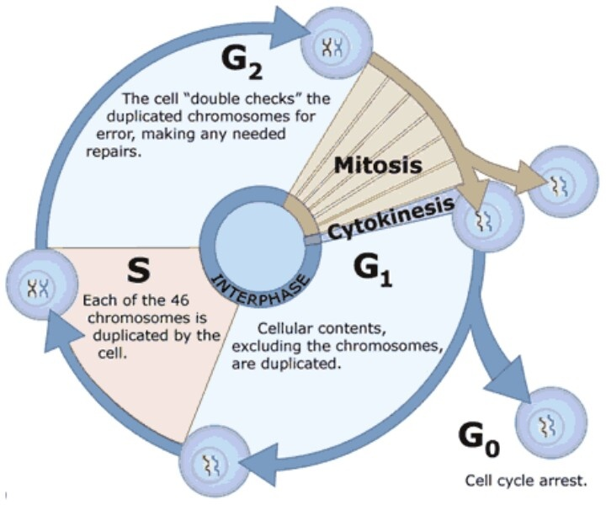
TIME LINE ORGANIZER - CELL

Slide 12
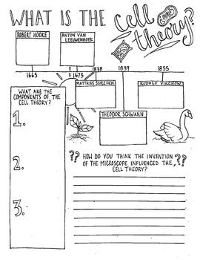
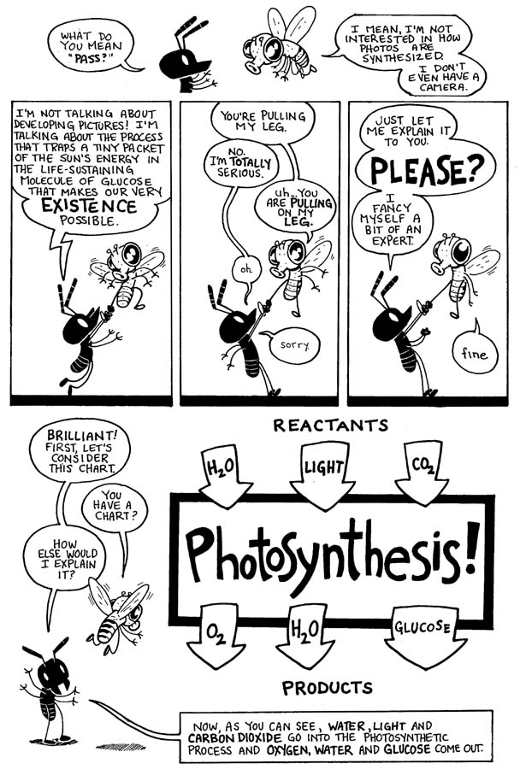
TIME LINE ORGANIZER

Slide 13
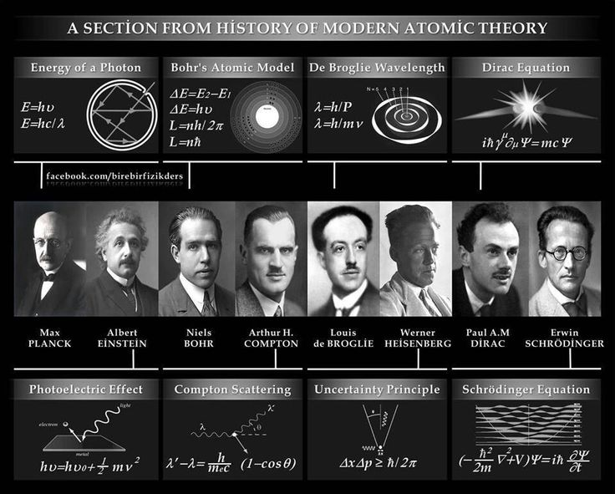
TIME LINE ORGANIZER

Slide 14
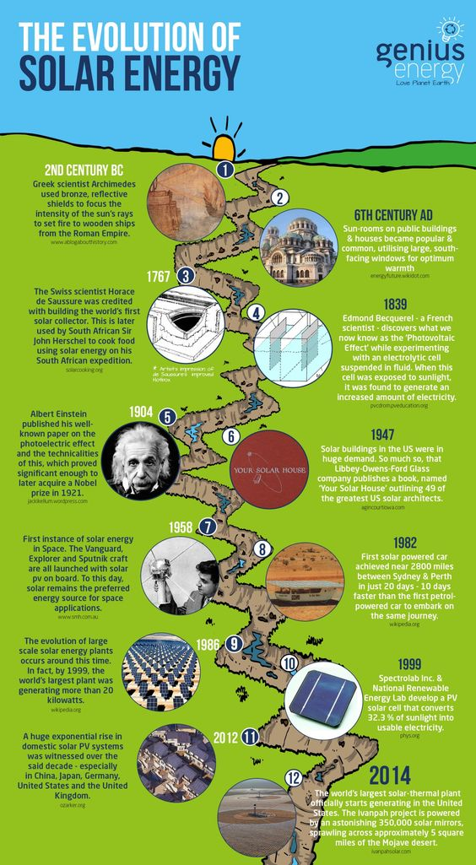
TIME LINE ORGANIZER

Slide 15
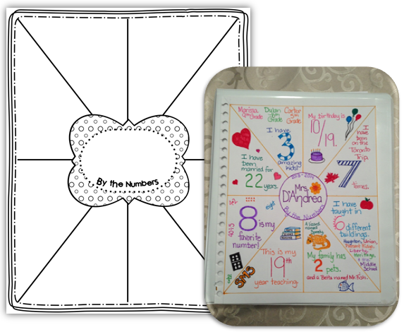
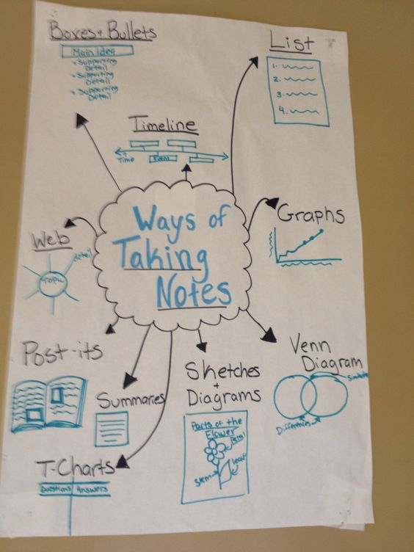

Slide 16
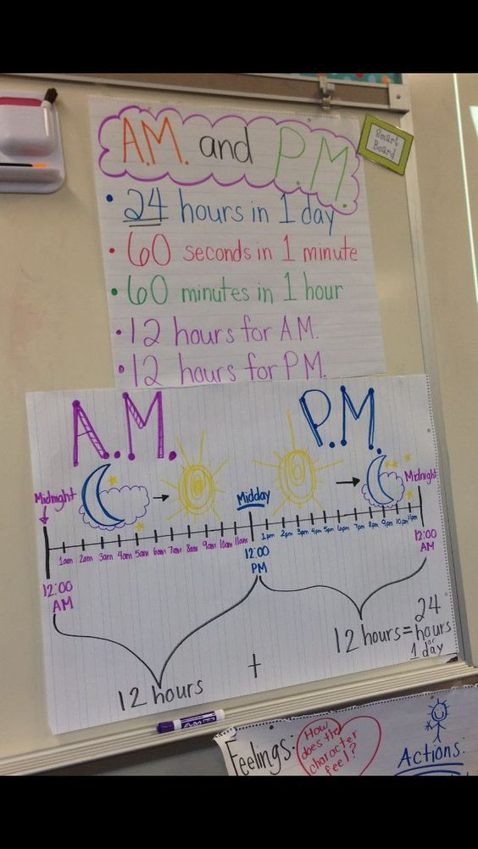
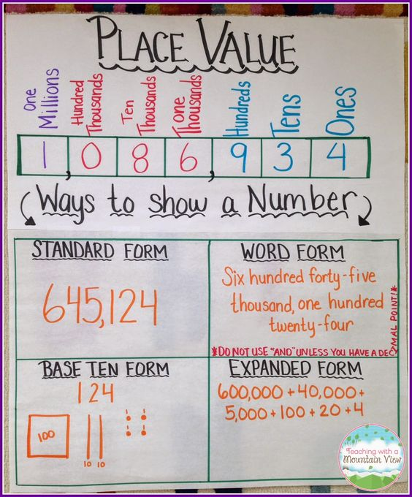

Slide 17
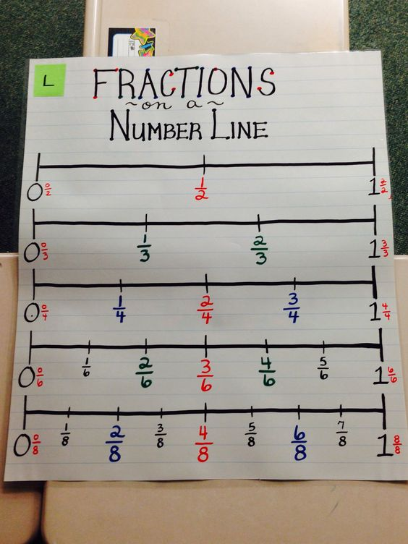
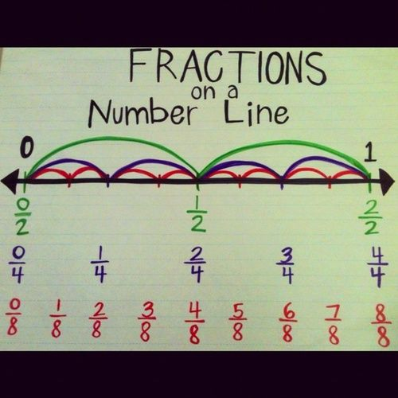

Slide 18
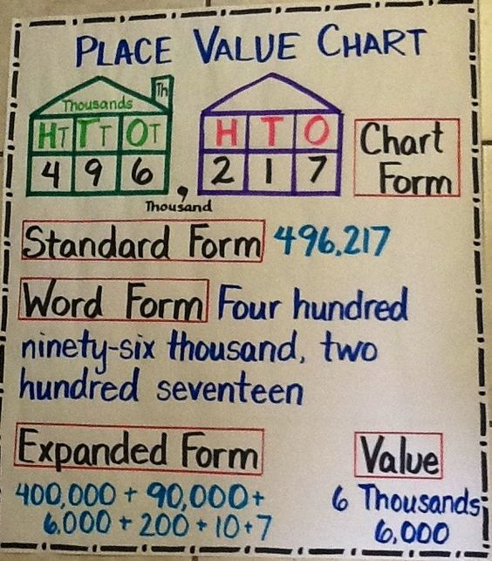

Slide 19
ASSIGNMENT POSTER
How to be a successful science/biology/maths teacher
How to be a successful person.

Slide 20
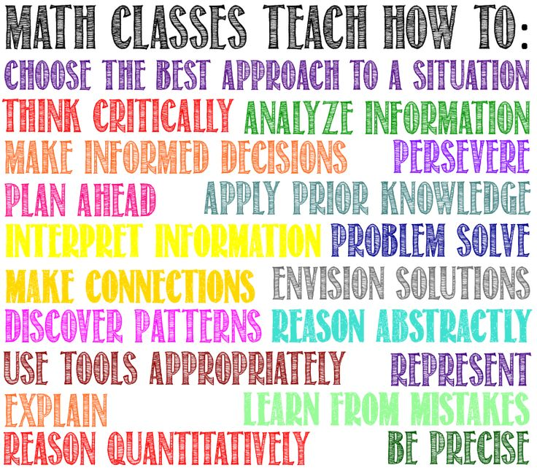

Slide 21
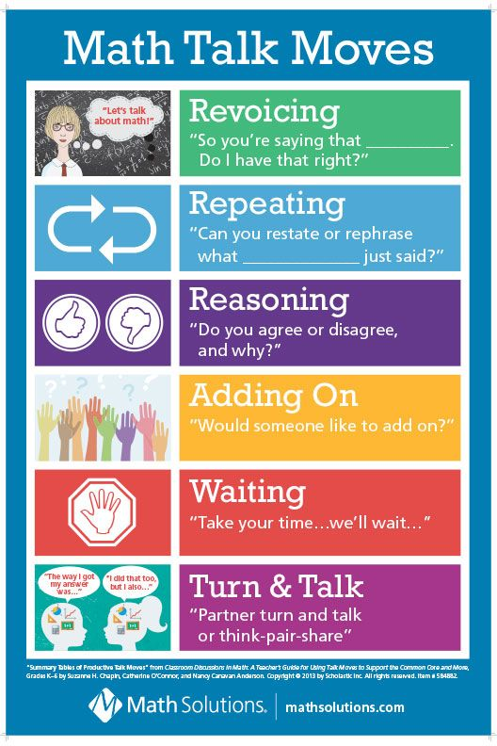
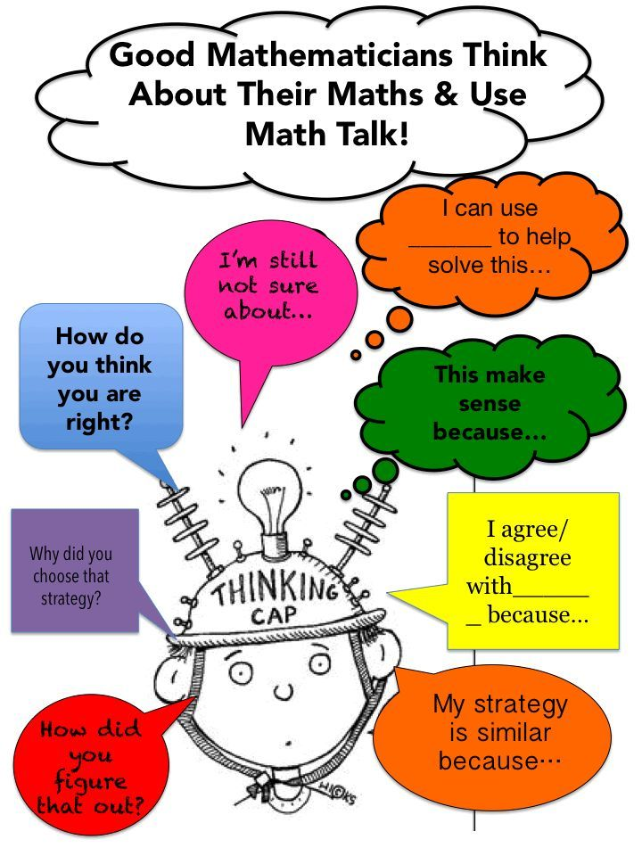
POSTER

Slide 22
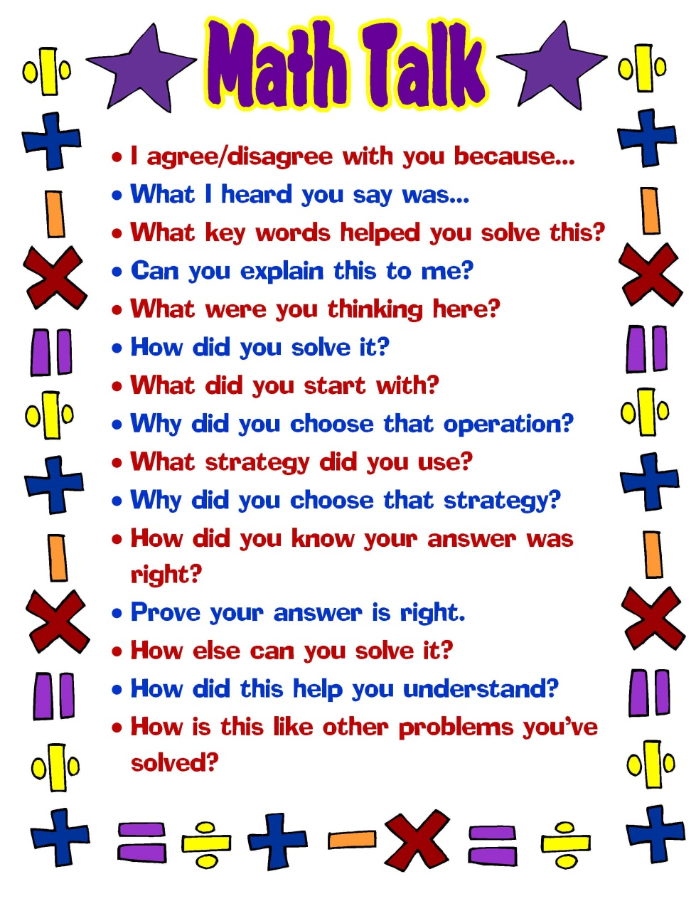
POSTER

Slide 23

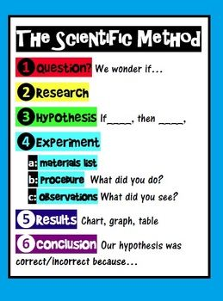

POSTER

Slide 24
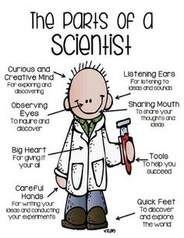
POSTER

Slide 25
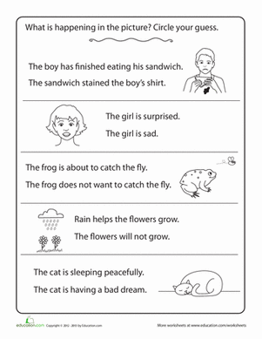
MAKING INFERENCE

Slide 26
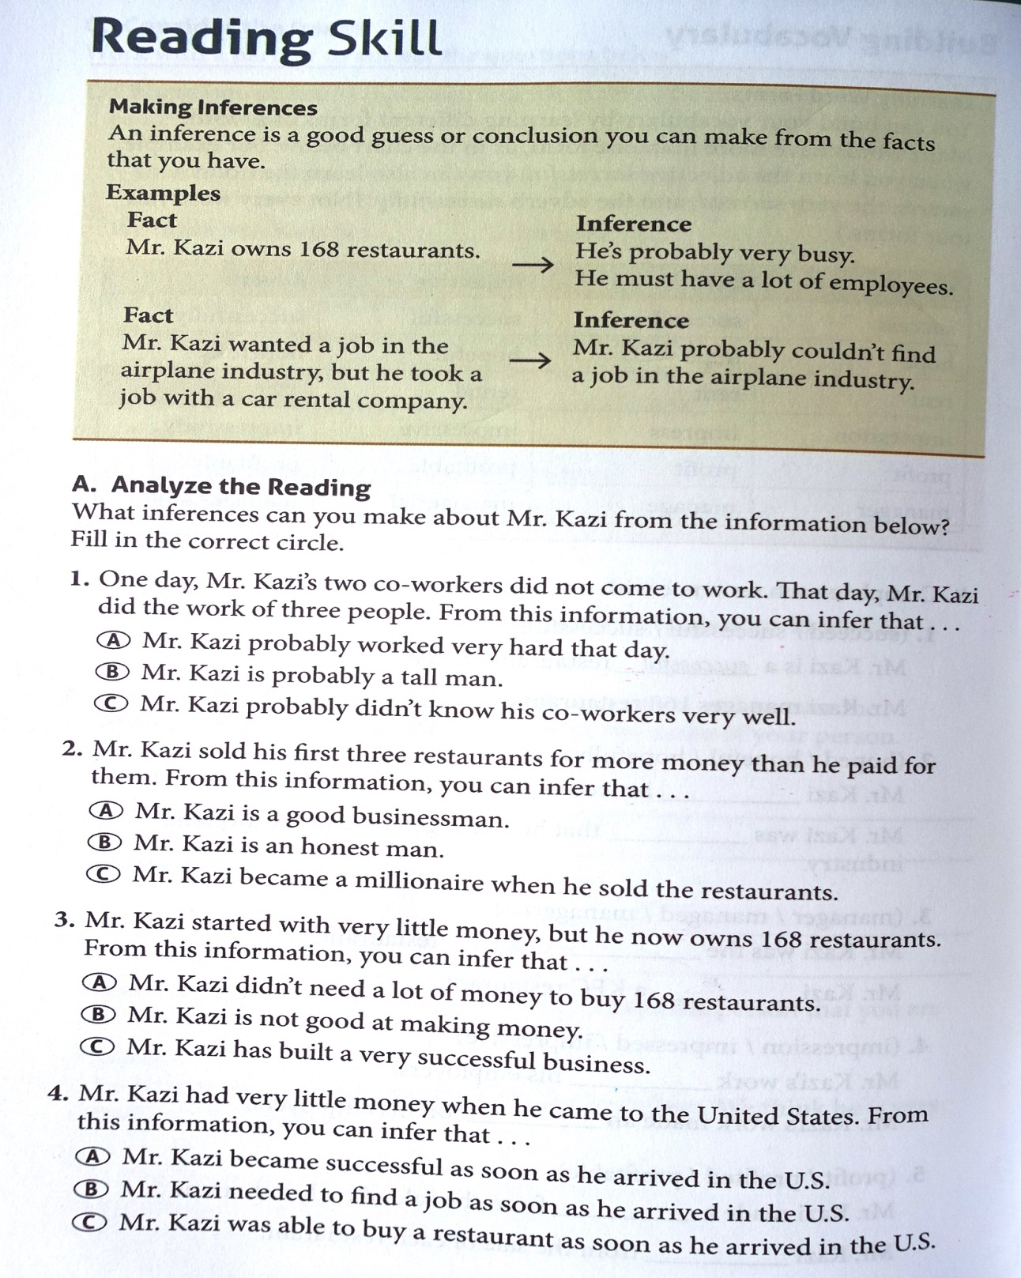
MAKING INFERENCE

Slide 27
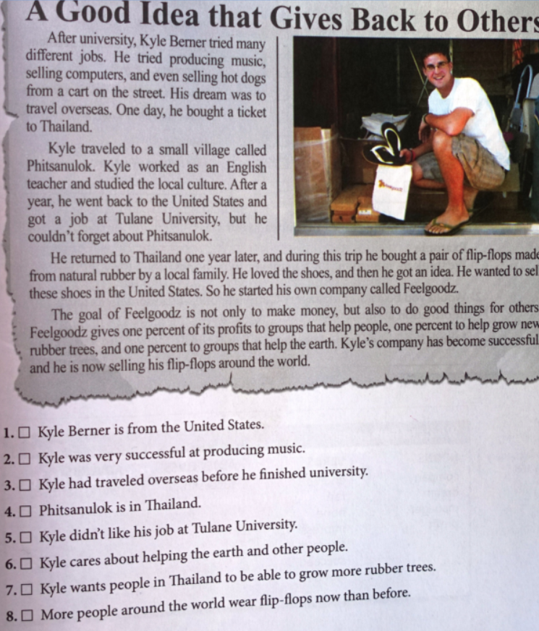
MAKING INFERENCE

Slide 28
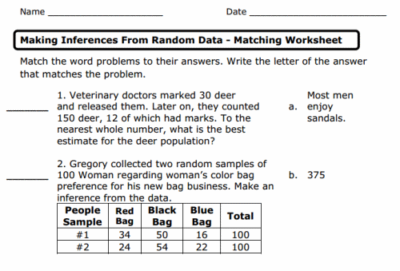
INFERENCE in MATH

Slide 29
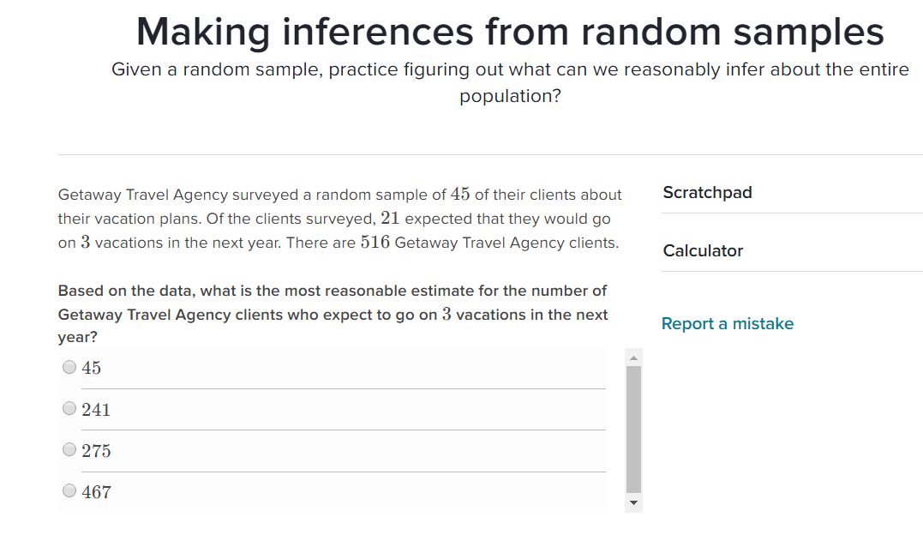
INFERENCE in MATH

Slide 30
TODAY’S LINKS
http://www.ldoceonline.com/
http://dictionary.cambridge.org/us/
https://www.pinterest.com

