Slide 1

MARCH 13, 2012
LESSONS- 17-18-19
UNIT 1: “Life Style ”
Ronaki – Gulan Group
09.00-12.30

Slide 2
Lesson Plan
SONG
Noun endings
01- Writing
-Informal email
-Direct object – indirect object

Slide 3
NOUN ENDINGS
Adjectives. (Let’s learn meanings.)
real
Unwilling /ʌnˈwɪlɪŋ/
Disappointed*
Determined /dɪˈtɜːmɪnd/
Perfect /ˈpɜːfɪkt /
Generous /ˈdʒenərəs/
Satisfying /ˈsætɪsfɪɪŋ/
Luxurious /lʌɡˈʒʊəriəs/
lazy
Notes:
appoint / əˈpɔɪnt / verb [ T ] to officially choose someone for a job resmen atamak, görevlendirmek
He was appointed as company director last year.
determined / dɪˈtɜːmɪnd / adjective wanting to do something very much, and not letting anyone stop you kararlı, azimli
[ + to do sth ] He's determined to win this match.

Slide 4
NOUN ENDINGS – ion, -y, -ity, -ation, -ment, -action, -ness
Adjective noun
a. real
reality
b. Unwilling /ʌnˈwɪlɪŋ/
unwillingness
c. Disappointed*
disappointment
d. Determined /dɪˈtɜːmɪnd/
determination
e. Perfect /ˈpɜːfɪkt /
perfection
f. Generous /ˈdʒenərəs/
generousity
g. Satisfying /ˈsætɪsfɪɪŋ/
satisfaction
h. Luxurious /lʌɡˈʒʊəriəs/
Luxuriousness/luxury
i. Lazy
laziness
Notes:
appoint / əˈpɔɪnt / verb [ T ] to officially choose someone for a job resmen atamak, görevlendirmek
He was appointed as company director last year.
determined / dɪˈtɜːmɪnd / adjective wanting to do something very much, and not letting anyone stop you kararlı, azimli
[ + to do sth ] He's determined to win this match.

Slide 5
NOUN ENDINGS – Practice Voc. Book. Unit 1 Ex 1
The older --- doesn’t seem to understand young people. (generate)
I thought James was rich. In---- he hasn’t got a penny! (real)
When our holiday was cancelled, it was a big ----for us. (disappoint)
I can’t understand your----. You never do any work. (lazy)
The natural----of this part of Scotland is absolutely amazing. (beautiful)
Thank you for your ----during my stay. (generous)
It took me a long time to make the ---- to become a doctor. (decide)
They say that ---has nothing to do with material possessions – it’s just a state of mind. (happy)
When I saw Maria, I got the --- that there was something worrying her. (impress)
Which do you think is more important: earning a lot of money, or job ----? (satisfy)
It takes a lot of --to succeed when everything seems to be against you. (determine)
Notes:
Unit 1, Vocabulary, Exercise 1
Generation
reality
disappointment
laziness
beauty
generosity
decision
happiness
impression
satisfaction
determination

Slide 6
More examples NOUN ENDINGS - NESS
-ness
adj. n.
dark - darkness
loud - loudness
red - redness
ugly - ugliness
dry - dryness
close - closeness
new - newness
kind - kindness
fresh - freshness

Slide 7
WRITING
Please read all the information in the input text and make a note of any points which should be included in the writing task (as in example page 8)

Slide 8
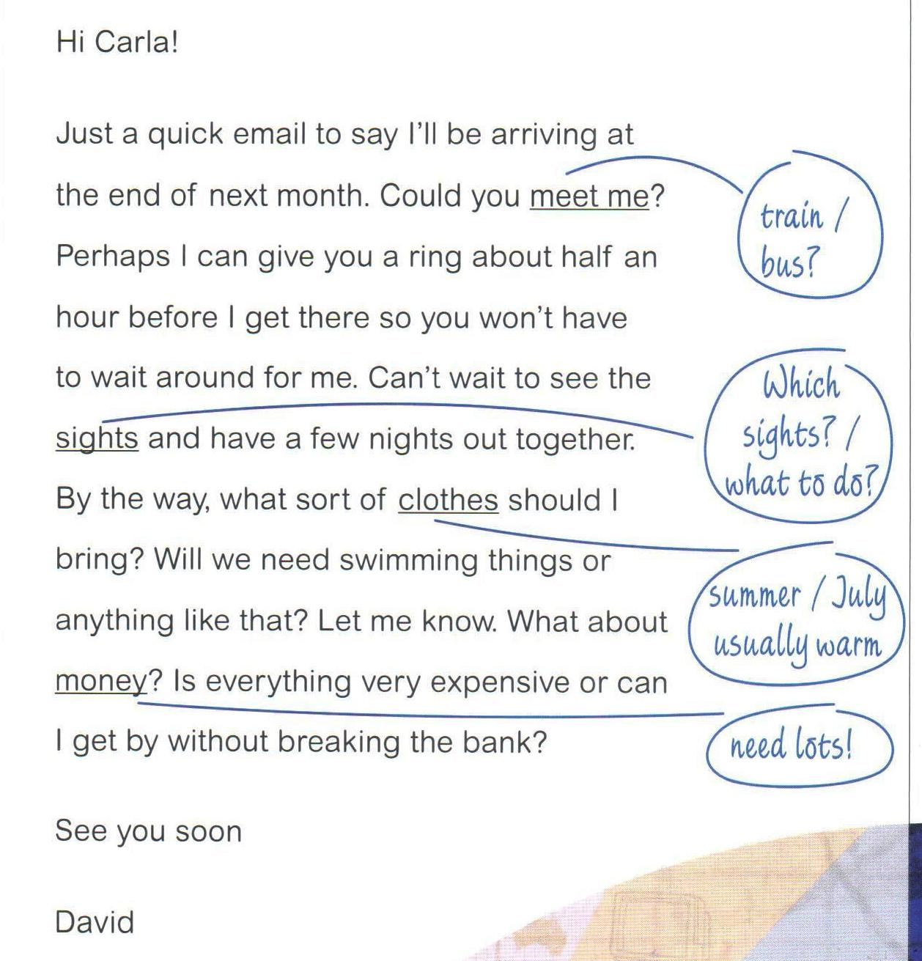

Slide 9
WRITING – 1
(Transactional Email
Why has David sent the email?
................
ANS: to get some information from Carla about his visit next month
b) What would he like Carla to do?
- ...... (like sb to do )
ANS: to meet him when he arrives.
(He’d like Carla to meet him when he arrives)

Slide 10
WRITING – 1
(Transactional Email
c) What is he looking forward to?
................
ANS: seeing the sights and having some nights out with Carla.
d) What does he want to know?
- ......
ANS: what sort of clothes to bring and whether he will need a lot of money?

Slide 11
USEFUL EXPRESSIONS - 2
(Try to find for the given title)
Giving information:
.....
I’ll be arriving;
Can’t wait to see
2. Requesting Information
.....
What sort of clothes should I bring?
Will we need....?
What about money...?
Is everyting expensive?

Slide 12
USEFUL EXPRESSIONS - 2
(Try to find for the given title)
3. Making a suggestion:
Perhaps I can give you a ring about half an hour before I get there ...
4. Making a request:
Could you meet me?

Slide 13
More USEFUL EXPRESSIONS
at the end of newt month
give me a ring
to wait around for me
let me know
to get by without breaking the bank
by the way
Notes:
Get by: to be able to live or deal with a situation with difficulty, usually by having just enough of something you need, such as money
break the bankto cost too much Having a winter vacation in the sun without breaking the bank is a dream come true.

Slide 14
More USEFUL EXPRESSIONS
at the end of newt month
give me a ring
to wait around for me
let me know
to get by without breaking the bank
by the way
Notes:
Get by: to be able to live or deal with a situation with difficulty, usually by having just enough of something you need, such as money
break the bankto cost too much Having a winter vacation in the sun without breaking the bank is a dream come true.

Slide 15
3 – Informal words or expressions means the same as these more formal ones.
a) Telephone you (formal)
Give you a ring (informal)
b) Waste time waiting for me
- Wait around for me
c) I’m very excited at the thought of
- can’t wait to ....
d) Similar kinds of things
- anything like that
e) Give me some information.
- What about .....?

Slide 16
4 – Look at the notes Carla has made. Write one sentence for each of Carla’s notes
Train/bus
......
Eg. Can you tell me if you are coming by train or bus?
b) Which sights?/ What to do?
.....
- Which sights in particular do you want to see, and what exactly do you want to do while you are here?

Slide 17
4 – Look at the notes Carla has made. Write one sentence for each of Carla’s notes
c) summer/July usually warm:
.....
- In the summer, especially in July, it (the weather) is usually warm.
d) need lots!
.....
- It’s quite expensive here so you’ll need lots of money.

Slide 19
5 – Is Carla’s email different from what you expected?
Please use the following headings as a checklist to find errors in Carla’s email.
- In the summer, especially in July, it (the weather) is usually warm.
d) need lots!
.....
- It’s quite expensive here so you’ll need lots of money.

Slide 20
5 – Is Carla’s email different from what you expected?
Please use the following headings as a checklist to find errors in Carla’s email.
Is the reader well informed?
Is the layout organized? (plan, outline)
Are ideas linked clearly?
Is the style appropriate?
Are the opening and closing suitable?
Are grammar and spelling correct?
Is the right vocabulary used for the task/work?
Is the right length and, if written by hand, is the handwriting legible /understandable?

Slide 21
5 – Is Carla’s email different from what you expected?
Is the reader well informed?
....
-There isn’t any reference to the weather or money so the reader isn’t fully informed.
2. Is the layout/plan/outline organized?
....
- Only one paragraph.
3. Are ideas linked clearly?
....
- No obvious linking. Isolated sentences.
Therefore, however, ....

Slide 22
5 – Is Carla’s email different from what you expected?
4. Is the style appropriate?
Some parts are fine but there is an odd mixture of very direct semi-formal style and language.
5. Are the opening and closing suitable?
Dear David instead of Dear my cousin. No opening sentence to refer to the previous email. Best wishes/All the best instead of Yours sincerely.
6. Are grammar and spelling correct?
What day you arriving; you mention to see; doesn’t like me to staying out; swiming; I am exciting; since a long time.

Slide 23
5 – Is Carla’s email different from what you expected?
7. Is the right vocabulary used for the task/work?
Not much expansion of vocabulary; many words are taken from the input material.
8. Is the right length and, if written by hand, is the handwriting legible /understandable?
It’s too short because it doesn’t include all points

Slide 24
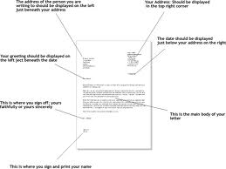
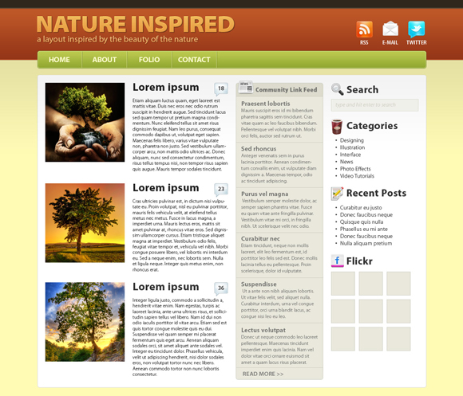
LAYOUT

Slide 25
CAN YOU TELL ME? - 6
Are you coming by train? (Direct Question)
Can you tell me ....?
(Indircet question YN question)
Can you tell me if/whether you are coming by train?

Slide 26
CAN YOU TELL ME? – 7
Rewrite the sentences
What time does your train arrive?
...
Can you tell me what time your train arrive?
b. Which hotel are you staying in?
Can you tell me which hotel you are staying in?
c. Where should I meet you?
Can you tell me where I should meet youP
d.

Slide 27
CAN YOU TELL ME? – 7
Rewrite the sentences
d. Do you need somewhere to stay?
Can you tell me If/whether you need somewhere to stay?
e. What would you like to do?
Can you tell me what you would like to do?
f. Are you interested in opera?
Can you tell me if/whether you are interested in opera?
Gram. Practice: 1

Slide 28
CAN YOU TELL ME? – 7
Rewrite the sentences
g. Would you like to go on a river trip?
Can you tell me if/whether you would like to go on a river trip?
h. When’s your return flight?
Can you tell me when you return flight is?
Are you a vegetarian?
Can you tell me if/whether you are a vegetarian?
Gram. Practice: 1

Slide 29
CAN YOU TELL ME? – 7
Rewrite the sentences
g. Would you like to go on a river trip?
Can you tell me if/whether you would like to go on a river trip?
h. When’s your return flight?
Can you tell me when you return flight is?
Are you a vegetarian?
Can you tell me if/whether you are a vegetarian?
Gram. Practice: 1

Slide 30
EXPRESSIONS WITH WAY- 8
In English the same word can often be used in different expressions and with many meanings such as:
before long
It wasn't long before
long before/after sth
get around (sth)
get around sth
get around to doing sth
get around to sth
get at sb/sth
get away
get away from
get away from it all
get away from sb/sth
get away to
get away with
get away with murder
get away with sth
get away!
get back
get back at sb
get back into
get back to
get back to normal
get back to sb
get back to sleep
get back together
get behind
get behind sb
get behind with
get by
get by on
get ... cheap
get doing sth
get down
get down to doing sth
get down to sth
get hurt/broken/stolen etc
get in
get in on sth
get in on the act
get in to
get in with sb
get into sth
get it
get it on
get it through to ... that
get it together
get it up
get off

Slide 31
EXPRESSIONS WITH WAY- 8
By the way: While I think of it
the way in
be in the way/be in sb's way
not much/enough in the way of sth
was wise in the ways of
little in the way of sth
get in the way of sth
puts obstacles in the way of
in the family way
in the same way/in different ways etc
(in) the right/wrong way
in the ordinary way
in the normal way
in the same way
all the way down/across/through etc (sth)
be laughing all the way to the bank
on the/your/its way to

Slide 32
EXPRESSIONS WITH WAY- 8
find your way
a long way
On our way
out of their way
in the way
get her own way
VOC EX. 3

Slide 33
EXPRESSIONS WITH WAY- 8
YOUR SENTENCE:
find your way
Will you be able to find your way back?
a long way: great distance
Ist. is a long way from Erbil.
My sister lives in Izmir, which is a long way away.
On our way
out of their way
in the way
get her own way

Slide 34
WRITING REPLY - 9
Circle the mistakes

Slide 35
WRITING REPLY - 9
Dear David
What day you are arriving
you mention seeing
doesn’t like me staying out
swimming
I am excited
for a long time
Notes:
men‧tion.: to talk or write about something or someone, usually quickly and without saying very much or giving details:
Was my name mentioned at all?

Slide 36
SONG
25. GOT THE BLUE
http://prepsch.fatih.edu.tr/?dokumanlar,0,0,129,290

Slide 37
LuzümsuzNotlar.
Şu FCE FAST kitabının Writing kısmı inanılmaz yoğun.. Ne bu kardeşim. Kathy (Kitap yazarı) hanım abartmış...
Mektup dertleri adamların bitmiyor. Biz yıllarca asker mektubu yazarak işi bitirdik. Düzen-müzene ne gerek var. Anam bize mektup yazarak yazmasını geliştirdi. Düzen müzen yoktu anlaşıyorduk. Kathy abla bir daha şu kitabı yazarsan sen bize SSK’ya veya savcı Hilmi Bey’e komşumuzun horozu hakkında şikayet nasıl nasıl yazılır onu de.
Şarkı bulana kadar epey uğraştım. İlla modal ile ilgili olsun dedim. Vaz geçtim. Bugünlerde Blues takılmak ilazım. Tam yaşıma uygun mu ne. GARY MOORE – still got the blues. Eleman gitarı konuşturuyor. Yanlık arka arkaya 10 defa dinleyince bulantı başladı. Eskiden böyle değildim. Yaşlandık mi harbiden. Bizim delikanlıyı göndersem ders verir mi acep? Ahiretini kurtaracak bir amel olur mu?
Şu anaokuluna nazar değdi. Kitap meselesi dün saat 9.21’de oturdu. Bizim işler son dakikaya kalıyor.

