Slide 1

MARCH 14, 2012
LESSONS-20-21-22
UNIT 1: “Life Style ”
Ronaki – Gulan Group
09.00-12.30

Slide 2
Lesson Plan
SONG
-Informal email

Slide 3
Quiz.
way out - one way or another - by the way - own way - no way - way of
We'll find the money to go to Istanbul,___.
'Are you going to offer to work over the weekend?'
'___!'
Some of the tribes’ traditional ___ life is under threat.
Mr Teacher is a man, ___, not a monster.
I'm supposed to be going to this meeting at 2.00 and I'm looking for a ___.
She always gets her ___ in the end.

Slide 4
5 – Is Carla’s email different from what you expected?
Please use the following headings as a checklist to find errors in Carla’s email.
Is the reader well informed?
Is the layout organized? (plan, outline)
Are ideas linked clearly?
Is the style appropriate?
Are the opening and closing suitable?
Are grammar and spelling correct?
Is the right vocabulary used for the task/work?
Is the right length and, if written by hand, is the handwriting legible /understandable?

Slide 5
5 – Is Carla’s email different from what you expected?
Is the reader well informed?
....
-There isn’t any reference to the weather or money so the reader isn’t fully informed.
2. Is the layout/plan/outline organized?
....
- Only one paragraph.
3. Are ideas linked clearly?
....
- No obvious linking. Isolated sentences.
Therefore, however, ....

Slide 6
5 – Is Carla’s email different from what you expected?
4. Is the style appropriate?
Some parts are fine but there is an odd mixture of very direct semi-formal style and language.
5. Are the opening and closing suitable?
Dear David instead of Dear my cousin. No opening sentence to refer to the previous email. Best wishes/All the best instead of Yours sincerely.
6. Are grammar and spelling correct?
What day you arriving; you mention to see; doesn’t like me to staying out; swiming; I am exciting; since a long time.

Slide 7
5 – Is Carla’s email different from what you expected?
7. Is the right vocabulary used for the task/work?
Not much expansion of vocabulary; many words are taken from the input material.
8. Is the right length and, if written by hand, is the handwriting legible /understandable?
It’s too short because it doesn’t include all points

Slide 8
WRITING GUIDE – PAGE 116
P. 116 -Running dictation (Mark’s email)
P.117 - Running dictation (P. Kelly’s email)
Ss will write an email to David (p. 8) 120-150 words
Ss will write an email to Mark. 120-150 words

Slide 9
A Beginning a FORMAL letter
OFFERING INFORMATION:
I am writing to enquire about ... (to get inf. about)
I am interested in ... and would like to know ...
I am writing to inform you that ...
I am writing to inform you about ...
I wonder if you could do something .....
I would be greatful if you could inform me of /about...
ANSWER:
I am writing in connection with your letter of (date) concerning ...
Thank you for your letter of (date) enquiring about ...
With reference to your letter of (date) concerning ...
Notes:
enquire UK ( UK/US inquire ) / ɪnˈkwaɪə r / verb [ I , T ] to ask someone for information about something sormak, soruşturmak, soru sormak
"Are you staying long?" she enquired.
I'm enquiring about dentists in the area.
enquirer UK ( UK/US inquirer ) noun [ C ] soruşturan
enquire after sb phrasal verb UK formal to ask someone for information about someone else's health and what they are doing, in order to be polite birini sorup soruşturmak; merak ederek sormak; halini hatırını sormak
enquire into sth phrasal verb formal to try to discover the facts about something araştırmak, soruşturmak

Slide 10
A Beginning a ENDING letter
I’d better close now
By the way
I look forwart to your promt reply.
...
All the best
Best wishes, (formal)
See you soon,
Yours sincerly; (formal)
Hope to hear from you soon.
Your friend
Notes:
enquire UK ( UK/US inquire ) / ɪnˈkwaɪə r / verb [ I , T ] to ask someone for information about something sormak, soruşturmak, soru sormak
"Are you staying long?" she enquired.
I'm enquiring about dentists in the area.
enquirer UK ( UK/US inquirer ) noun [ C ] soruşturan
enquire after sb phrasal verb UK formal to ask someone for information about someone else's health and what they are doing, in order to be polite birini sorup soruşturmak; merak ederek sormak; halini hatırını sormak
enquire into sth phrasal verb formal to try to discover the facts about something araştırmak, soruşturmak

Slide 11
WRITING GUIDE – PAGE 116
Ending an informal letter or email:
Well, time to go
Well, it's time to go
Well, got to go
Well, time to close
I've got to leave off now
Write soon
Make sure you write soon
Love
Lots of love
All my love
Will write again soon
Look after yourself
Take care of yourself
All the best
Everything good

Slide 12
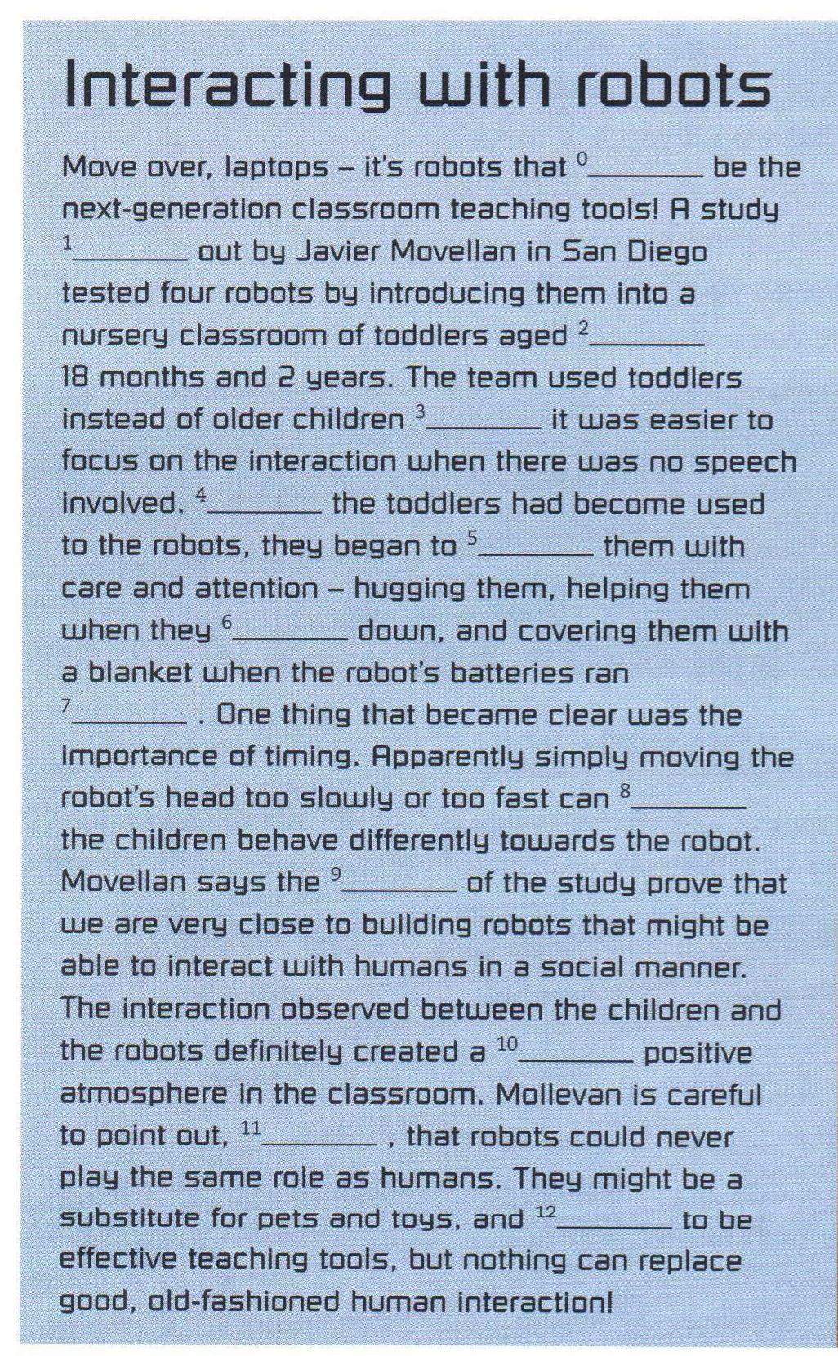
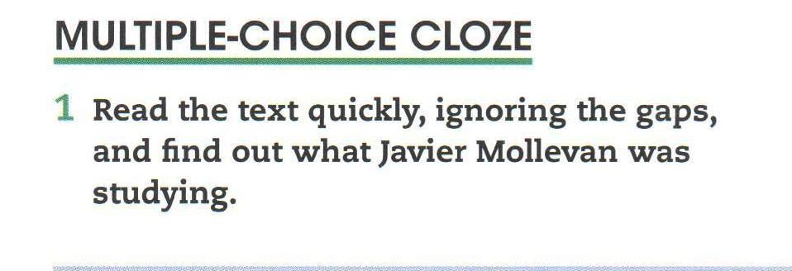
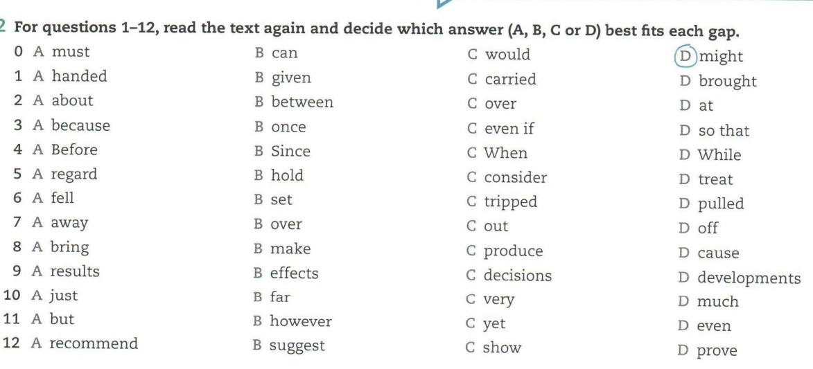
Use of English
Notes:
appoint / əˈpɔɪnt / verb [ T ] to officially choose someone for a job resmen atamak, görevlendirmek
He was appointed as company director last year.
determined / dɪˈtɜːmɪnd / adjective wanting to do something very much, and not letting anyone stop you kararlı, azimli
[ + to do sth ] He's determined to win this match.

Slide 13
Use of English -
Reading tips:
LOOKING CAREFULLY AT THE TITLE
have an idea of what the text is about will help you to choose the correct word in each question.

Slide 14
Use of English - 11 – CAN -COULD – BE ABLE TO
SOME USEFUL VOCABULARY:
Request: ask for, demand,
Suggestion: proposal, offer,
Permission: approval, go ahead
Possibility: probability, chance
Obligation: requirement, necessity, requisite
Lack: not have, be short of,

Slide 15
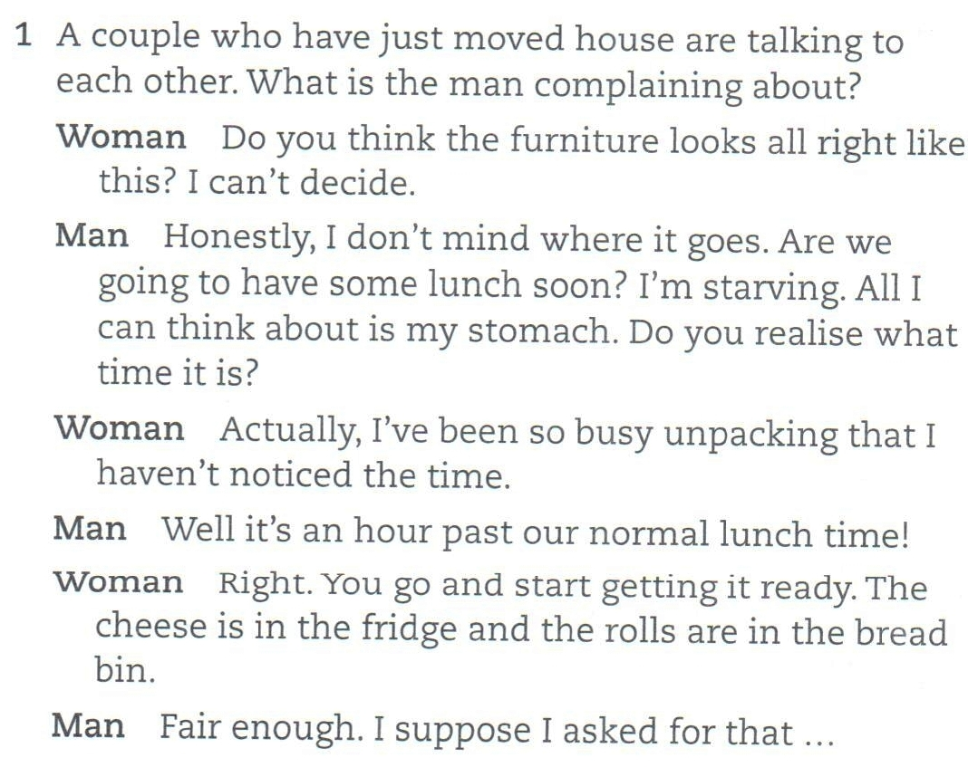
Listening – Multiple Choice 2/1

Slide 16
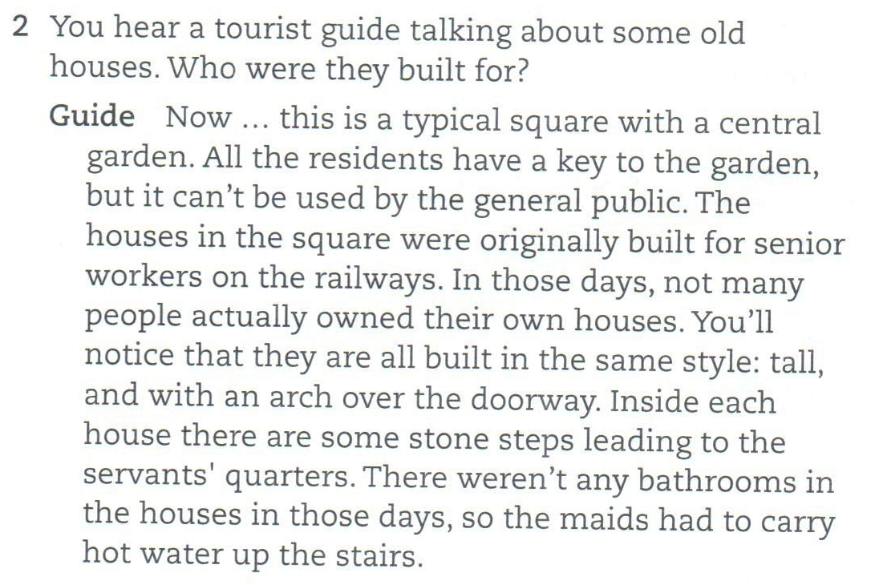
Listening –2

Slide 17
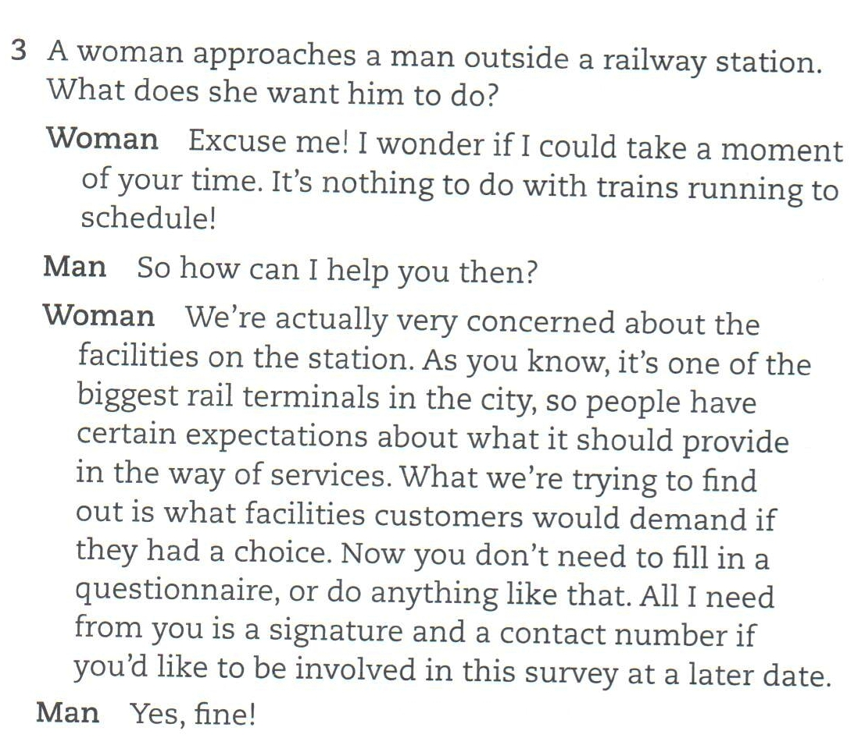
Listening –3

Slide 18
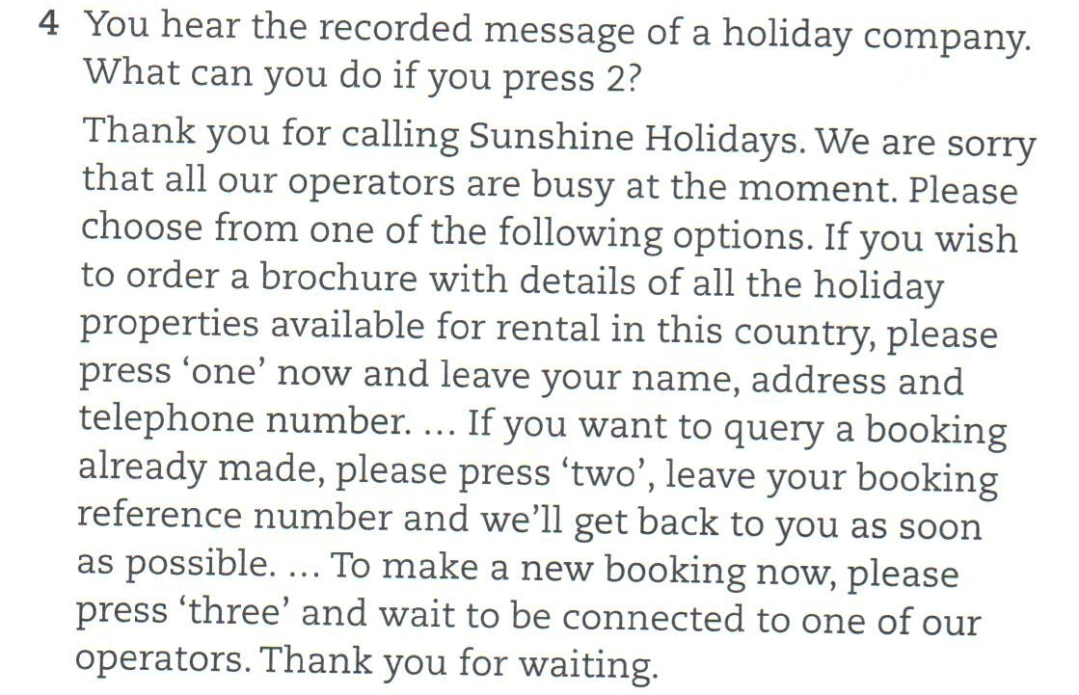
Listening –4

Slide 19
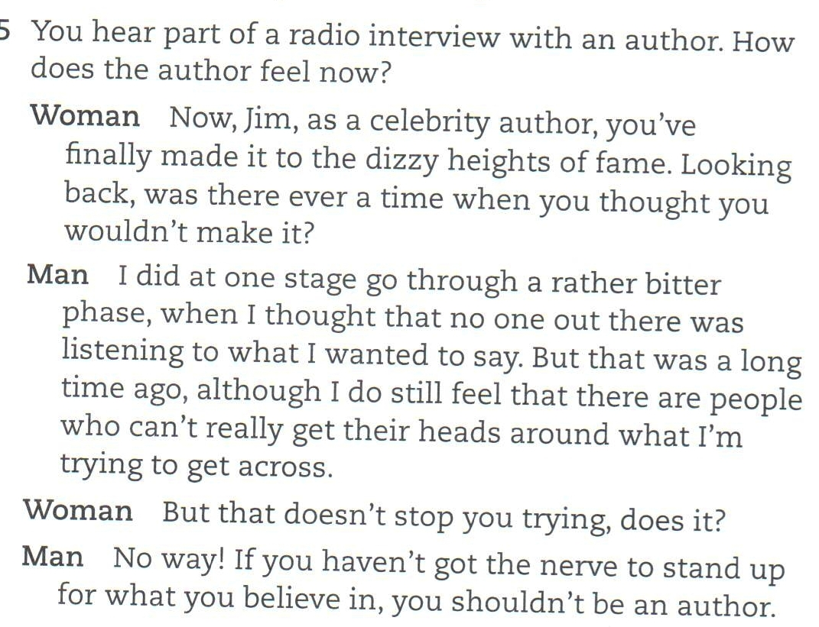
Listening –5

Slide 20
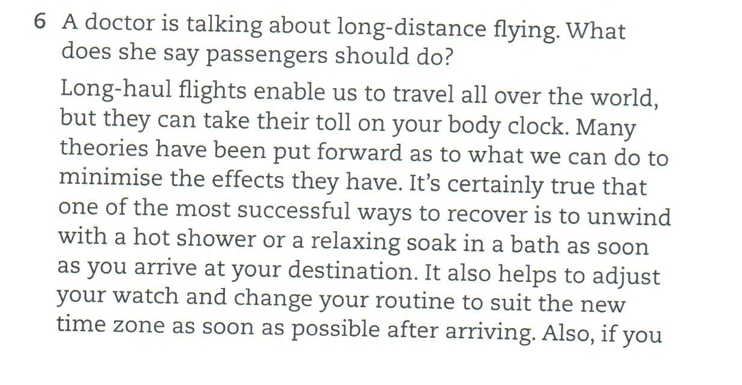
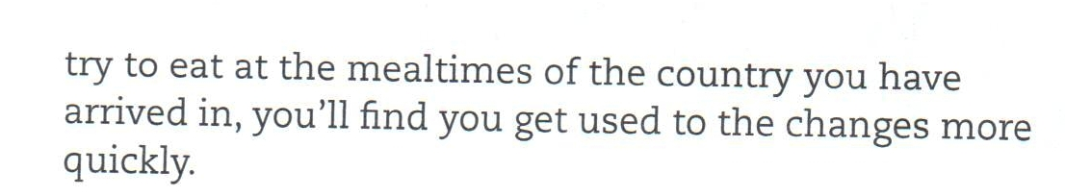
Listening –6

Slide 21
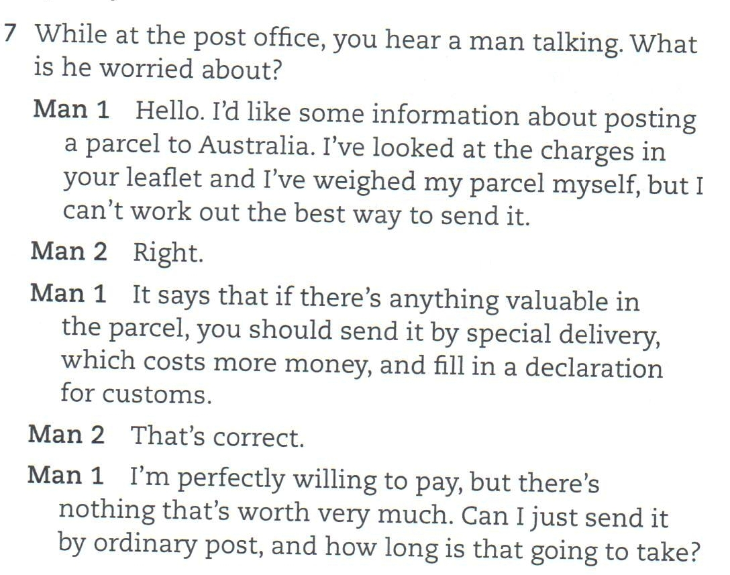
Listening –7

Slide 22
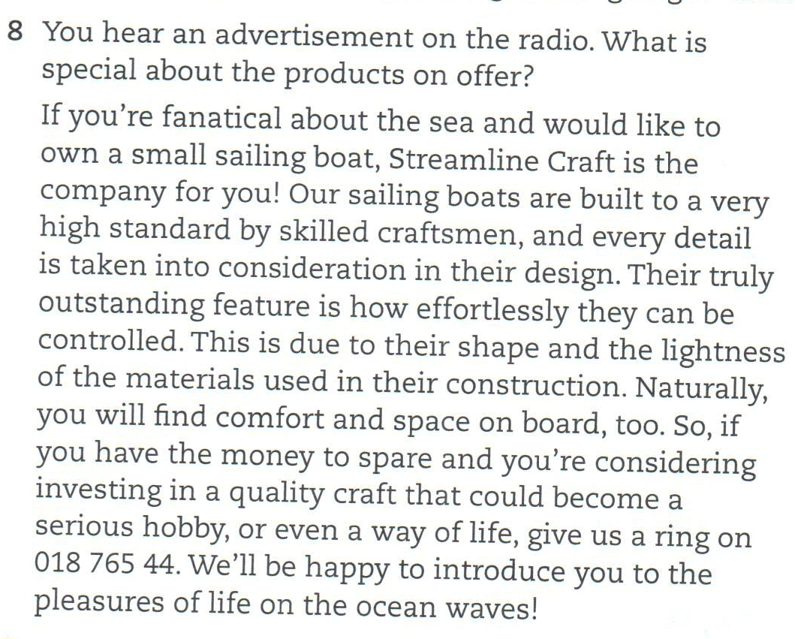
Listening –8

