Slide 1

THANK YOU NOTES

Slide 2
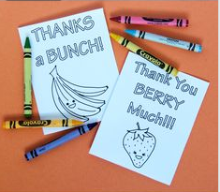

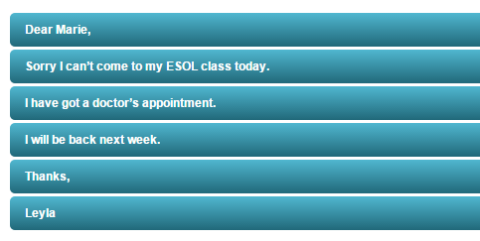
sorry

Slide 3
Birthday Notes
Dear _______,
You're the most caring and self-accepting person I know. You're my
Soul Sister (or Bro Buddy).
I wish you a great birthday and a great year ahead, especially if I can be a part of it.
With love from
Mustafa

Slide 4
Birthday Notes
Dear Mom,
Wow! I can't believe that you only get one day a year to be thanked for giving me 9 months of free womb and board. So I'm going to make the most of it. I hope you really enjoy this (name of gift, flowers, etc.). "

Slide 5
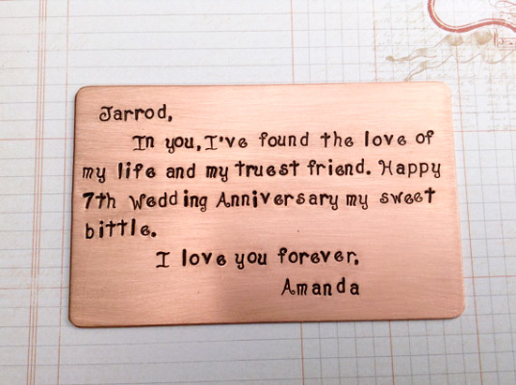

Slide 6
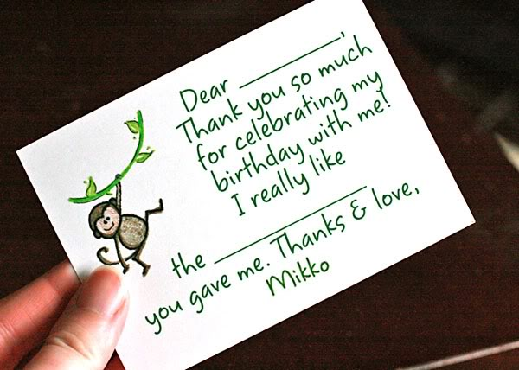
Birthday Note

Slide 7
Dear ____,
Thank you so much for the sweater. It is so soft that I feel like you've sent me 100 hugs. When the weather gets colder, I'll definitely have you in my thoughts. Thanks for your kindness.

Slide 8
USEFUL SENTENCES / THANK YOU
Thank you so much for the sweater.
I want to thank you for the lovely flower
Thank you for doing..
I would like to thank you ...

Slide 9
I'm sorry to hear about

Slide 10
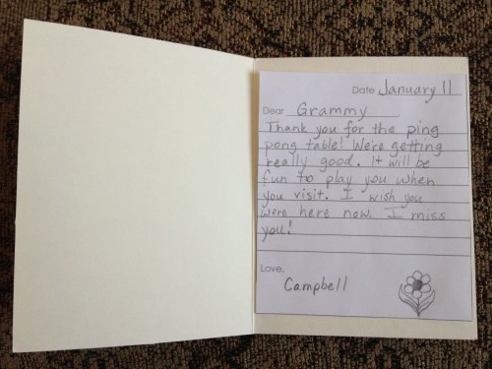
Thank you note

Slide 11
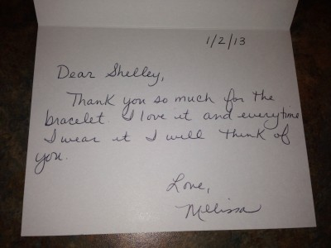
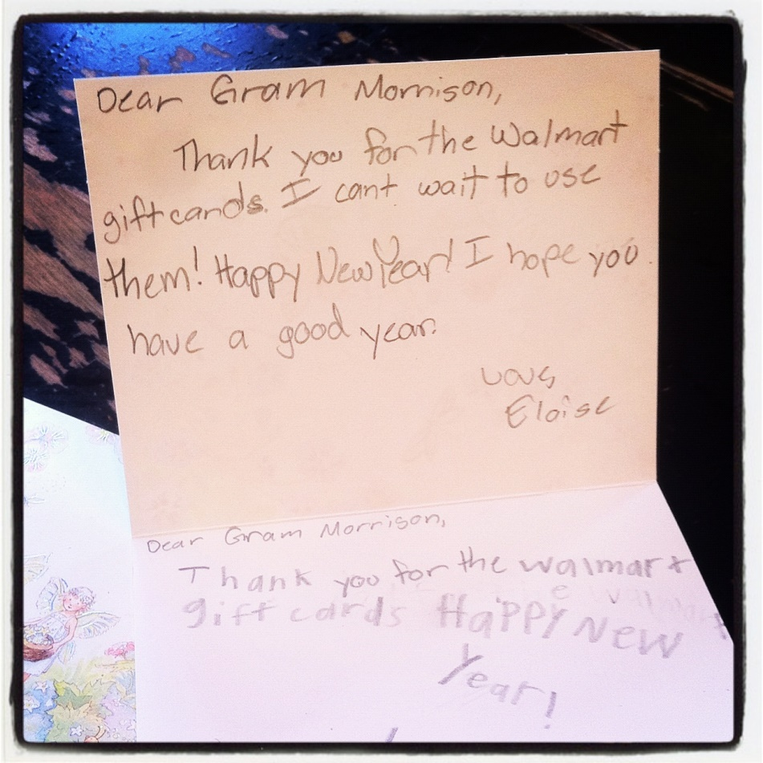
Thank you note

