Slide 1
RICE Unit 3 LESSON 3 – Pp: 82/85

Slide 2
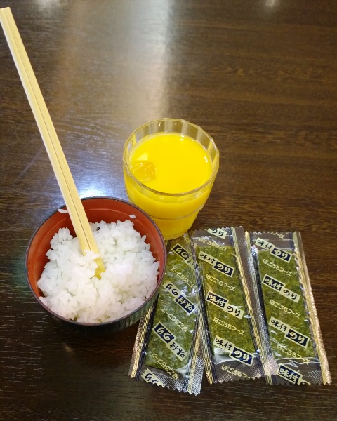
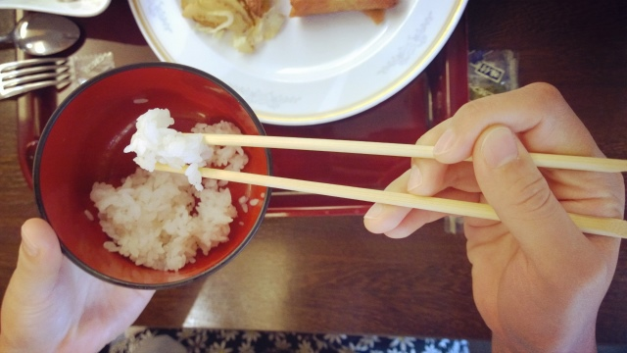
Ask questions about the pictures
What?
_____________________________________________________________
Where?
_____________________________________________________________
How?
chopsticks

Slide 3
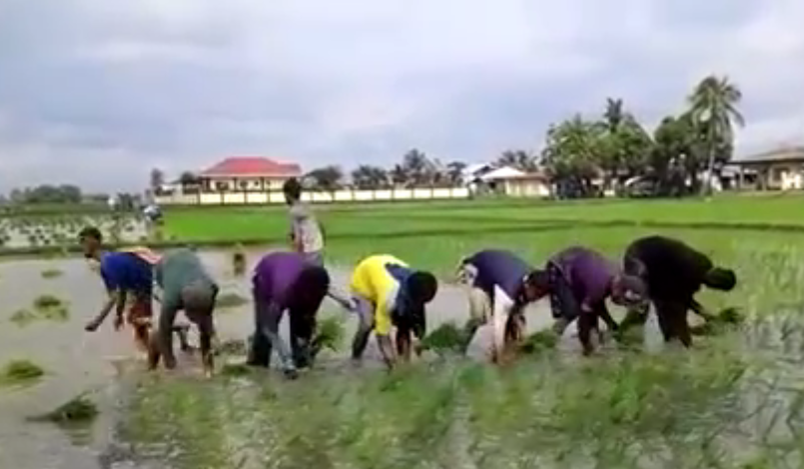
1. Warm up- Video discussion

Slide 4
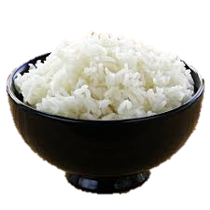
2. RICE (What do you know about rice?
WHITE
DELICIOUS
SWEET
IT NEEDS SALT, OIL, WATER, ONION, FIRE TO COOK.
GROWING IS DIFFICULT,
COOKING IS EASY.

Slide 5
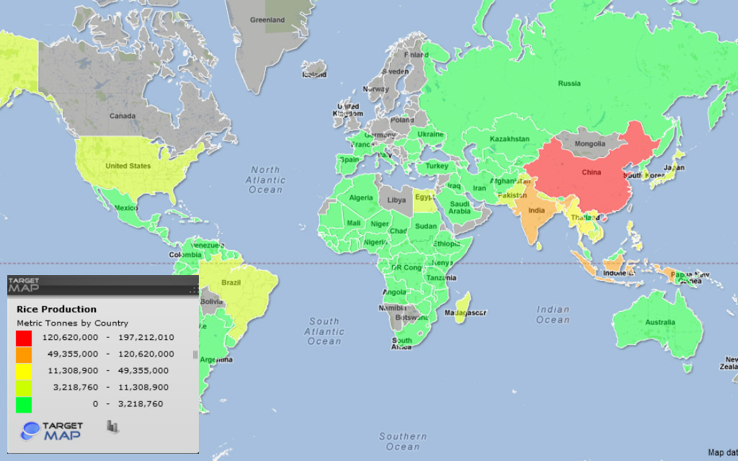
RICE PRODUCTION
SOUTHREN ASIA
WEST AFRICA

Slide 6
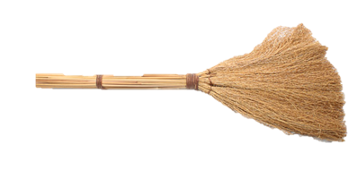
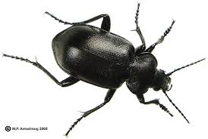
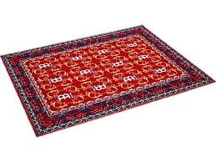
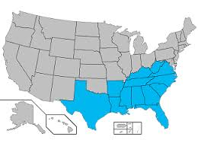
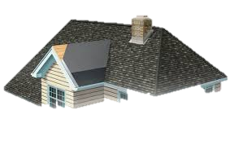
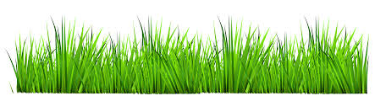
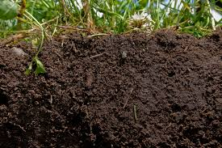
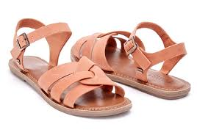

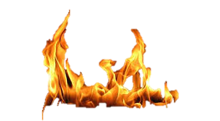
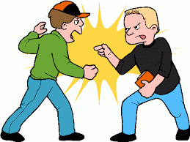
Vocabulary
RICE Unit 3 LESSON 3 – Pp: 82/85
A
B
E
broom
sandals
grass
rug
roof
soil
insect
west
Heat /hiːt/
enemy
Southern /ˈsʌðən/
C
D
K
F
G
I
H
J

Slide 7
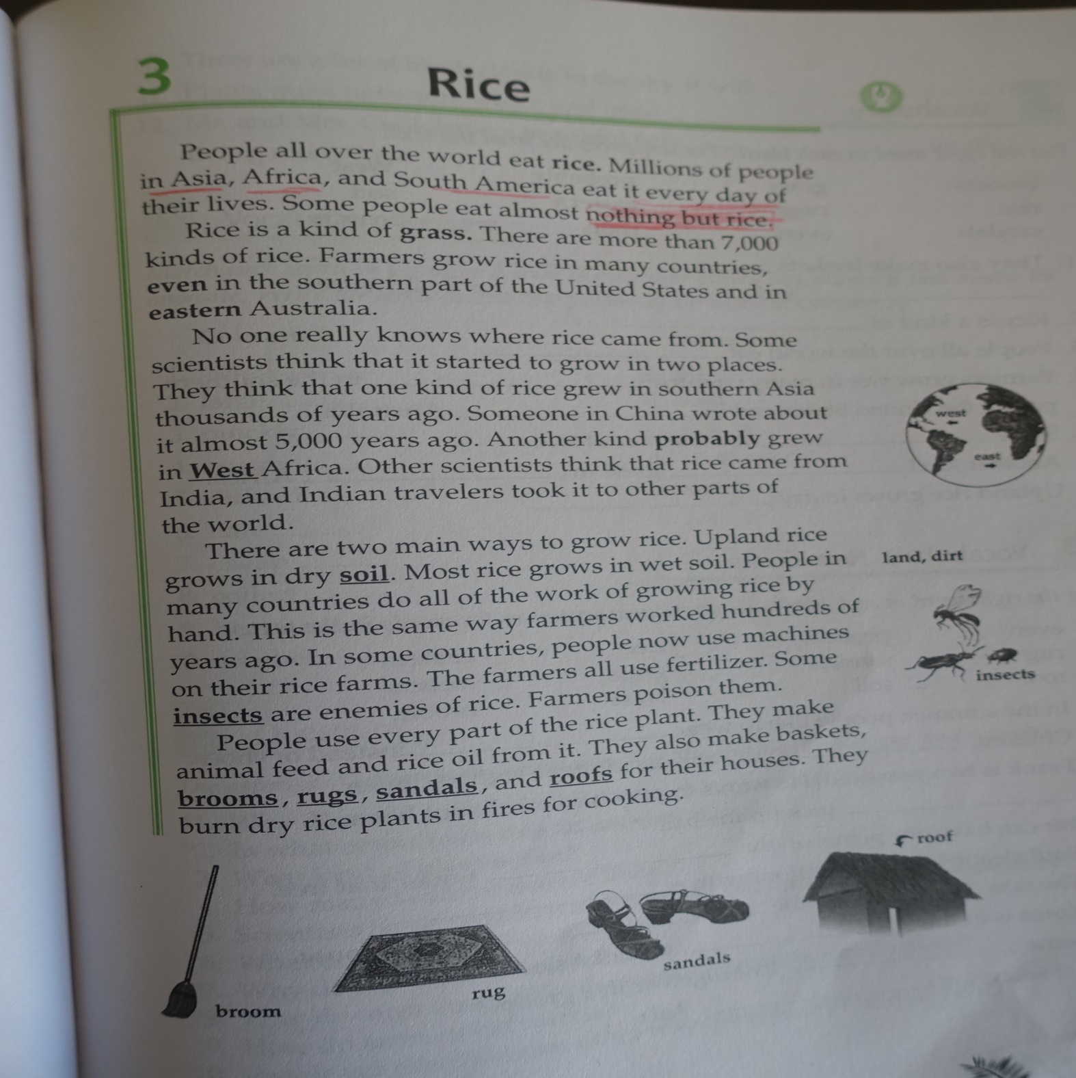
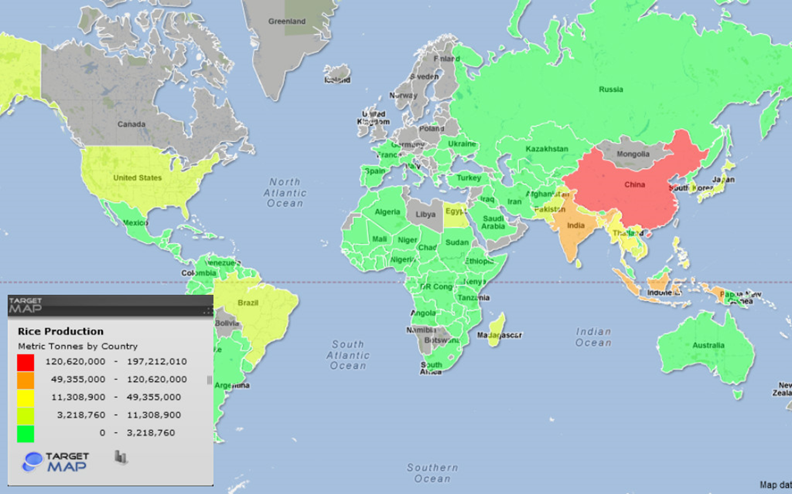

Slide 8
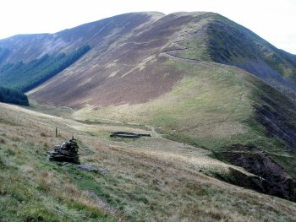
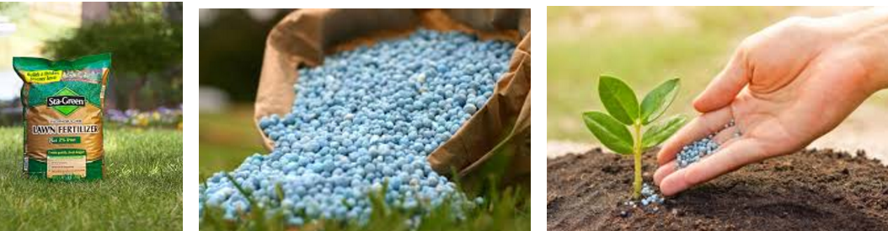
UPLAND
UPLAND
FERTILIZER: /ˈfɜːtɪlaɪzər/

Slide 9
ASSIGNMENT
1. ANALYZE THE TEXT
A) USEFUL EXPRESSION
---ALL OVER THE WORLD
B)Prepositions in, on, at, - in many countries
2. MAKE SENTENCES FOR THE GIVEN WORKSHEET

Slide 10
3. 04. 2017

Slide 11
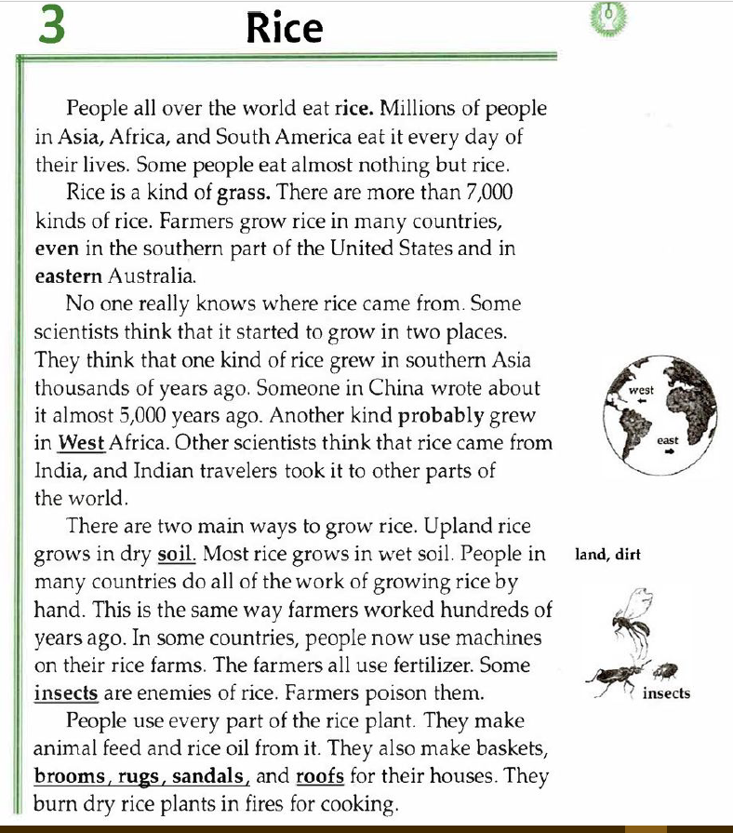
READING NOTES
TOPIC: RICE
Words to Learn:
Soil
Soothern
fertilizer
What I learned:
There are more than 7.000 kinds of rice.
Someone in China wrote about rice almost 5, 000 years ago.
There are two main ways to grow rice.
Rice grows in dry soil.
Rice grows in wet soil.
4. People in countries use do all the work of growing rice by hand.
5. People use every part of the rice.
To feed animal.
Make rice oil.
Baskets, rugs, sandals, roofs.
WELCOME TO MY RICE HOUSE

Slide 12
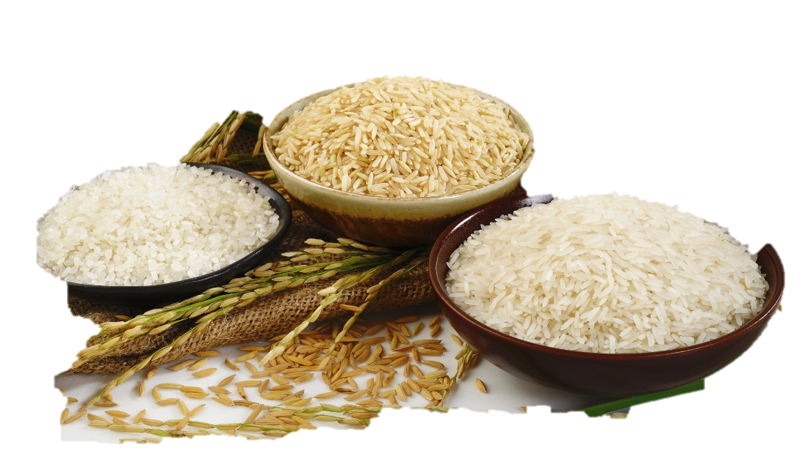
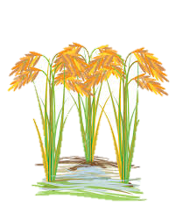
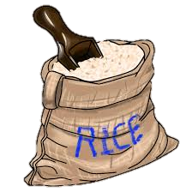
All about Rice
WHERE DO PEOPLE USE IT?
WHERE DOES IT GROW ?
HISTORY of RICE
Name: _____________
Class: _________
Date: __________

