Slide 1


MY GOALS

Slide 2

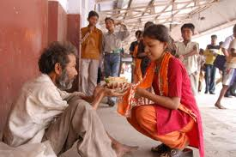
be helpful

Slide 3

Be happy

Slide 4


be healthy

Slide 5

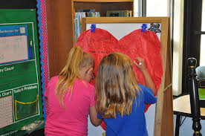
be nice to others

Slide 6

carry a book everywhere

Slide 7

clean my room

Slide 8
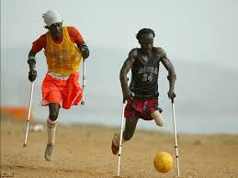
Don’t give up

Slide 9
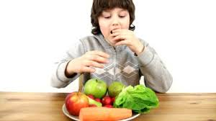
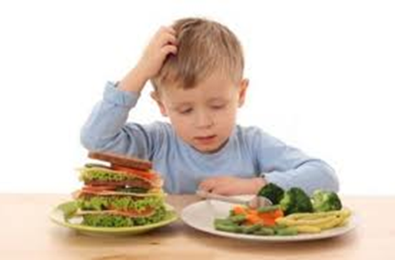
eat healthy food

Slide 10

get good grades in exam

Slide 11


go to bed early and get up early

Slide 12
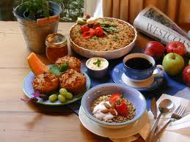

have breakfast every morning

Slide 13
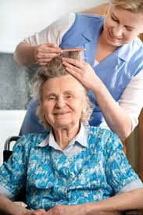
help my parents

Slide 14

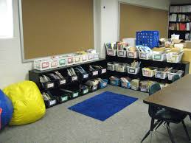
keep my room and class clean

Slide 15

learn how to play an instrument

Slide 16

make my parents happy

Slide 17
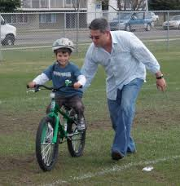

learn to ride

Slide 18

do my homework on time

Slide 19

read two books each week

Slide 20
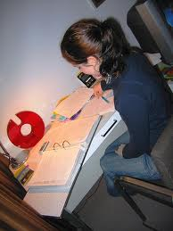
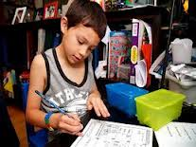
study a lot

Slide 21

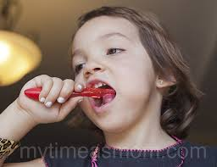
brush my teeth twice a day

Slide 22


learn new things everyday

Slide 23


have good friends

Slide 24

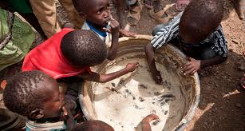
help people in need

