Slide 1

MARCH 14, 2012
LESSONS-23-24-25
UNIT 1: “Life Style ”
Ronaki – Gulan Group
09.00-12.30

Slide 2

While Listening
Listening – Multiple Choice 2/1
Read the questions in 3 minutes.
Underline the important /Key words that you think.

Slide 3
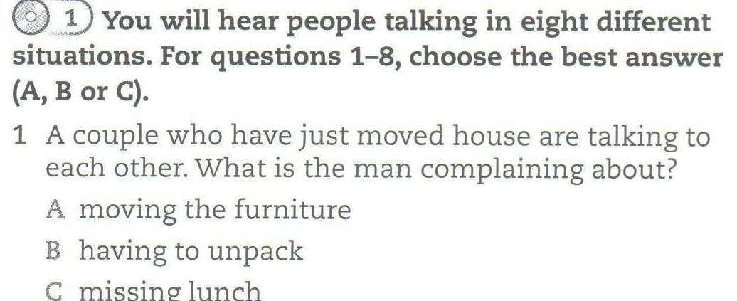
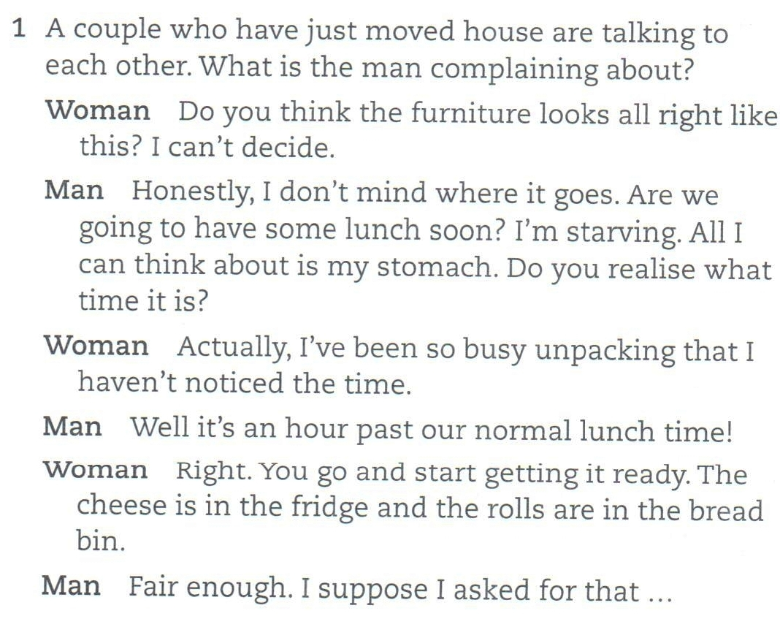
Listening – Multiple Choice 2/1
Notes:
c

Slide 4
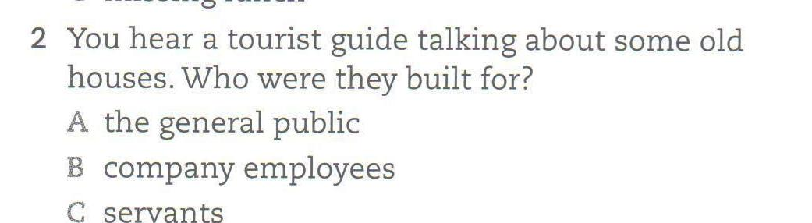
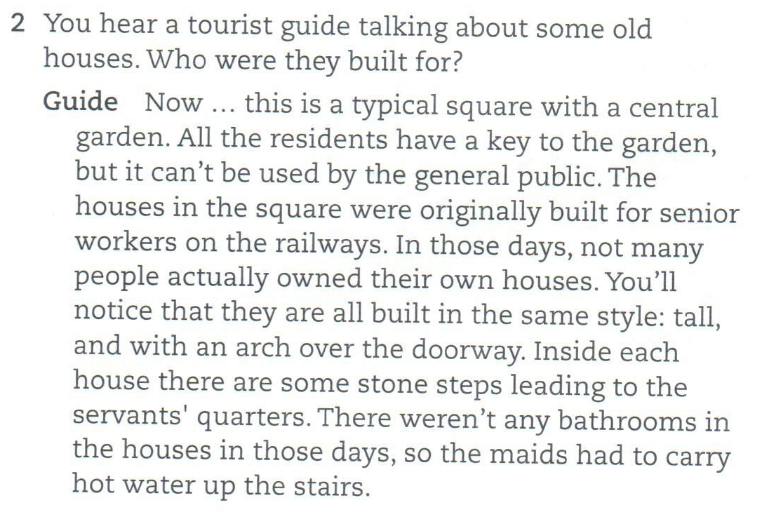
Notes:
b

Slide 5
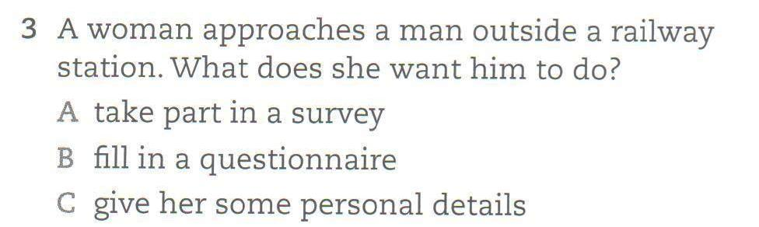
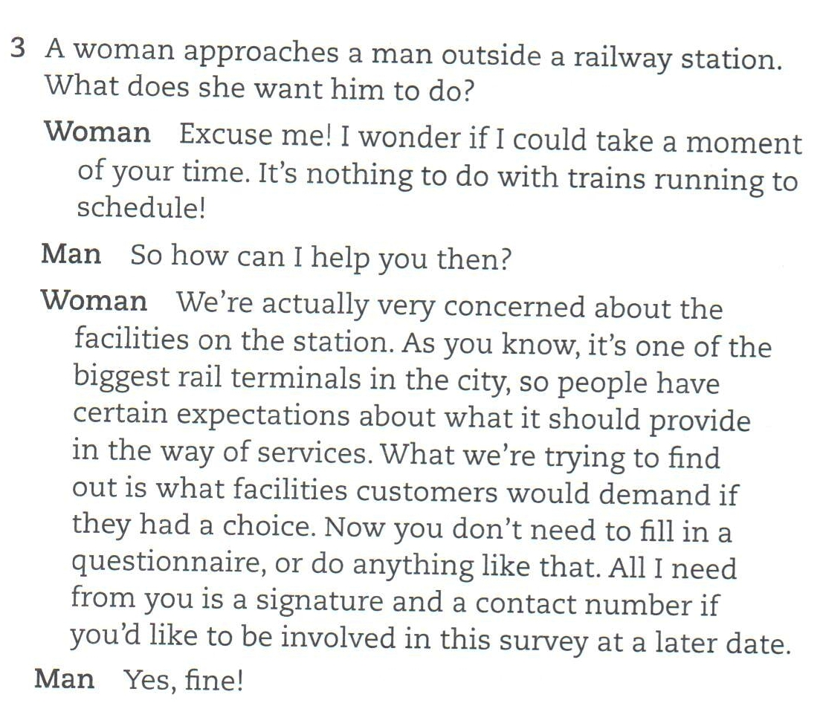
Notes:
c

Slide 6
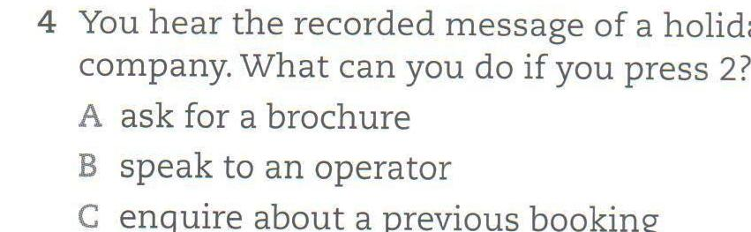
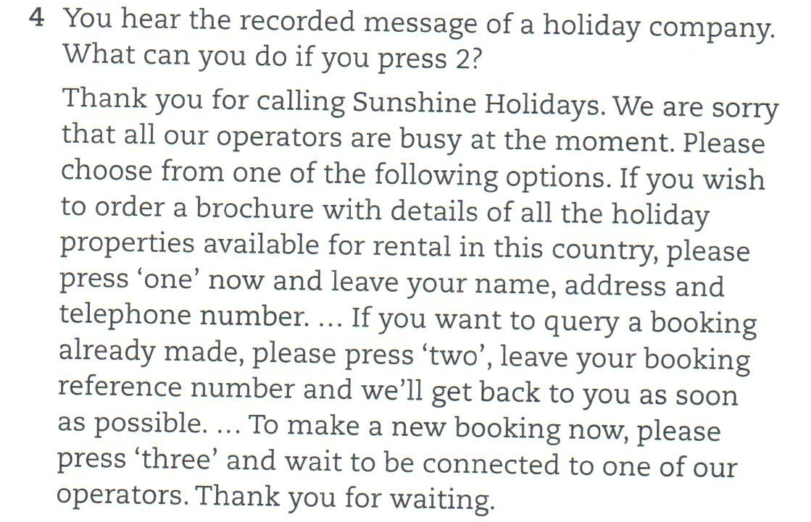
Notes:
c

Slide 7
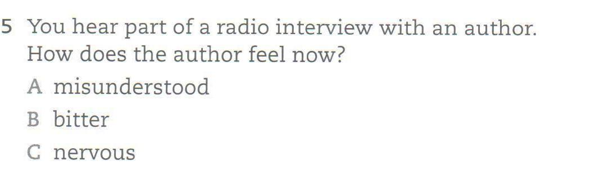
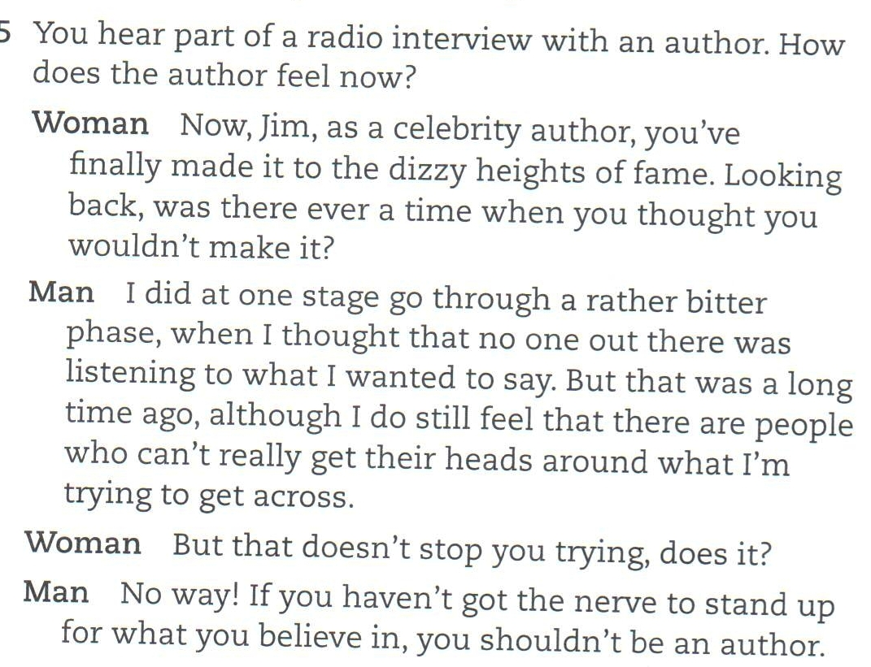
Notes:
a

Slide 8
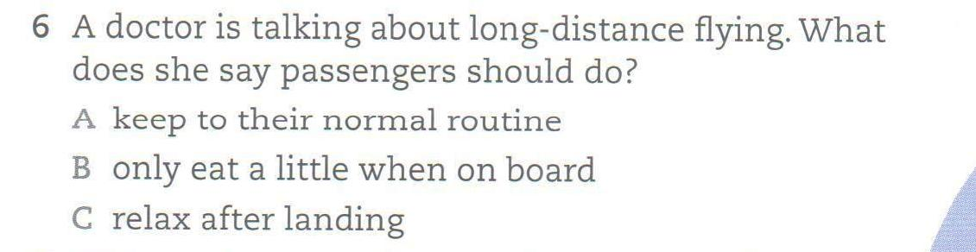
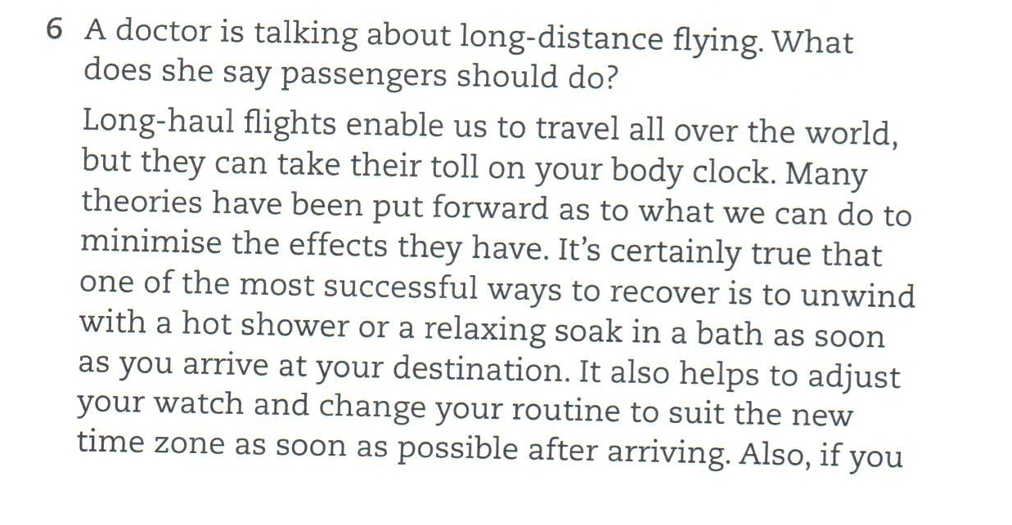
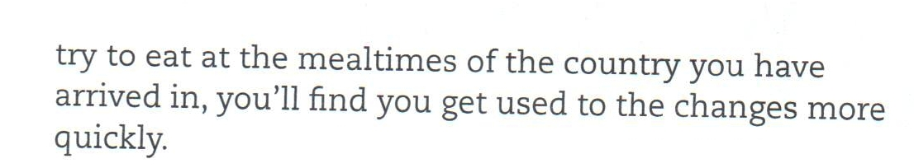
Listening –6
Notes:
c

Slide 9
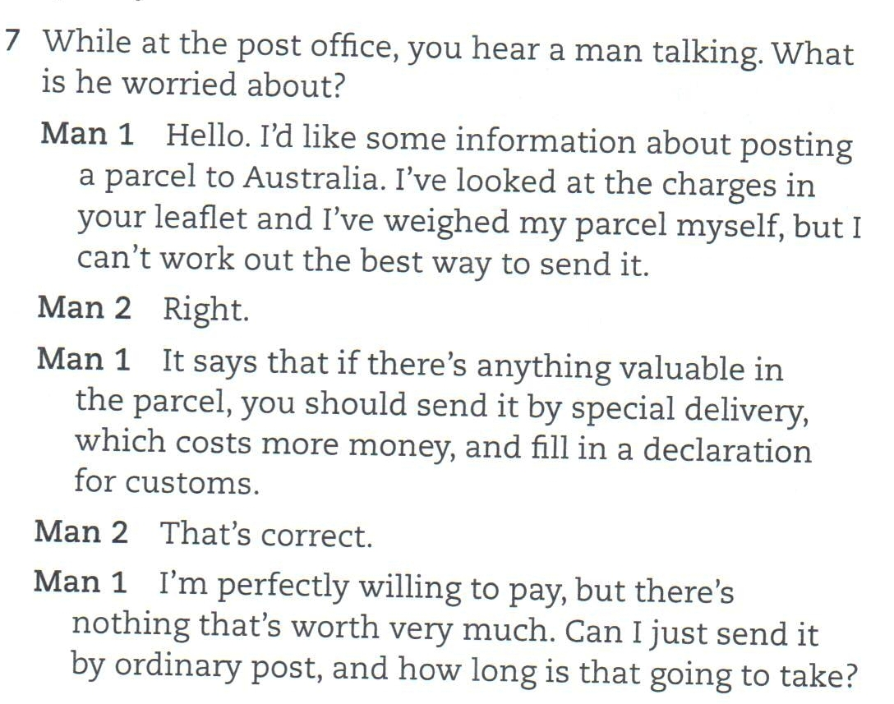
Notes:
b

Slide 10
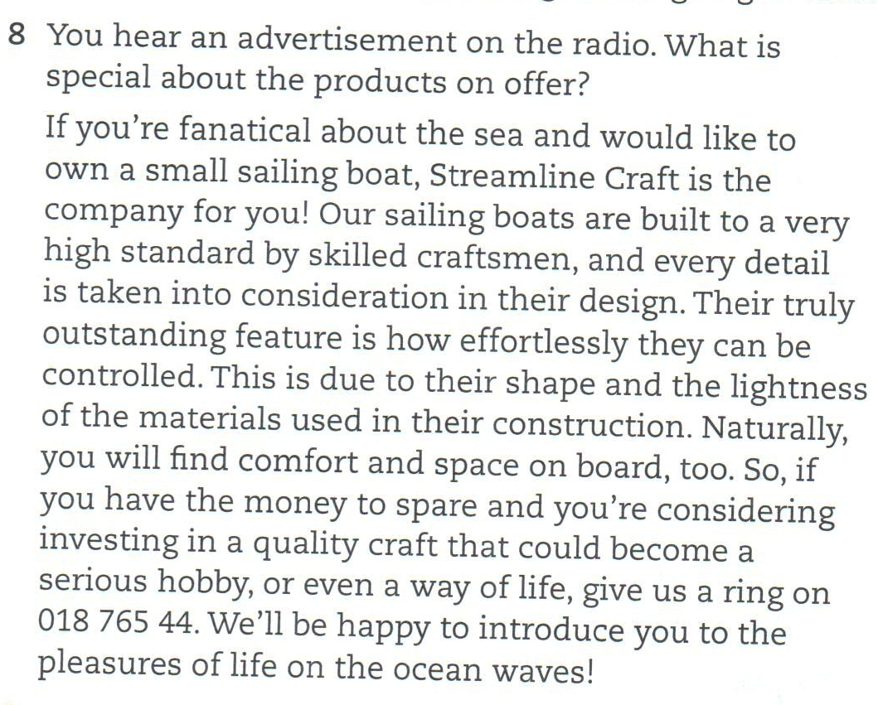
Listening –8
Notes:
b

Slide 11
SPEAKING -1 Home
What kind of housing are you living in?
Where did you grow up?
Is your home in a convenient location?
How many rooms are there in your house?
What do you like about your home? What don't you like?
What would you like to change in your house?
How long have you lived where you are living now?
Who lives with you? / Who do you live with?

Slide 12
SPEAKING -1 Neıghbourhood
Do you find easy to live where you live?
What do you like about living in Erbil?
Can you tell me who your neighbours are?
Do you like the place where you are living? Why or why not?
Are there any parks near your home?
How can houses be made more environmentally friendly?
How often is garbage collected in your neighborhood?

Slide 13
SPEAKING -1 Family
Can you describe your family.
Can you talk about your family?
Who in family do you spend time most?
How many people are in your family?
Who is in your family you spent most time?
Do you like your family? Why or why not?
Do your parents get along with each other?
How big is your family?
What do you and your family like to do together?
What do you think of married couples who decide not to have any child?
What do you think of your mother and your father?
What do your mother and father look like? How about your grandparents?
What do your parents do in their free time?
What does your father do? What's his job?
What does your mother do?

Slide 14
SPEAKING -1 Future Plans
What are some of your future plans?
Is there anything new that you want to learn about?
What job would you like to do in the future?
Where do you plan on going in the future?
Would you like to be in different position in the future?
If you could change any aspect of your personality, what would it be?

Slide 15
SPEAKING -1 Favourite day of week
What is your favourite day of week? Why?

Slide 16
SPEAKING -1 study English
Can you tell me about some of your hobbies and interests?
Do you like...

Slide 17
SPEAKING -1 hobbies and interests
Can you tell me about your hobbies and interests?
What are your favorite kinds of books?
What kinds of movies or which actors don’t you like?
What kinds of music don’t you like?
What kind of music do you like?
Tell me about something you love.
Tell me about something you hate.

Slide 18
SPEAKING – past experience
How long have you been working in Erbil?
How long have you been teaching ....?

Slide 19
SPEAKING -1 feelings
Can you tell me about your hobbies and interests?

Slide 20
REVISE and EXTENTION 1-2
A. pick on somebody/something :
Why don't you pick on someone else for a change?
B. pick somebody's pocket: to quietly steal something from someone's pocket
On our last day in the city, someone picked my pocket.
C. pick a quarrel/fight (with somebody): to deliberately start a quarrel or fight with someone:
I could see he was trying to pick a fight with me.
D. pick up speed/steam: to go faster:
The train was gradually picking up speed.
E. pick your way through/across/among etc something: To walk in a slow careful way, choosing exactly where to put your feet down:
She picked her way between the puddles.

Slide 21
3. Negative prefix un-
uncomfortable
unexpected
unnecessarily
unsafe
unknown
unpleasant
unsuccessful
undress

Slide 22
3. Negative prefix dis -
disagreement
disadvantage
disappear
dishonest
disaggreeable
disloyal
Dislike
Disappointed
disobey
disable

Slide 23
3. Negative prefix in -
inactive
incorrect
informal
İnsufficient
independence

Slide 24
3. Negative prefix im - (b, m, b)
impossible
impolite
impatient
impolite

Slide 25
REVISE and EXTENTION 4
a. learn pick something ↔ up: o learn something by watching or listening to other people:
I picked up a few words of Arabic when I was there last year.
b. keep something ↔ up: to continue doing something:
I don't think I can keep this up any longer.
Slow down! I can't keep up with you.
c. Turn up: to arrive at a place, especially in a way that is unexpected:
You can't just turn up and expect a meal.
d. bring up: raise children
e. put something ↔ up British English to increase the cost or value of something [= raise]:
They've put up the price of petrol again.
f. if the weather clears up, it gets better

Slide 26
UNIT 2 READING
1- Video
In some countries, work experience is usually organised by the school the student is attending.
Advantages??????
It is opportunity for students to understand the world of work, discover their strengths (and possibly their weakness), and find out whether they would enjoy doing a particular kind of job permenantly.

