Slide 1
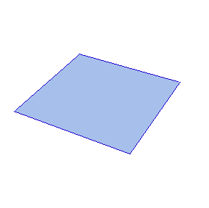
Mathematics and Origami
By
Paige Avery
Faculty Advisor
Dr. Paul Schuette
http://mathworld.wolfram.com/Origami.html

Slide 2
Mathematics and Origami
Chapter 1
  History
  Geometry
  Angle Construction
Chapter 2
  Education
Chapter 3
  Survey of Robert Lang’s Design Methods
Notes:
Chapter 1 of my thesis was the major focus of my research. I looked at the history behind origami and its origin and also the history behind the mathematics of origami. I chose to focus on the geometry and trigonometry found in origami. I chose these two mathematical concepts because they could possibly be concepts that I will be teaching once I leave Meredith College but there is a wide range of extensions that can be taken with mathematics and origami. With that in mind, I also decided to look at the educational benefits of origami when teaching mathematics. Chapter 3 was not as much a focus of my research but I have learned many complex mathematical ideas behind the design of origami that I feel will continue to be of much interest to me.

Slide 3
History
Myths
  Origin of Origami
Facts
  What is origami?
  Who practices origami?
  Why is origami practiced?
Notes:
When someone says “origami”, more than likely you immediately think “the Japanese art of paper folding.” I will admit that I thought the exact same thing. In fact, some historians believe that origami is a mixture of the Japanese and European culture and that it was more than likely brought about by the German Kindergarten Movement around 1880. I also found it interesting that origami has not always been called “origami” but has gone through a number of names including “orikata,” “oriuse,” “orimono,” and even “tatamgami.”
Origami is often defined as a form of visual or sculptural representation that is defined by folding a medium which is often a square piece of paper. I say that the medium is often, but not always, a square piece of paper because I have learned that the mathematics of origami also involves geometric shaped paper or strips of paper.
Origami is practiced by a number of different people for a number of different reasons. There are those that practice origami for hobby, those that look at the mathematics of origami, those that use origami to teach students, those that design origami, and just recently, those that are looking to origami for chemical and biological answers. Origami is practiced to keep what has become known as the Japanese art of paper-folding a part of the culture, to help researchers understand and represent mathematical concepts visually, and those that use origami to motivate children to learn.

Slide 4
Geometry
Purpose of Origami in Geometry
Comparison
  Geometric Constructions
  Origami Constructions
Activity
  Geometric Construction of Equilateral Triangle
  Origami Construction of Equilateral Triangle
Notes:
The purpose of origami in geometry is the ability to manipulate and construct geometric constructions and to understand why certain steps need to be taken in order to construct a geometric construction. Origami can also be used to compare the mathematics behind origami constructions and geometric constructions. I focused a lot on the comparison of origami constructions and geometric constructions because I found it interesting that there were two different ways to represent geometry and that origami provided the ability to manipulate geometric constructions.
One of the constructions I compared was the geometric construction of an equilateral triangle and the origami construction of the equilateral triangle.
USE THE DOCUMENT CAMERA to show the geometric construction of an equilateral triangle and then perform the origami construction of an equilateral triangle on the document camera.
When comparing these two constructions, it’s easy to see that the same basic steps were taken, the difference is that one construction was completed through manipulation and the other with the aid of compass and straightedge. In the end, both constructions started with a line and two endpoints and ended with the construction of the final point (either by the intersection of two arcs – circles represent compass - or the intersection of two creases).

Slide 5
Angle Construction
Purpose of Origami Angle Construction
  Hands-On
  Accuracy
Trisection of an Angle
  The Impossible is Possible with Origami
Activity
  Visual of Trisection of an Angle
Notes:
I also looked at the purpose of using origami to construct angles. I mentioned earlier that one of my constructions was performed on a strip of paper (SHOW STRIP OF PAPER). After working with the strip of paper and creating a number of different folding sequences, I realized that the successive folds were creating creases more accurate than the previous, meaning that the greater the number of folds, the more accurate the angle. I found this very interesting because often it is very hard to get an angle accurate with a pencil and a protractor or a compass.
While researching the construction of angles with origami, I found that an arbitrary angle can be trisected with origami but cannot be trisected through traditional mathematics. While a known angle can be trisected with traditional and origami methods, I find it fascinating that origami can be used to trisect an unknown angle.

Slide 6
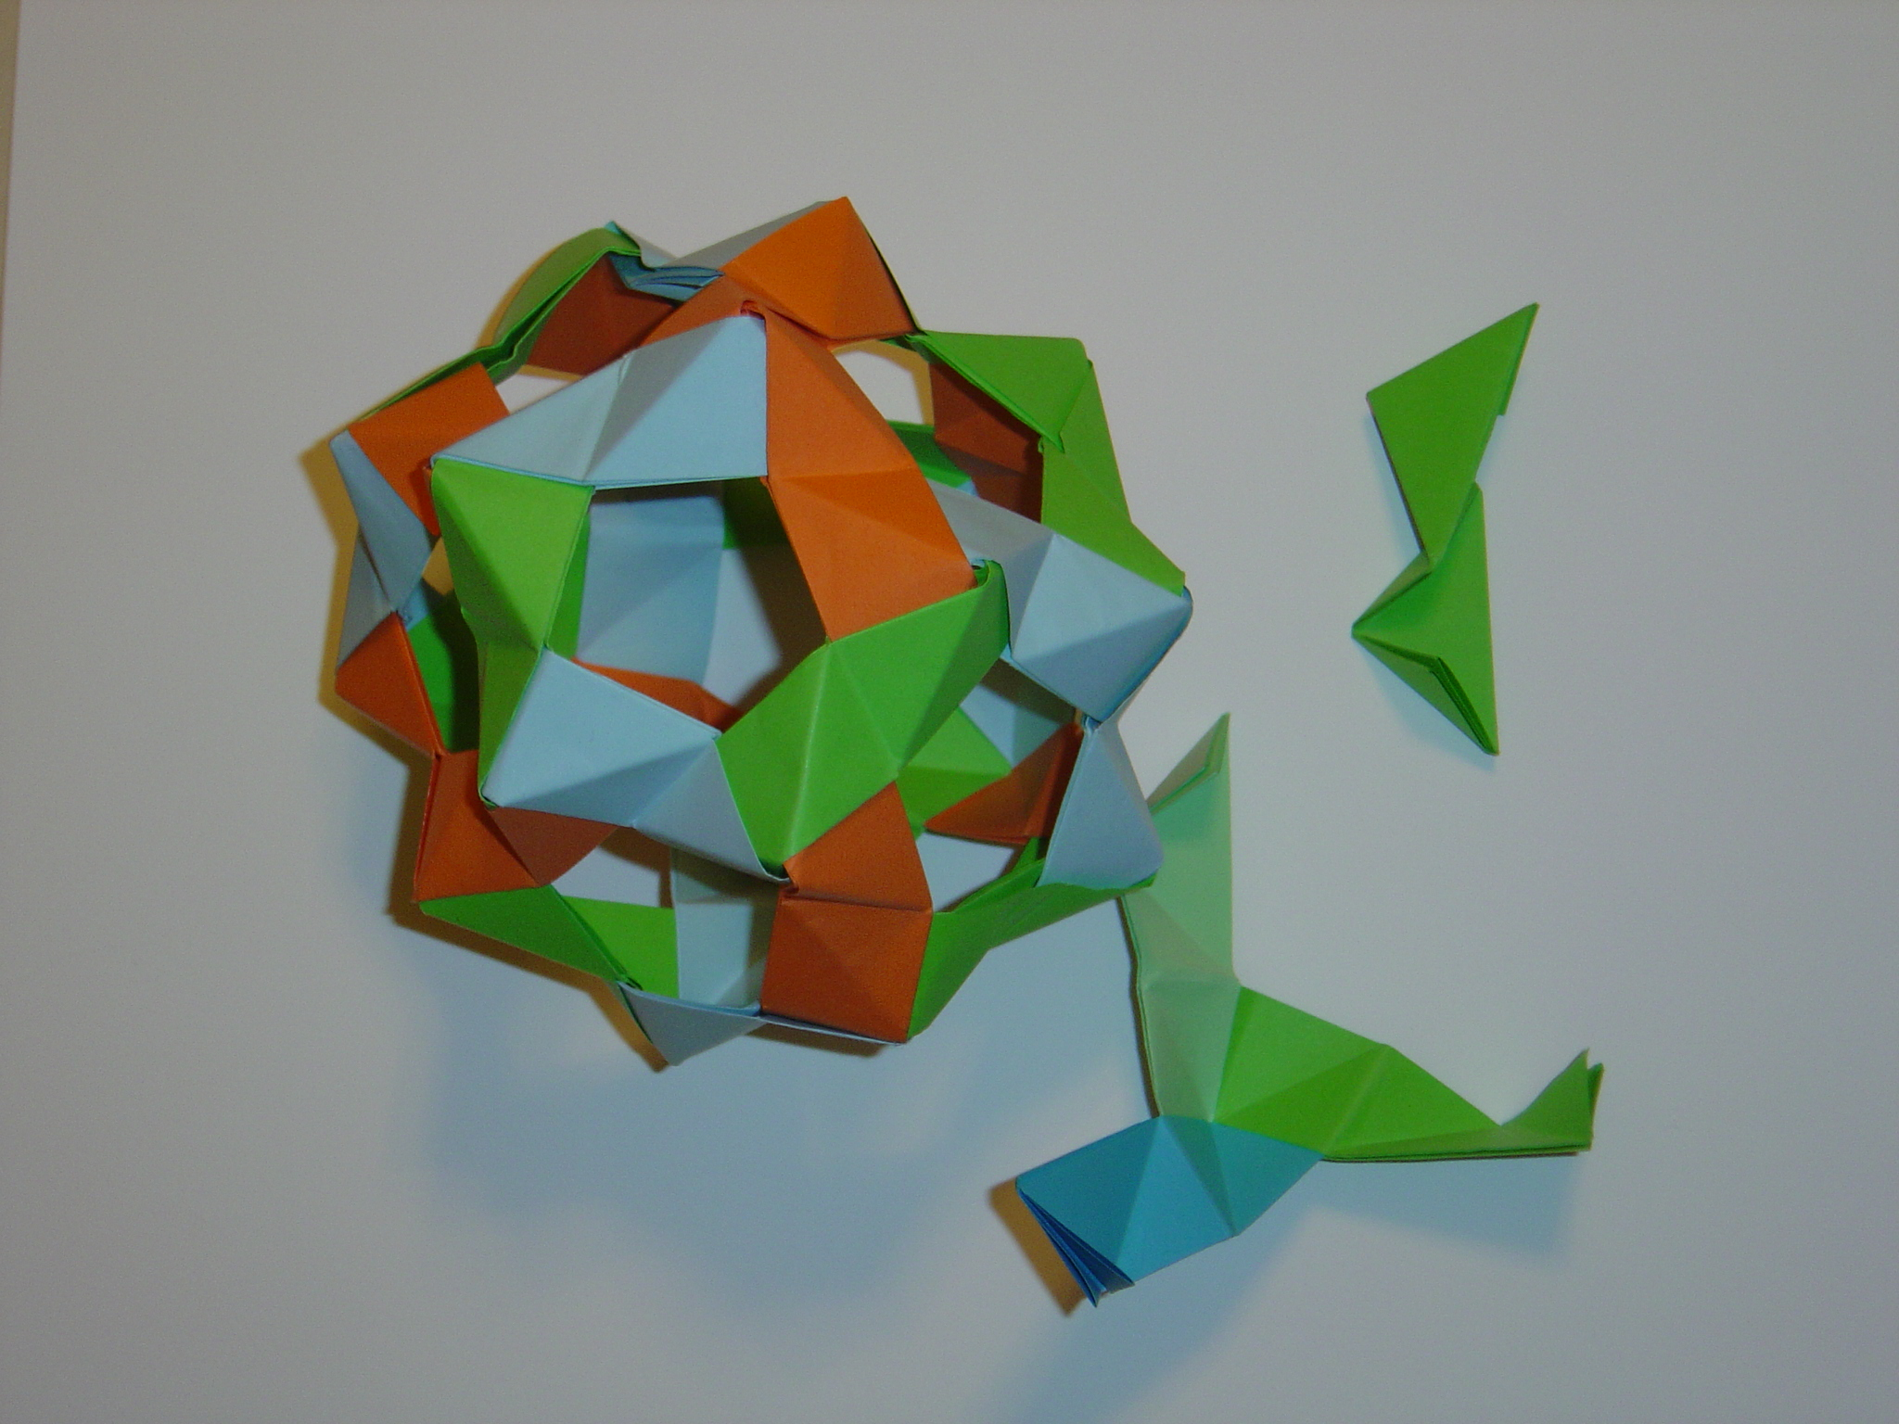
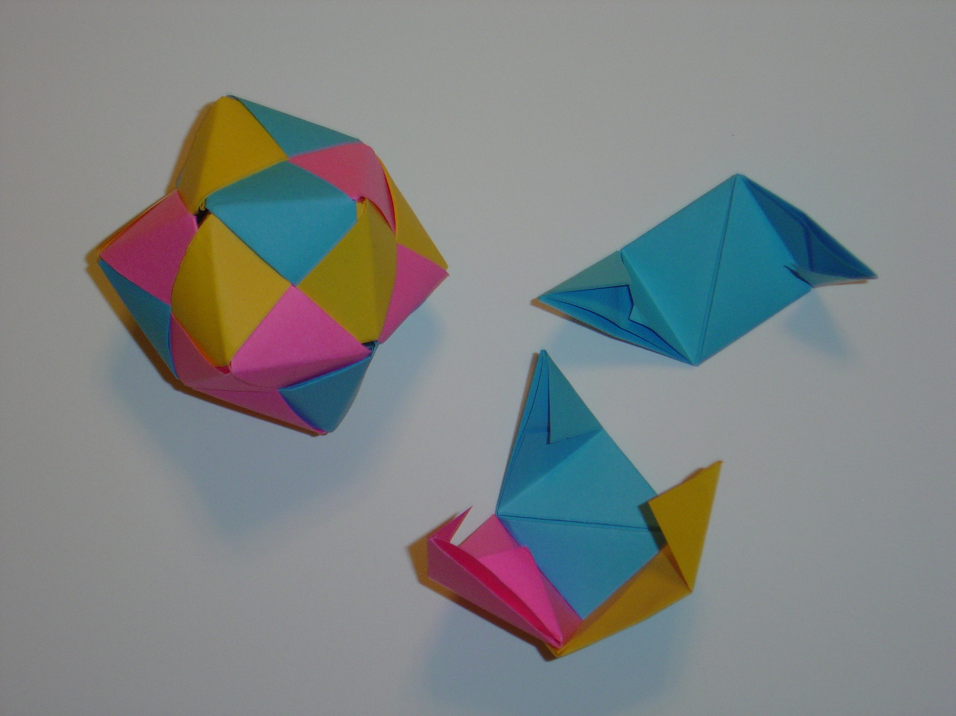
Polyhedra
Individual Units
Bucky Balls
Importance of Angle Construction
Dodecahedron
Capped Icosahedron
30 Pentagon-Hexagon Zig-Zag Units
12 Sonobé Units
Notes:
Another area of mathematical origami that I thought was interesting was polyhedra. I worked hard to construct a 30 unit dodecahedron from pentagon-hexagon zig-zag units, which you can see, and also a 12 unit capped icosahedron from sonobe units. While I enjoyed constructing these two polyhedra which are similar to polyhedra constructions known as “bucky balls,” I was not able to explore the mathematical concepts and the links to origami any further than the importance of angle construction. Angle construction is very important when constructing these polyhedra because each unit must fit together exactly in order to create an accurate model of the polyhedra.

Slide 7

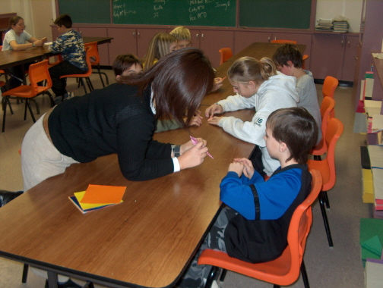
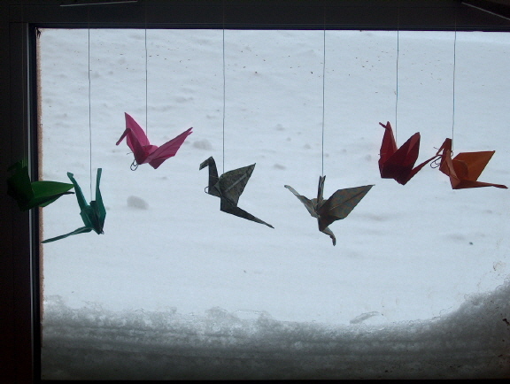
Education
Hands-On Experience
Educational Benefits of Origami
Levels of Geometric Thinking
Notes:
After looking at the educational benefits of origami, I realized that not only can mathematical concepts be taught with origami, but also other important topics, including character education. The hands-on aspect of origami is very beneficial within education. Levenson also points out numerous other benefits of origami in education, including behavioral skills, cooperative learning, cognitive development, multi-cultural awareness, and community building. Pierre and Dina van Hiele researched and found that origami can also help students progress through the levels of geometric thinking, such as visualization, analysis, informal deduction, deduction, and rigor.
I was most impressed by Levenson’s work with the benefits of origami because he focused his research on a book titled Sadako and the Thousand Paper Cranes . Levenson has created a lesson for schools worldwide that teaches students the importance of hard work and also that an individual can make a difference. Sadako was a two year old little girl affected by the bombing in Hiroshima. Her friend told her a legend of 1000 paper cranes and Sadako began to fold in hopes that the cranes would make her well. When Sadako died at the age of 12 from leukemia she only had 300 some cranes left to fold. Sadako was buried with 1000 paper cranes thanks to her classmates.

Slide 8
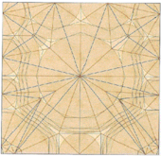
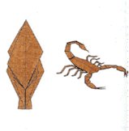
Survey of Design Methods
Robert J. Lang
  Crease Pattern
  Tree Theory
  Circle River Method
  Grafting
Notes:
The final chapter of my thesis looked at the origami design methods of Robert J. Lang, a renowned origami designer. Lang’s work reflect a number of different mathematical techniques but I was only able to focus on a few. The backbone of all origami designs is the crease pattern. The crease pattern represents the mountain and valley folds needed to construct an origami model. Here I have a picture of the crease pattern of a scorpion. Tree theory is also a very important part of origami design and reflects the mathematics behind graph theory. A “tree” in origami design looks like a stick figure but represents the axis of the origami model. To me, the tree appeared to represent the shadow of the origami model after construction. From the tree Lang introduced a circle/river method which turned the crease pattern into a square full of circles and rivers. The crease pattern shown also represents the circle/river design of the scorpion. Finally, I looked at Lang’s explanation of grafting. His question was, “What do you do if you just want to add an extra set of legs or wings to an insect?” The rules behind origami state that you cannot cut or glue any extra paper to the model. Lang and other designers look to grafting for help with any small additions. Grafting involves creating a border around or a strip within the existing square by downsizing the existing crease pattern and adding the crease pattern of wings or legs in the appropriate spots. I was never able to get a good grasp on origami design but it has intrigued me enough to continue looking at the mathematics of origami. Result of this design method is a variety of fairly complicated constructions.

Slide 9
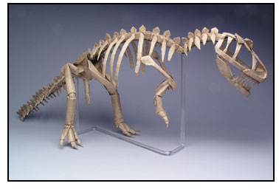
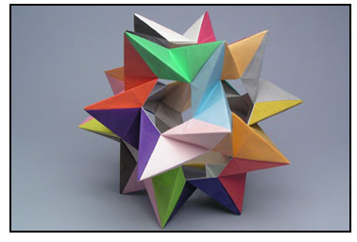
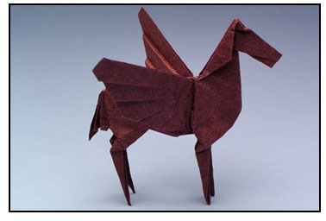
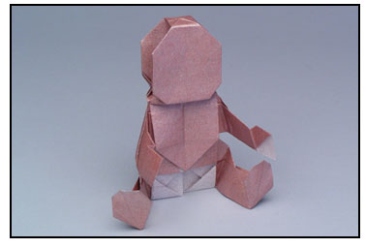
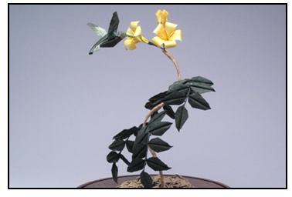
Lang’s Constructions
http://www.langorigami.com/Art/artmain.htm

Slide 10
Conclusion
Chapter 1
  History
  Geometry
  Angle Construction
Chapter 2
  Education
Chapter 3
  Survey of Robert Lang’s Design Methods
Notes:
MAYBE YOU’LL BE INTERESTED TO LOOK INTO THE MATHEMATICS OF ORIGAMI YOURSELF.
REAL LIFE APPLICATIONS:
Folding Airbags – Lang helped with this design.
NASA – foldable antennas – Lang is also working on this.

