Slide 1
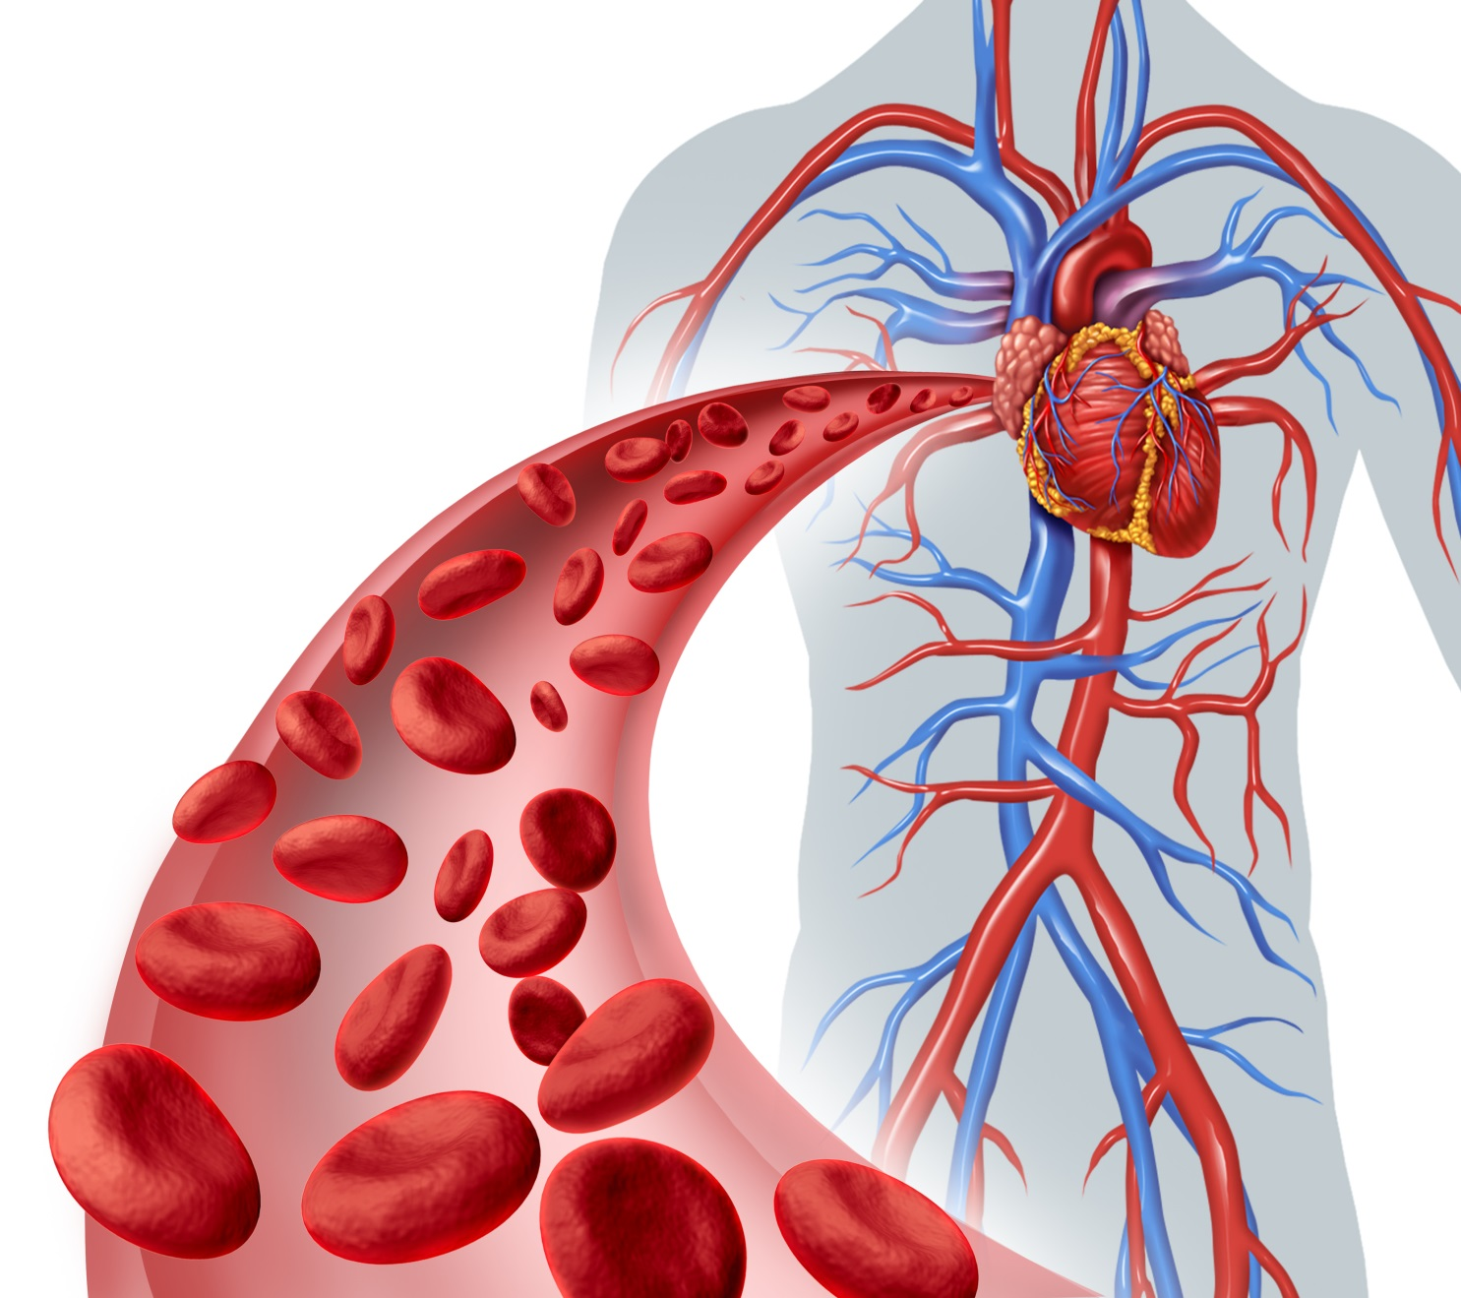


CIRCULATORY SYSTEM
Prepared by:-
Aram Ibrahim

Slide 2
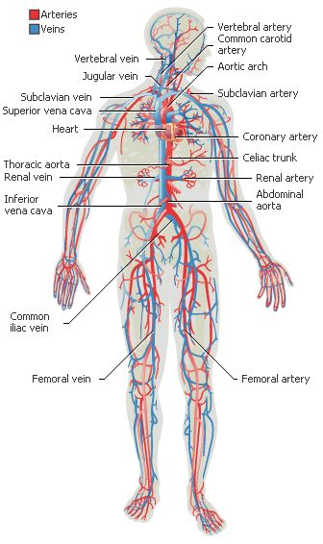
Circulatory system :-
The system that circulates blood and lymph through the body.

Slide 3
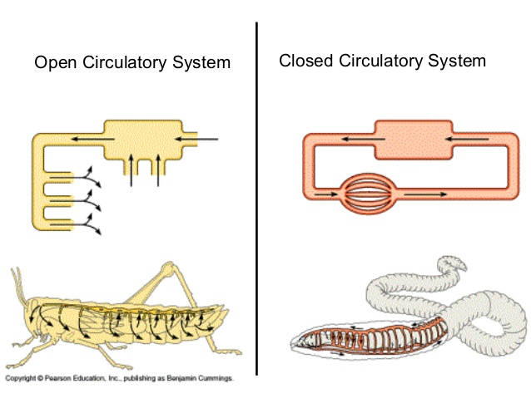

Type’s of Circulatory system

Slide 4
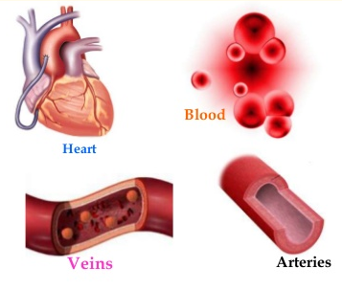
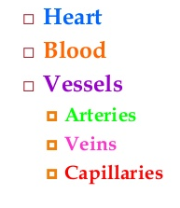
Part of circulatory system

Slide 5

Have
wonderful
day
Thank you for listening

