Slide 1

WEEK # 1
LESSONS # 3-4
UNIT 1: “Life Style ”
Ronaki – Gulan Groups
Ready for FCE
11. 1. 2012
13.30-15.45

Slide 2
Lesson Plan
Quiz
Free writing
Today we will learn/review
Some Classroom Language
Phonetic
Vocabulary 1: Clothes (Parts 1-2-3-4)
Reading FCE Part 2: Gapped text (Ps:1-2-3)
How to go about it (Pg:3)
Reading Text: Handle with care (Pg:4)
Language Focus 1: Habitual behavior (?)

Slide 3
Revision – Quiz (5 min)
Make a question for the following words.
blazer (n) /ˈbleɪzə/
cardigan (n) /ˈkɑːdɪgən/
dungarees (n) /ˌdʌŋgəˈrɪːz/
jumper/pullover /sweater (n)
/ˈdʒʌmpə, ˈpUləUvə, ˈswetə/
scarf (n) /skɑːf/
waistcoat (n) /ˈweɪstkəUt/

Slide 4
Free writing – 5 min
Topic: Write down your feelings while listenin to music. (click!)

Slide 5


Class Rules!
Speak English!
Work hard!
Work fast!
Listen attentively!

Slide 6
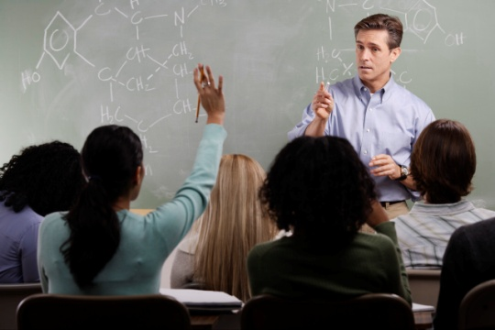
Classroom Language – 3min
"Are we all on the same page?“
"Are you with me?“
(Do you understand what I am telling you or explaining to you?)
"As far as I know.“
(used when you think something is true but are not sure)
"Break it up" or "Stop fighting“
(Stop it! (An order to two or more people to stop doing something, such as fighting.):
All right you two, break it up!
Ss can make role-play- TPR

Slide 7
PHONETIC :
Voiceless Consonant Sound /ʃ/
ship /ʃɪp/
sure /ʃɔːr/
nation /ˈneɪʃən/
fish /fɪʃ/
shush* /ʃʊʃ/
Notes:
shush /ʃʊʃ/ used to tell someone, especially a child, to be quiet [= shh]

Slide 8
PHONETIC :
Voiceless Consonant Sound /ʃ/
ship /ʃɪp/
sure /ʃɔːr/
nation /ˈneɪʃən/
fish /fɪʃ/
shush* /ʃʊʃ/
Notes:
shush /ʃʊʃ/ used to tell someone, especially a child, to be quiet [= shh]

Slide 9
PHONETIC :
Voiceless Consonant Sound /ʃ/ and /s/
ship /ʃɪp/ sip /sɪp/
show /ʃəʊ//ʃoʊ/ so /səʊ//soʊ/
Shy /ʃaɪ/ sigh /saɪ/
chauffeur/ˈʃəʊfə/ /ʃəʊ fɜː/ sofa /səʊfə/ /soʊfə/
shock /ʃɒk/ /ʃɑːk/ sock /sɒk//sɑːk/

Slide 10
Vocabulary 1.1: Clothes- (5 min)
Look at the pictures and write name of the items of clothing /ˈkləʊð ɪŋ/kloʊð ɪŋ/and accessories
PICTURE 1
bow tie
shirt
waistcoat
trousers
PICTURE 2
scarf
tie
blazer
skirt
tights
shoes

Slide 11
Vocabulary 1.1
PICTURE 3
hat
T-shirt
jacket
dungarees
trainers
PICTURE 4
necklace
cardigan
bracelet
dress
High heeled shoes

Slide 12
Vocabulary 1.1
PICTURE 5
jumper
jeans
shoes
PICTURE 6
baseball cap
t-shirt
trainers
tracksuit bottoms

Slide 13
1.2: ADJECTIVES (P.2) (7 min)
SMART / smɑːt / adj. tidy; If you look smart or your clothes are smart, you look clean and tidy. Fashionable
a smart, blue suit
_________________________________________________________
SHABBY / ˈʃæbi / adjective -untidy looking untidy and in bad condition
shabby clothes/furniture
_________________________________________________________
PLAIN / pleɪn / adj. 1 simple simple and not complicated
Plain T-shirt food
2 not mixed not mixed with other colours, substances, etc
a plain blue carpet
plain yoghurt
_________________________________________________________
Notes:
SHABBY: eski püskü, kılıksız, pejmurde, yıpranmış PLAIN: düz, desensiz, tek renkli, sade, basit, gösterişsiz
BAGGY: geniş, bol, sarkık, asık

Slide 14

1.2: ADJECTIVES (P.2)
COLOURFUL UK ( US colorful ) / ˈkʌləf ə l/ adj. 1.having bright colours
a colourful dress
_________________________________________________________
2. interesting and unusual
a colourful character
CASUAL / ˈkæʒjuəl / adj. CLOTHING Casual clothing is comfortable and not suitable for formal occasions.
_________________________________________________________
TASTEFUL / ˈteɪstf ə l / adj. attractive and chosen for style and quality
a tasteful blue suit
_________________________________________________________
TIGHT-ˈFITTING: /fɪtɪŋ/ fitting very closely or tightly
a tight-fitting shirt
_________________________________________________________
Notes:
SHABBY: eski püskü, kılıksız, pejmurde, yıpranmış PLAIN: düz, desensiz, tek renkli, sade, basit, gösterişsiz
BAGGY: geniş, bol, sarkık, asık COLOURFUL: renkli, cıvıl cıvıl, parlak, rengarenk, ilginç, ilgi çekici CASUAL: gündelik, rastgele, resmi omayan, rahat
TASTEFUL: zarif, zevkli, hoş, enfes

Slide 15
1.2: ADJECTIVES (P.2)
TRENDY / ˈtrendi / adj. informal fashionable at the moment
Have you seen Mrs Star's trendy clothes?
____________________________________________________
BAGGY / ˈbægi / adj. Baggy clothes are big and loose.
____________________________________________________

Slide 16
Vocabulary 1.2: (8 min)
Look at the pictures and find which of the ADJECTIVES desribe clothes.
PICTURE 1 adj.
bow tie formal
shirt plain
waistcoat tasteful
trousers smart
PICTURE 2 adj.
scarf unfashionable
tie smart
blazer
skirt
tights
shoes

Slide 17
Vocabulary 1.2
PICTURE 3 adj.
hat casual
t-shirt unfashionable
jacket shabby
dungarees colourful (jacket)
Trainers waterproof (jacket)
PICTURE 4 adj.
necklace formal
cardigan clourful
bracelet tasteful
dress smart (shoes)
high heeled shoes tight-fitting (dress)

Slide 18
Vocabulary 1.2
PICTURE 5 adj.
Jumper plain (jumper)
Jeans casual
Shoes baggy (jumper)
colourful (jumper)
PICTURE 6
baseball cap baggy (T-shirt/tracksuit bottoms)
T-shirt plain (T-shirt)
Trainers trendy (trainers)
tracksuit bottoms casual
colourful (baseball cap)
trendy (trainers/tracksuit bottoms)

Slide 19
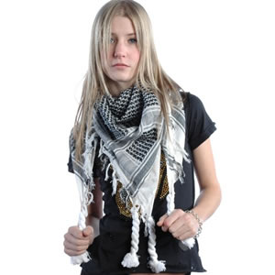
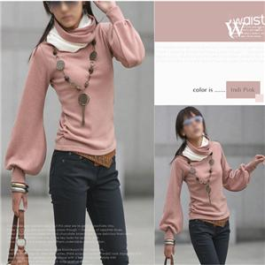
Practice: 4 min
Decribe one of the girls’ wearing style. Write 4 – 5 sentences. Try to use adjective
Notes:
Tight-fitting jumper
Trendy jumper
Plain jumper
causual

Slide 20
USEFUL EXPRESSIONS
What other items can you see?
What other questions do people ask to spirits?
What other countries have you visited so far?
What other galaxies are there?

Slide 21
Vocabulary 1.3
wear and put on (transitive verb)* (ppt.22)
Today my mother is wearing a black silk dress.
He wore glasses for reading.
My father used to wear glasses for reading.
get dressed (intransitive)*
My father got dressed quickly and ran outside.
My son got dressed in a hurry.
Sandra's in the bedroom getting dressed.

Slide 22
Vocabulary 1.3
to suit someone: suitable or convenient for a particular person or in a particular situation:
There are countryside walks to suit everyone.
Either steak or chicken would suit me fine.
suit something to something
She had the ability to suit her performances to the audience.
to go with something
go with that dress
match: look the same [intransitive and transitive] two things that match look the same because they are a pair:
Your socks don't match.
I can't find anything to match my green shirt.
fit: if a piece of clothing fits you, it is the right size for your
These trousers don't fit any more.
His clothes did not fit him very well.
The uniform fitted her perfectly.
The jacket's fine, but the trousers don't fit.
I know this dress is going to fit you like a glove (=fit you very well).

Slide 23
Grammar Point transtive verbs
There are two kinds of verbs in English. Some verbs need a noun to help the verb; they are called transitive verbs.
Incomplete: My dog needs. (Needs what? The sentence does not say.)
Complete: My dog needs a bone/a house.
Incomplete: The child broke.
Complete: The child broke the plate.

Slide 24
Grammar Point intranstive verbs
Other verbs don’t need a noun helper; they are called intransitive verbs.
She is sleeping. (Who? Well, the answer is she. So SLEEP is an intransitive verb. It does not need a helper.)
I worked all day.
It snowed last night.
The fashion model fell on the stage.

Slide 25
Practice: Decide whether the verb is transitive (vt) or intransitive (vi).
run __
live __
throw __
sell __
eat __
buy __
develop __
happen __
feed __
exist __
occur __
follow __
feed on __
take __
Fly __
Find __
Feed __

Slide 26
USEFUL EXPRESSIONS
Vocabulary 1.3
Personally, ˈpɜːs ən‿əli/ [sentence adverb] spoken used to emphasize that you are only giving your own opinion about something:
Personally, I don't think much of the idea.
I personally think it's too cold to go out.
as for /æz/ somebody/something
used when you are starting to talk about someone or something new that is connected with what you were talking about before:
Kitty's got so thin. And as for Carl, he always seems to be ill.
You can ask the others, but as for myself, I'll be busy in the office.

Slide 27
Should be verb+ing & should?
What is the different meaning of the following two sentences?
1. The man on the motorbike should be wearing a helmet.
2. The man on the motorbike should wear a helmet
Best Answer -
1 The man is already riding his bike and should be wearing a helmet
2 The man is not yet riding his bike but should wear it when he does should be relates to an event already happening
should is like advice

Slide 28
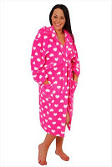
Though / ðəʊ / advb used to add a new fact or opinion which changes what you have just said
Okay, I'll come to the tea part on Tuesday - I'm not staying late though. Because....
dressing gown a piece of clothing like a long loose coat that you wear inside the house, usually over night clothes [= bathrobe, robe]
far too much/long/busy etc
That's far too much to pay.
It would take me far too long to explain.

Slide 29
READING: part 2: 1.2 (10 min)
1. Speaking
account: description a written or spoken description that says what happens in an event or process
2. Reading.
Read quickly
Ignore spaces for the moment.
Draw your attention to the gist/general idea question. Answer:*
Notes:
Yes, her comments in the last paragraph suggest she would recommend it.

Slide 30
READING: part 2: 3 (15 min)
3.
Read the instructions for the reading task.
The parts in the bold are designed to help you identify key elements of context.
Draw your attention to the “How to go about it”
Read “HOW to GO about IT”

Slide 31

VOCABULARY LIST
cat‧walk /"kætwé:k $ -wã:k/ [countable]
a long raised structure that models walk along in a fashion show [= runway American English]

