Slide 1
HOW CAN A PLANT KILL?
2-4

Slide 2
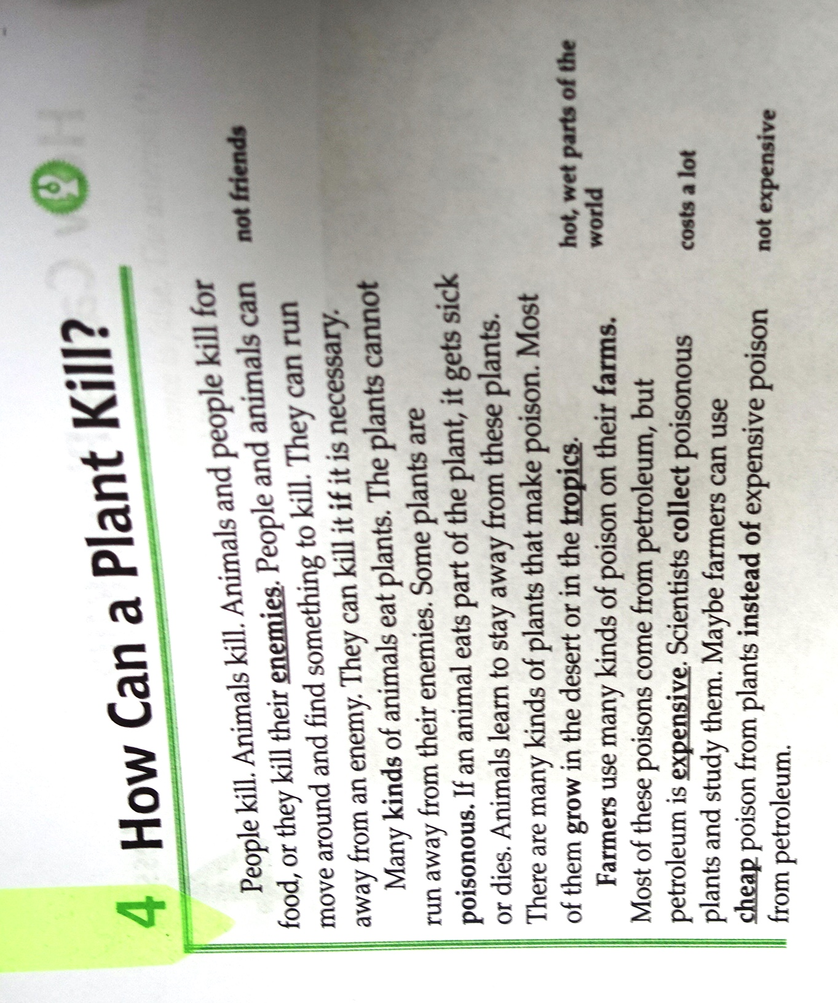
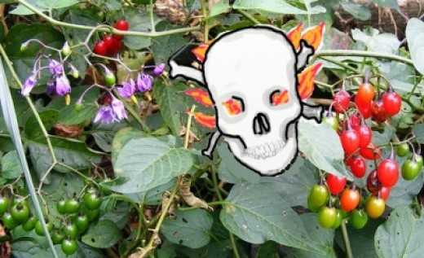
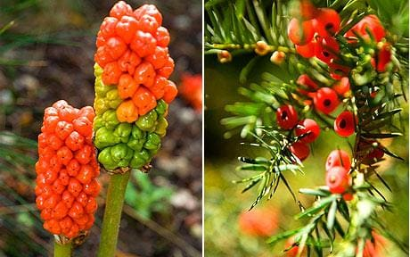

Slide 3

ENEMY/ˈenəmi/
PERSON [C] a person who you dislike
I try not to make any enemies.

Slide 4
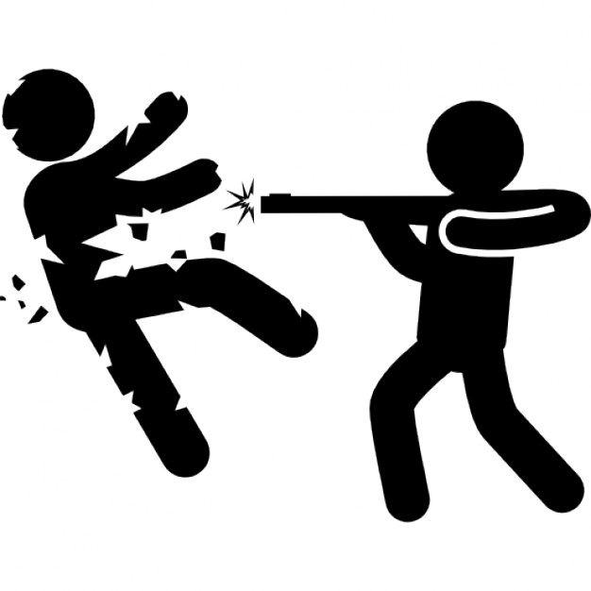
kill/kɪl/ v.
to cause someone or something to die
He killed his enemy.

Slide 5
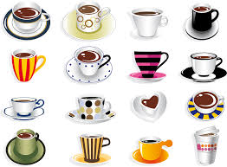
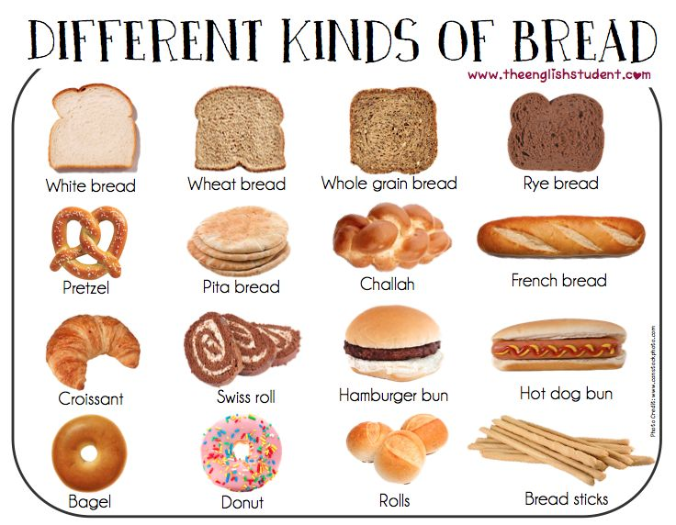
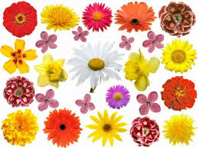
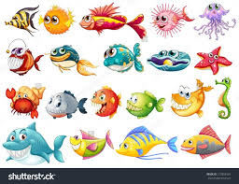
kind /kaɪnd/
a type of thing or person
I like all kinds of movies.
I meet all kinds of interesting people on my travels.

Slide 6
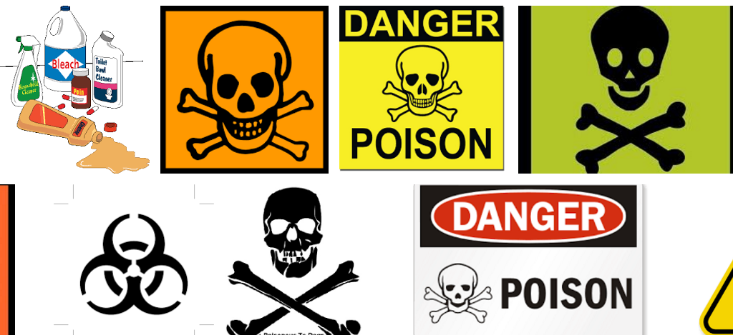
poisonous /ˈpɔɪzənəs/
WITH POISON containing poison

Slide 7
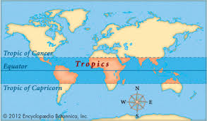
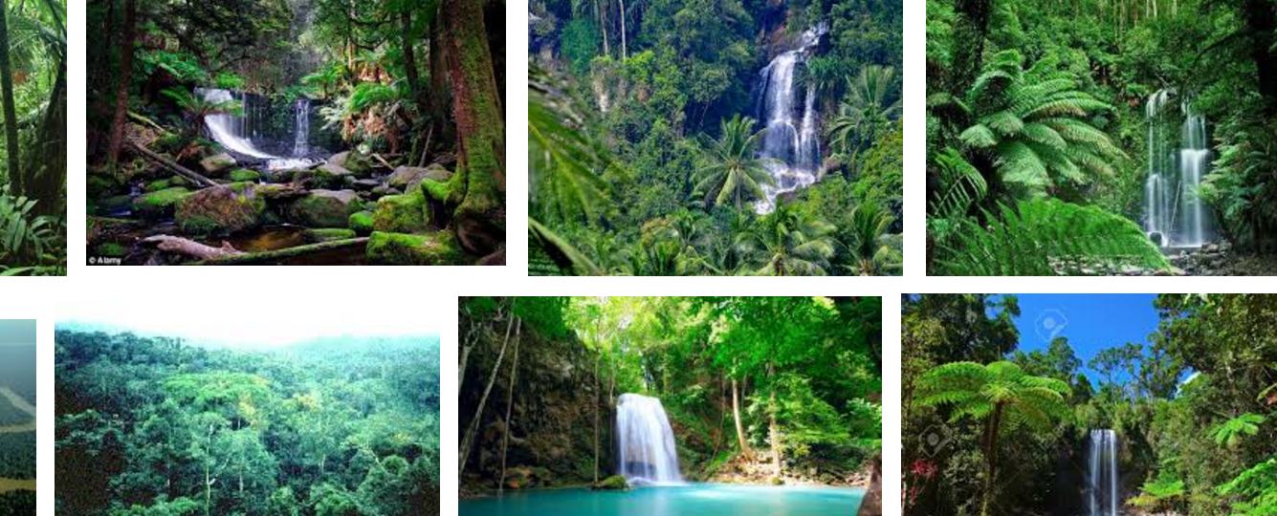
tropical /ˈtrɒpɪkəl/ adjective
From or in the hottest parts of the world

Slide 8
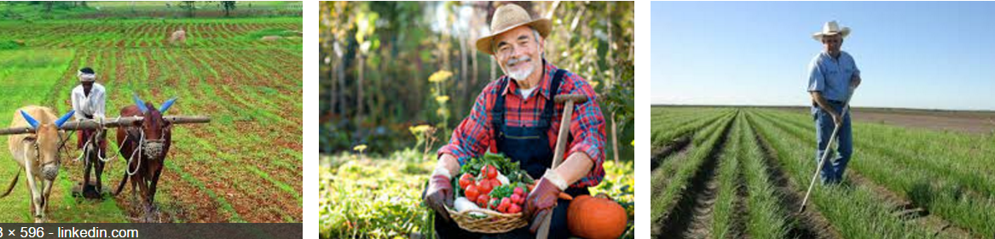
farmer /ˈfɑːmər/ noun
someone who owns or looks after a farm
This weather is bad news for farmers.
She's the daughter of a American sheep farmer.

Slide 9

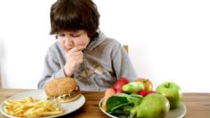
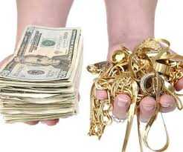
instead /ɪnˈsted/ adverb
in the place of someone or something else
I'd prefer to have a shower instead of a bath.
If you don't want pizza, we can have pasta instead.
I'm going swimming on Monday instead of Friday now.

Slide 10
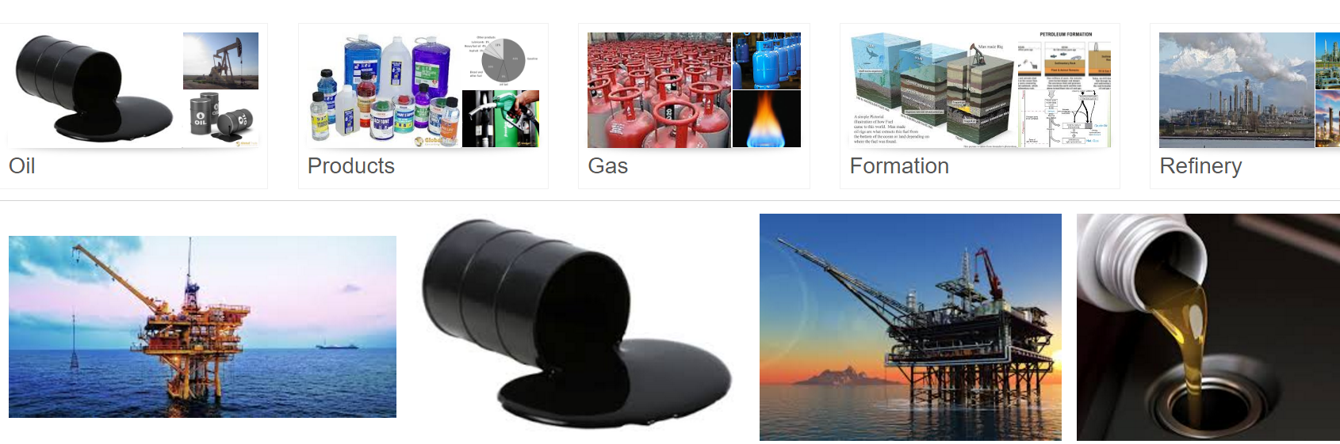
petroleum /pəˈtrəʊliəm/ noun
thick oil found under the Earth's surface which is used to produce petrol and other substances

Slide 11
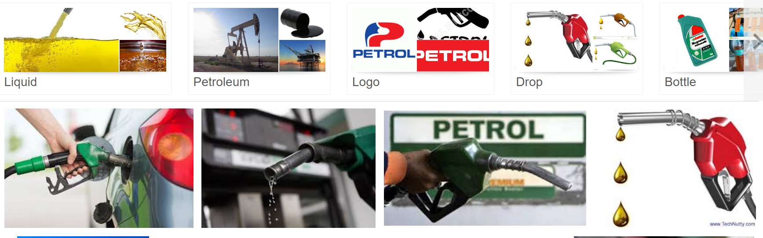
petrol /ˈpetrəl/
UK (gasn, at petrol nUS gas) noun [U]The air was thick with petrol fumes.We're nearly out of petrol.She's just gone to fill the car up with petrol.Petrol prices have risen sharply in the last year.Petrol had leaked all over the road.petrol n petrol /ˈpetrəl/ UK (gasn, at petrol nUS gas) noun [U] a liquid fuel used in cars

Slide 12
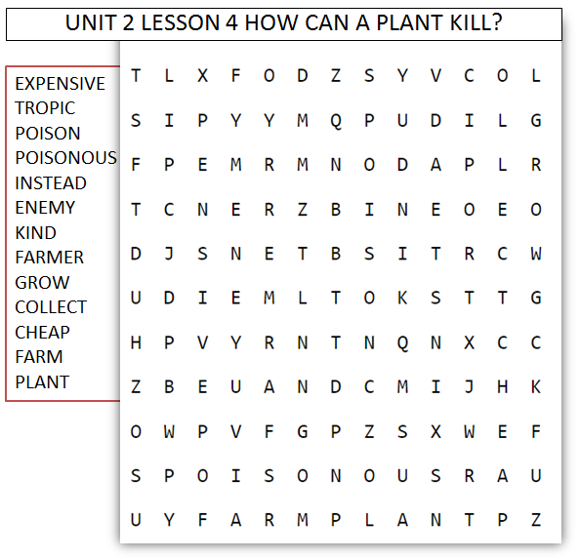
CROSSWORD

Slide 13
Scientist
Cool
bored
expensive
poisonous
farmer
farm
Enemy
Plants
Desert

