Slide 1


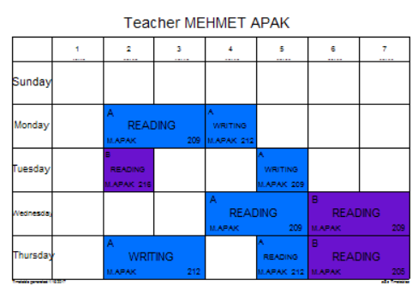

READING – WRITING
MEHMET A.

Slide 2
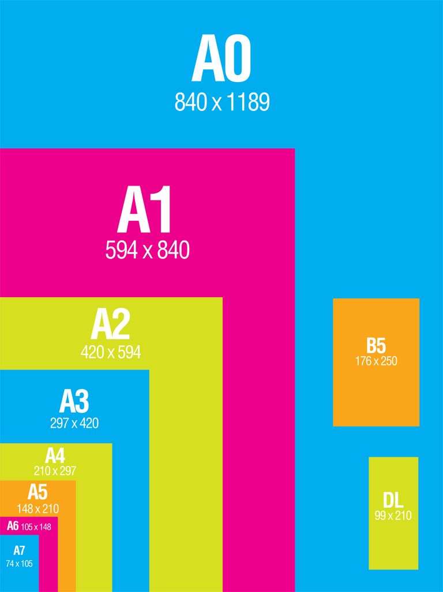
TYPES of PAPER

Slide 3



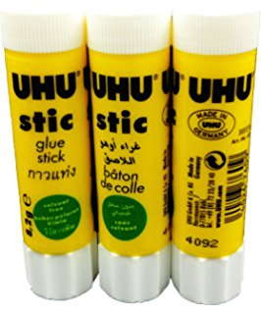
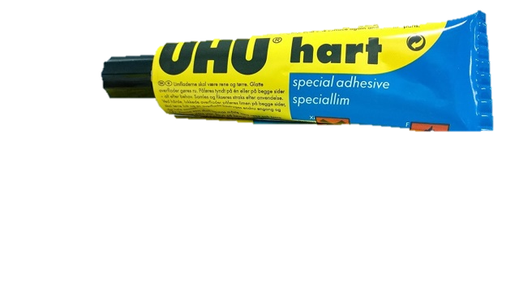
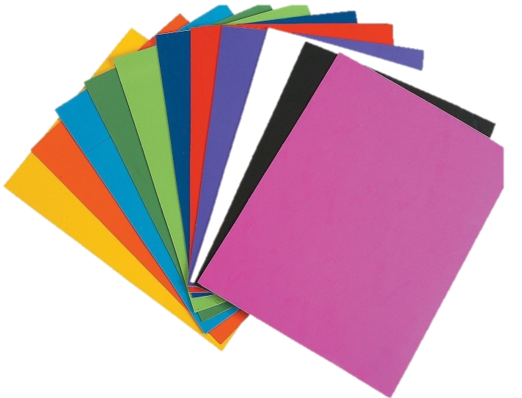
Materials
Course Books
Notebook (60 PAGES)
Colourful pens
Post-it
Glue
A 1 colorful paper
A 4 white and colorful paper

Slide 4
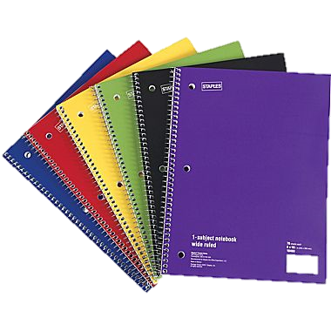
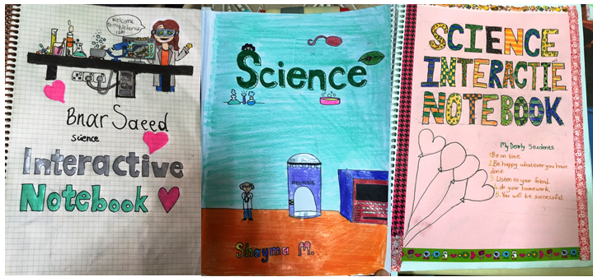
NOTEBOOK PREPARATION

Slide 5
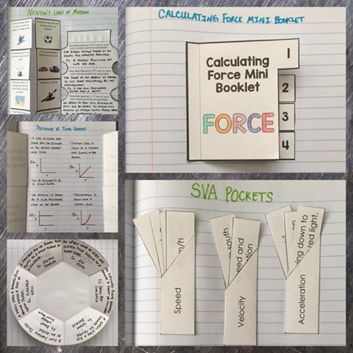
INTERACTIVE NOTEBOOK

Slide 6
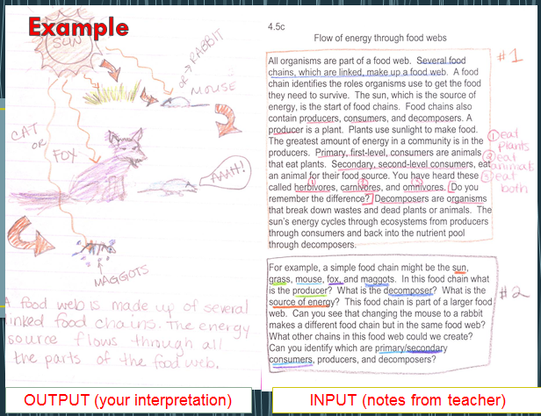
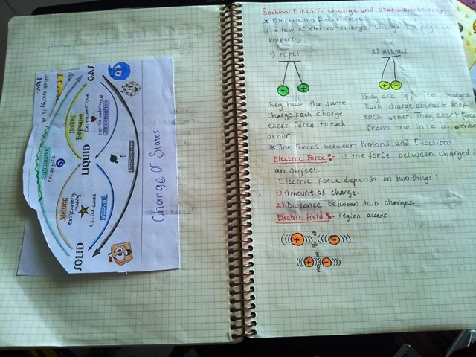
TEXT ANALYZING NOTEBOOK

Slide 7
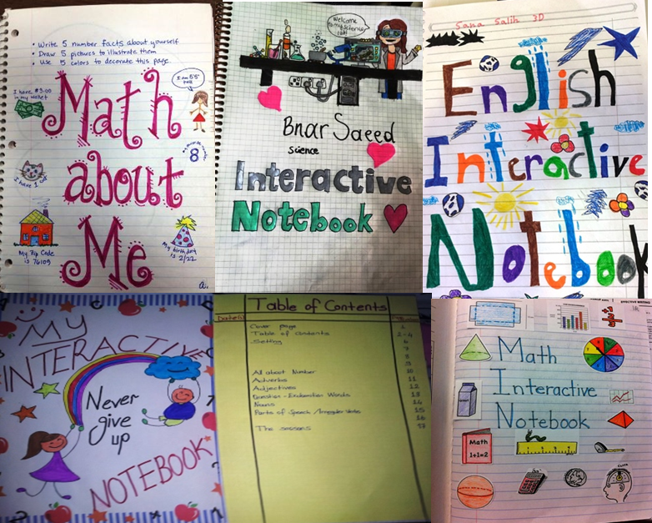
COVER, PAGE NUMBER, DATE, GOOD HAND WRITING

Slide 8
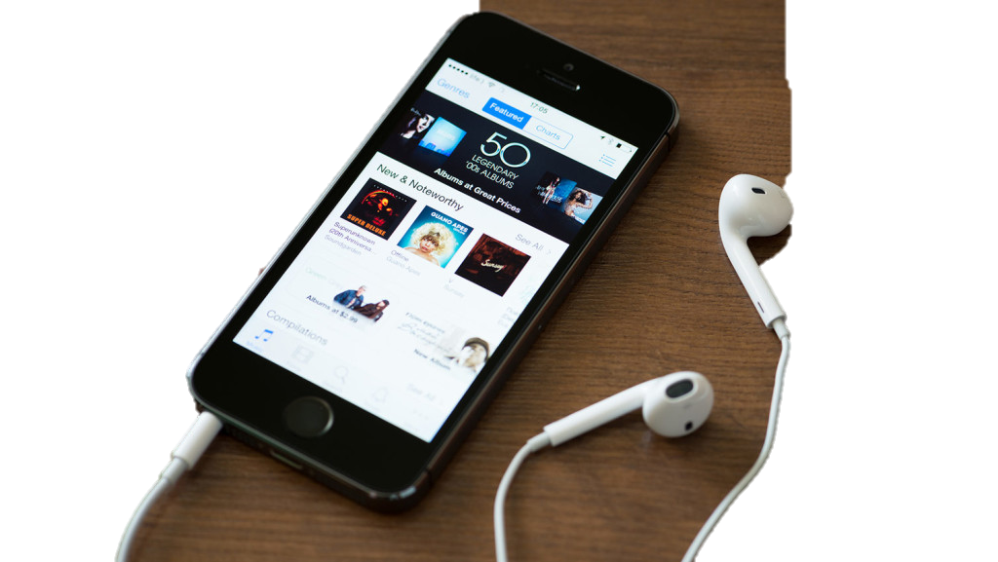
POD-CAST
You will record each reading text and upload to classroom computer.

Slide 9
WEB-PAGE/SOCIAL MEDIA
pblstem.wordpress.com
stempbl.com

Slide 10
Classroom Rules!

Slide 11

Attendance: 90%
Your Attention and Participation Are Required!

Slide 12

Your Attention and Participation Are Required!

Slide 13

Be Prepared -Be Responsible
Bring Your:
Book
Notebook
Colorful Pens
Highlighters

Slide 14
PROJECT / HOMEWORK: 20%
QUIZ: 10 %
POD CAST – VOICE / VIDEO RECORDING: 10%
MID TERM: 10%
FINAL: 40%
NOTEBOOK: 10%
Your Grade

Slide 15

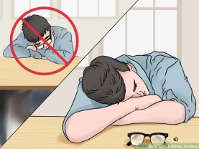

Recommended Behaviour
Attend class and arrive on time (or early).
Always bring the required supplies (notebook, book, pens, post-it...).
Turn your cell phone off or to vibrate before the start of class.
Do not sleep in class!

Slide 16
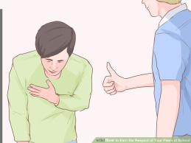

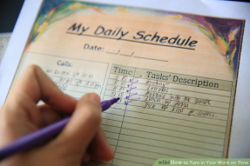

Recommended Behaviour
Show respect for others
Listen carefully; do not interrupt others.
If you strongly disagree with your instructor, it is a good idea to speak with him/her after class.
Turn in assignments on time
.

Slide 17



Recommended Behaviour
This is the place to TAKE RISKS and learn from your mistakes
No one is perfect.
It is good to have a MIND of YOUR OWN.

Slide 18
Recommended Behaviour
Recommended Behaviour
We are here to learn!
No one can learn for you.
Your effort will determine your success.

Slide 19
Two easiest ways to learn English:
Hard Work and
Practice

